Slide 1
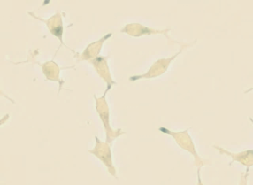
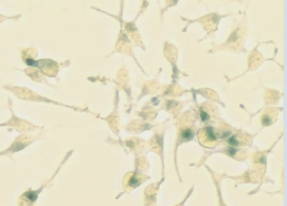
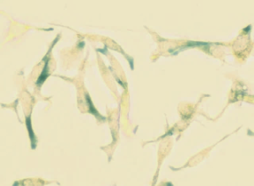
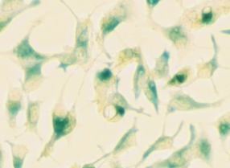
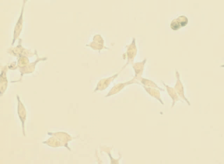
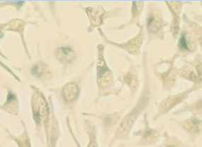
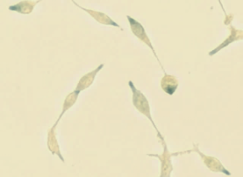
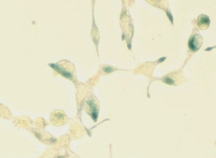
Fig.S2
A
+IR-day4
-IR
+IR-day1
+IR-day7
LNCaP/
Vec
LNCaP/
N-Myc
LNCaP/Vec
LNCaP/N-Myc
B
SA-β-gal positive cells (%)
AMO-ctrl
AMO-miR421
-IR
+IR-day1
+IR-day4
+IR-day7

