Slide 1
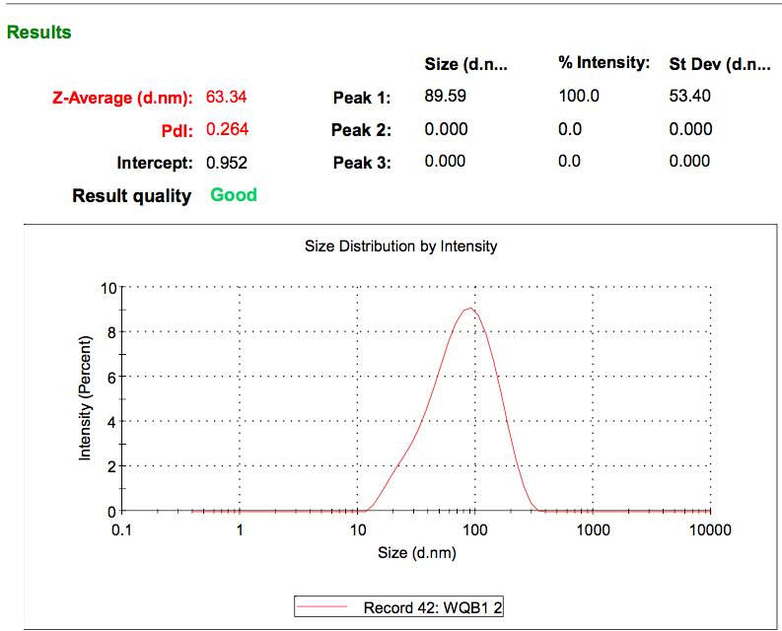
a
cell lysate
exosome
CD63
25KDa
Calnexin
100KDa
b
Figure S1. Identification of exosome isolated from cell culture medium. a Western blot analysis of SK-Hep1 cell lysates and isolated exosome using antibodies specific for exosome marker (CD63) and non-exosome marker (Calnexin); b Particle size of isolated exosome was measured by the laser particle size analyzer.

Slide 2
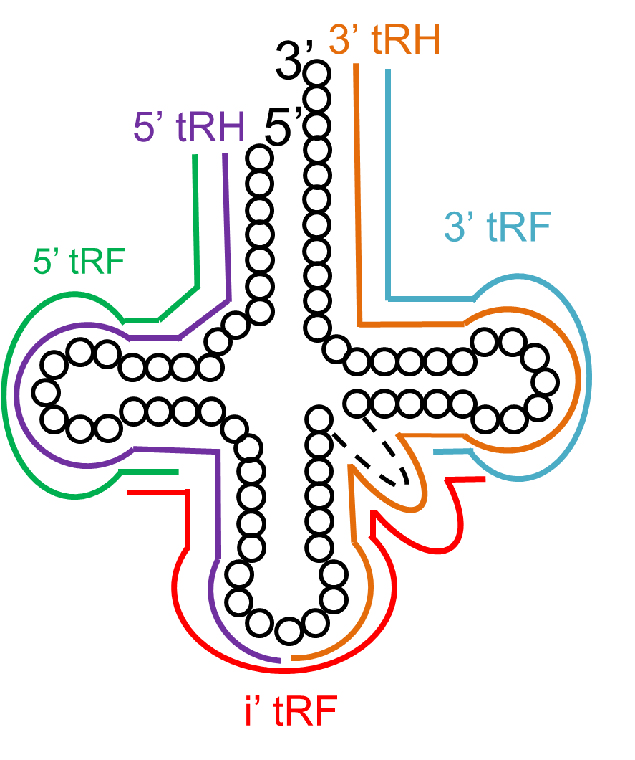
Figure S2. Classification of tsRNAs generated from mature tRNAs

Slide 3
a
c
b
d
Figure S3. Length distribution and classification of tRNA-3 and tRNA-i in exosome from cell culture medium. a-b Length distribution of tRNA-3 and tRNA-i, respectively; c-d Classification of tRNA-3 and tRNA-i, respectively.

Slide 4
a
b
Figure S4. Percentage of each RNA in plasma exosome. a Percentage of each type of small RNA in plasma exosome; b Percentage of each type of tsRNA in plasma exosome.

Slide 5
Figure S5. Length distribution of tRNA-3 and tRNA-i in plasma exosome from normal people and liver cancer patients.

Slide 6
Figure S6. Classification of tRNA-5, tRNA-3 and tRNA-i from plasma exosome.

