Slide 1
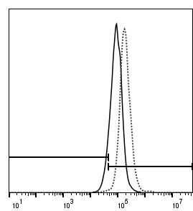
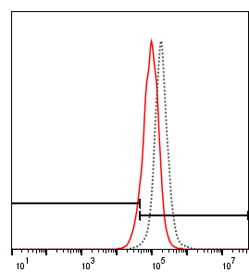
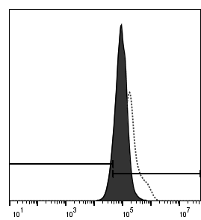
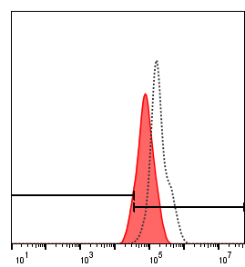
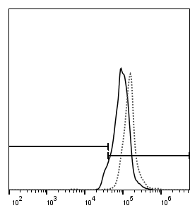
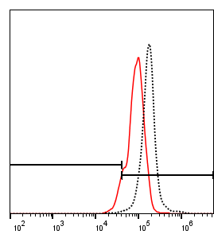
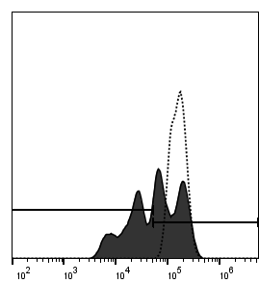
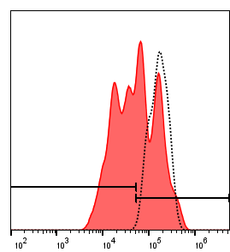
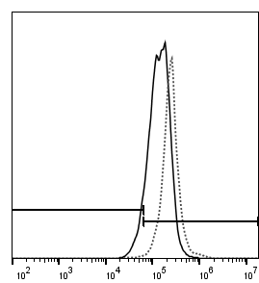
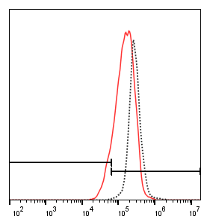
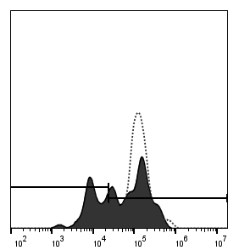
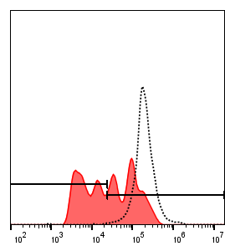
A
UTD
UTD+G
CAR-T
CAR-T+G
counts
counts
counts
counts
10.6
10.3
10.6
10.0
PKH26 proliferation
PKH26 proliferation
PKH26 proliferation
PKH26 proliferation
B-1
UTD+MOLM-13
UTD+MOLM-13+G
CAR-T+MOLM-13
CAR-T+MOLM-13+G
counts
counts
counts
counts
7.11
8.39
40.0
50.0
PKH26 proliferation
PKH26 proliferation
PKH26 proliferation
PKH26 proliferation
B-2
UTD+MV4-11
UTD+MV4-11+G
CAR-T+MV4-11
CAR-T+MV4-11+G
counts
counts
counts
counts
8.63
10.8
31.9
46.8
PKH26 proliferation
PKH26 proliferation
PKH26 proliferation
PKH26 proliferation
Supplementary Fig.6. Gilteritinib pretreatment enhanced the proliferation of FLT3scFv/NKG2D CAR-T cells. (A)Untransfected and FLT3scFv/NKG2D CAR-T cells were treated with 30nM gilteritinib for 24 hours, and then were labelled with PKH26. Flow cytometric analysis showed that gilteritinib had no significant effected on FLT3scFv/NKG2D CAR-T cell proliferation. (B) Untransfected and FLT3scFv/NKG2D CAR-T cells were labelled with PKH26 before stimulated by MOLM-13 and MV4-11 cells with or without 24-hour gilteritinib pretreatment. The dilution of PKH26 after 5-day co-incubation was assessed using flow cytometry compared to Day 0 (dot line).G, Gilteritinib; UTD,untransfected CD3+T cells.

