Slide 1
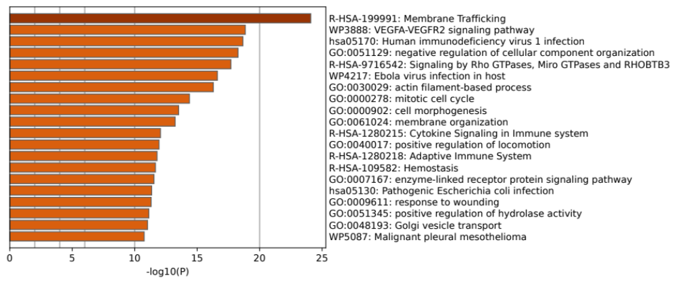
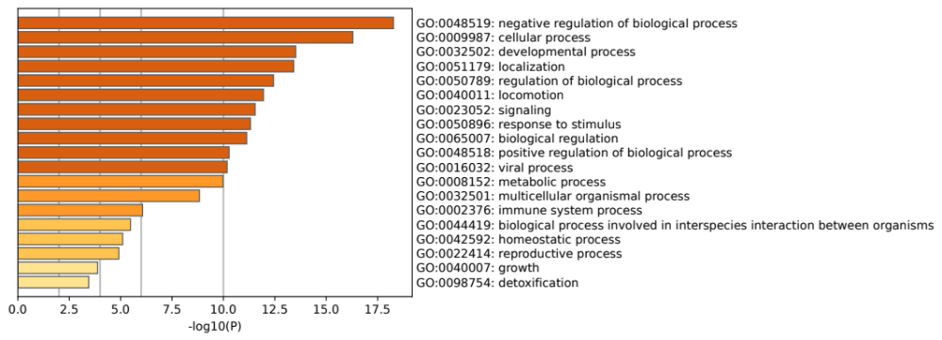
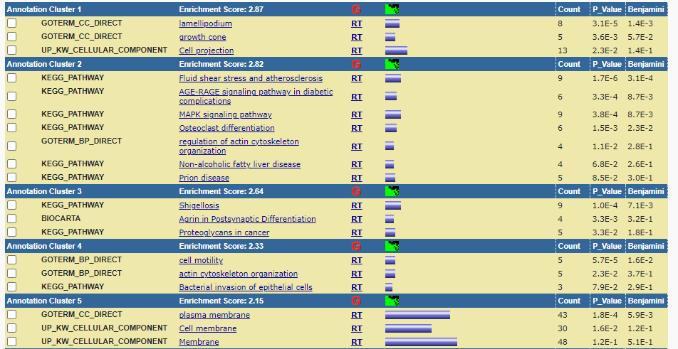
A
Supplemental Figure 2
Enriched Terms
Membrane Trafficking
VEGFA-VEGFR2 signaling pathway
Human immunodeficiency virus 1 infection
Negative regulation of cellular component virus 1 infection
Signaling by Rho GTPases, Miro GTPases and RHOBTB3
Ebola virus infection in host
Actin filament-based process
Mitotic cell cycle
Cell morphogenesis
Membrane organization
Cytokine Signaling in Immune system
Positive regulation of locomotion
Adaptive Immune System
Hemostasis
Enzyme-linked receptor protein signaling pathway
Pathogenic Escherichia coli infection
Response to wounding
Positive regulation of hydrolase activity
Golgi vesicle transport
Malignant pleural mesothelioma
B
Top-level Gene Ontology Biological Processes
Negative regulation of biological process
Cellular process
Developmental process
Localization
Regulation of biological process
Locomotion
Signaling
Response to stimulus
Biological regulation
Positive regulation of biological process
Viral process
Metabolic process
Multicellular organismal process
Immune system process
Biological process involved in interspecies interaction between organisms
Homeostatic process
Reproductive process
Growth
Detoxification
C

