Slide 1
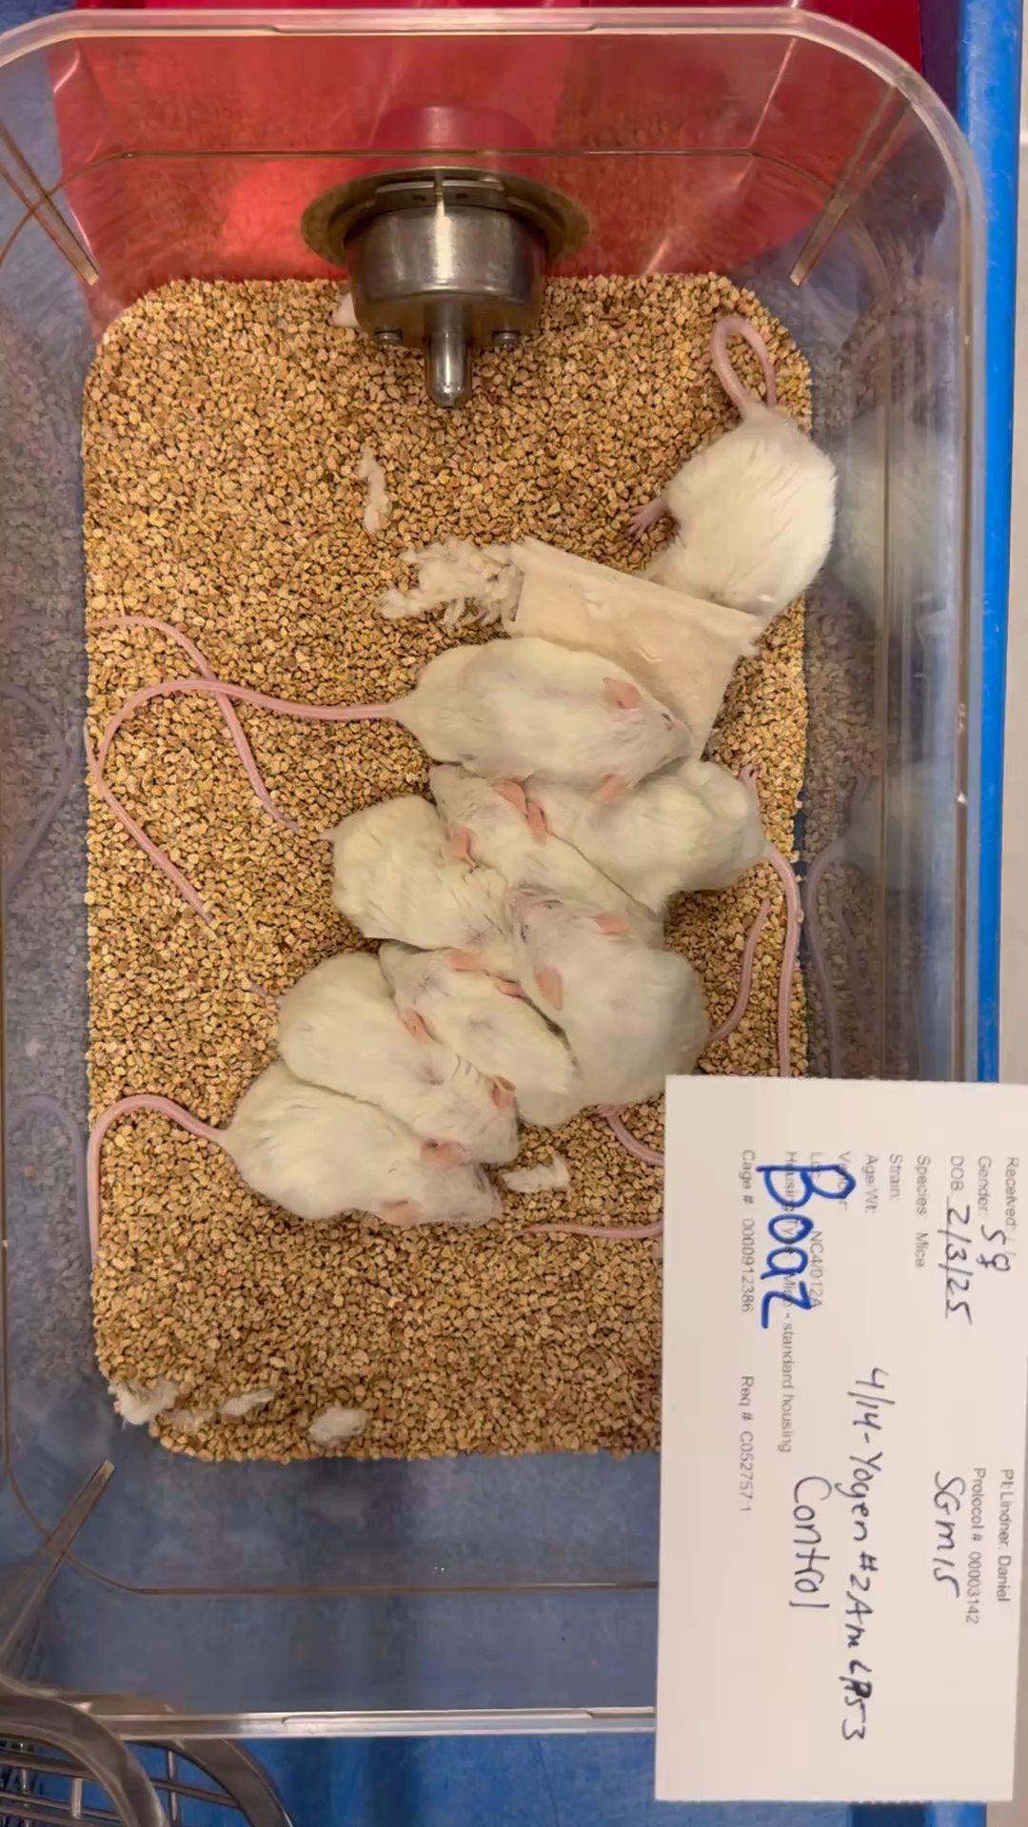
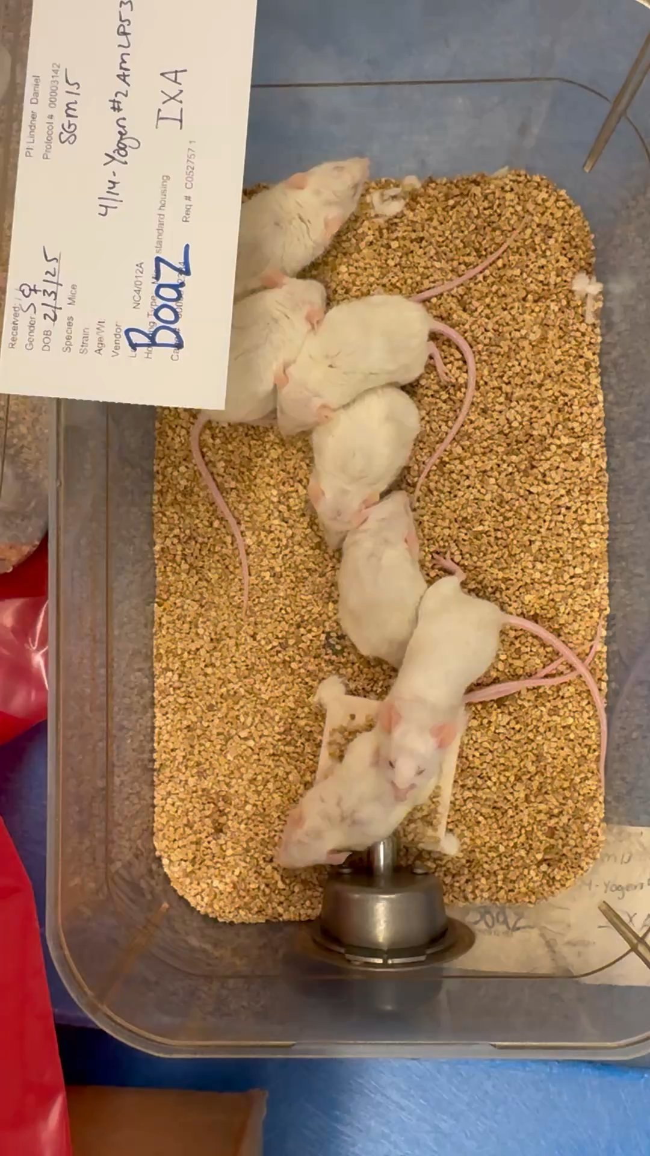
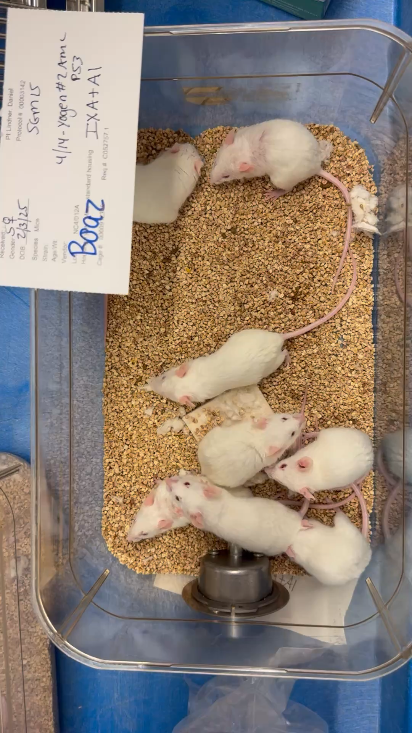
Videos demonstrating the drug's efficacy in TP53^PDX bearing mice
A
B
C
Figure S17: Representative images of TP53^PDX-bearing mice. (A) Vehicle-treated control group, (B) mice treated with IXZ (1 mg/kg body weight), and (C) mice treated with the combination of AcTor (30 mg/kg body weight) and IXZ (1 mg/kg body weight). After three weeks of treatment, mice in the combination group (C) appeared more active and exhibited improved mobility compared to those in the vehicle or IXZ-alone groups.

