Slide 1
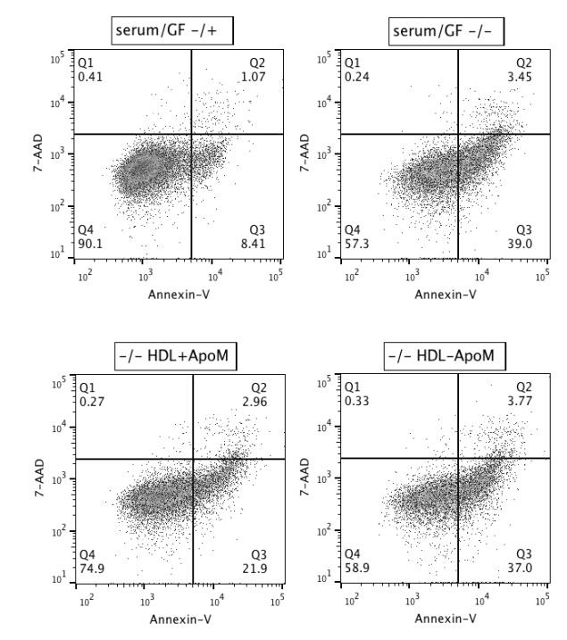
Figure 1.
serum starved
serum/GF starved
A.
B.
C.
*
*
*
*
*
Apoptotic cells (%)
Apoptotic cells (%)
serum/GF starved, HDL ⁺ ^{ApoM}
serum/GF starved, HDL ⁻ ^{ApoM}
HDL ⁺ ^{ApoM}
Full medium
Non-treated
HDL^{- ApoM}
Serum starved
Serum starved
Serum/GF starved
Serum/GF starved
D.
E.
F.
*
*
*
*
*
*
*
Apoptotic cells (%)
Caspase 3 activity (%)
Caspase 3 activity (%)
Total HDL
HDL^{- ApoM}
HDL^{- ApoM}
HDL ⁺ ^{ApoM}
HDL ⁺ ^{ApoM}
Non-treated
Full medium
Non-treated
HDL^{- ApoM}
Full medium
Non-treated
Serum/GF starved
Serum/GF starved
Serum/GF starved

Slide 2
Figure 2.
A.
24 h treatment
48 h treatment
*
*
*
*
Absorbance 570 nm
HDL ⁺ ^{ApoM}
HDL ⁺ ^{ApoM}
Full medium
Non-treated
HDL^{- ApoM}
Full medium
Non-treated
HDL^{- ApoM}
Serum/GF starved
Serum/GF starved
B.
*
*
Absorbance 570 nm
*
*
*
Full medium
Non-treated
50
25
10
50
25
10
(µg/ml)
HDL ⁺ ^{ApoM}
HDL ⁻ ^{ApoM}
Serum/GF starved

Slide 3
Figure 3.
A.
B.
C.
*
*
Fold Change
Normalized Apoptotic cells (%)
Normalized Apoptotic cells (%)
n.d.
n.d.
n.d.
Vehicle
Vehicle
CYM5541
S1P1
S1P2
S1P3
S1P4
S1P5
SEW2871
D.
E.
n.s.
n.s.
*
*
n.s.
Normalized Apoptotic cells (%)
*
Normalized Apoptotic cells (%)
Vehicle
ML-031
Vehicle
CYM5541
SEW2871
SEW2871 and CYM5541

Slide 4
Figure 4.
A.
B.
*
n.s.
*
n.s.
Normalized Apoptotic cells (%)
Caspase 3 activity (%)
Total HDL
Total HDL
HDL ⁺ ^{ApoM}
HDL ⁺ ^{ApoM}
Non-treated
Non-treated
Non-treated
Non-treated
W146
W146
C.
D.
*
*
n.s.
*
n.s.
Absorbance 570 nm
Normalized Apoptotic cells (%)
HDL ⁺ ^{ApoM}
HDL ⁺ ^{ApoM}
Total HDL
Total HDL
Non-treated
HDL^{- ApoM}
Non-treated
HDL^{- ApoM}
Non-treated
Non-treated
Full medium
Full medium
Serum/GF starved
Serum/GF starved
CAY10444
W146

Slide 5
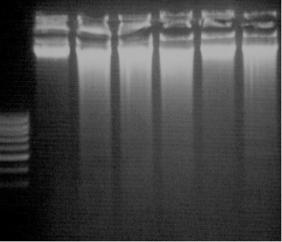
Figure 5.
A.
B.
*
*
*
*
*
Caspase 3 activity (%)
ApoM
ApoM
free S1P
ApoM+S1P
free S1P
ApoM+S1P
Non-treated
albumin+S1P
Non-treated
albumin+S1P
Full medium
Full medium
Serum/GF starved
Serum/GF starved
C.
D.
*
*
*
*
*
*
*
*
Caspase 3 activity (%)
Absorbance 570 nm
ApoM
ApoM
free S1P
ApoM+S1P
free S1P
ApoM+S1P
Non-treated
albumin+S1P
Non-treated
albumin+S1P
Full medium
Full medium
Serum/GF starved
Serum/GF starved
E.
F.
Caspase 3 activity (%)
Caspase 3 activity (%)
ApoM
ApoM
free S1P
ApoM+S1P
free S1P
ApoM+S1P
Non-treated
albumin+S1P
Non-treated
albumin+S1P
Full medium
Full medium
Serum/GF starved
Serum/GF starved
W146
CAY10444

Slide 6
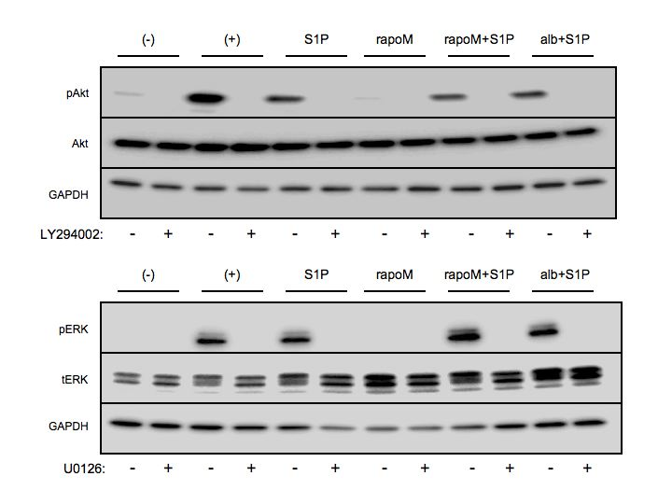
Figure 6.
A.
serum/GF
starved
full medium
serum/GF starved
serum/GF
starved
full medium
serum/GF starved
free S1P
ApoM
ApoM+S1P
albumin+S1P
serum/GF
starved
full medium
free S1P
ApoM
ApoM+S1P
albumin+S1P
free S1P
ApoM
ApoM+S1P
albumin+S1P
B.
LY294002
U0126
PD98059
Caspase 3 activity (%)
*
*
*
*
ApoM
ApoM
ApoM
ApoM
free S1P
free S1P
free S1P
free S1P
ApoM+S1P
ApoM+S1P
ApoM+S1P
ApoM+S1P
Non-treated
albumin+S1P
Non-treated
albumin+S1P
Non-treated
albumin+S1P
Non-treated
albumin+S1P
Full medium
Full medium
Full medium
Full medium
Serum/GF starved
Serum/GF starved
Serum/GF starved
Serum/GF starved

Slide 7
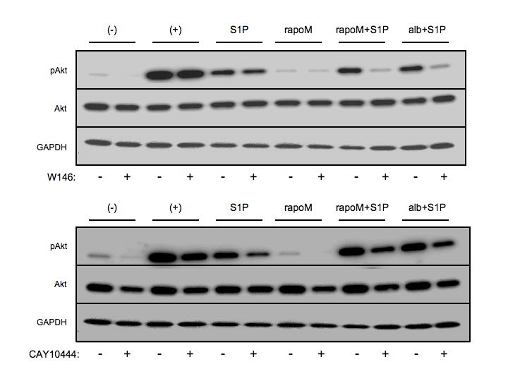
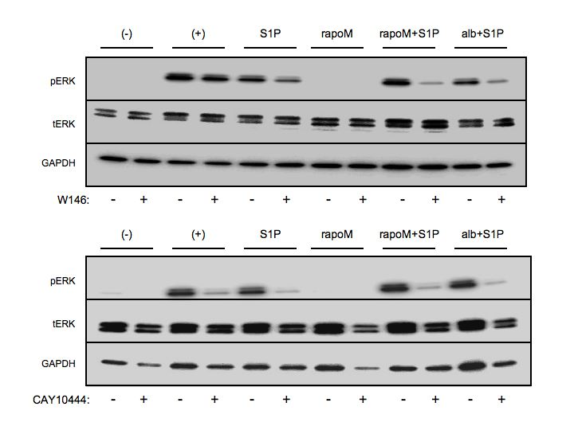
A.
Figure 7.
serum/GF
starved
full medium
serum/GF starved
serum/GF starved
free S1P
ApoM
ApoM+S1P
albumin+S1P
serum/GF
starved
full medium
free S1P
ApoM
ApoM+S1P
albumin+S1P
serum/GF
starved
full medium
serum/GF starved
serum/GF
starved
full medium
serum/GF starved
free S1P
ApoM
ApoM+S1P
albumin+S1P
free S1P
ApoM
ApoM+S1P
albumin+S1P
B.
*
*
*
*
*
pAKT/AKT (%)
pERK/ERK (%)
W146
- + - + - +
W146
- + - + - +
free S1P
ApoM+S1P
albumin+S1P
free S1P
ApoM+S1P
albumin+S1P
*
*
*
*
*
*
pAKT/AKT (%)
pERK/ERK (%)
CAY10444
- + - + - +
CAY10444
- + - + - +
free S1P
ApoM+S1P
albumin+S1P
free S1P
ApoM+S1P
albumin+S1P

Slide 8
Graphical Abstract
ApoM
S1P3 agonist (CYM5541)
S1P1 agonist (SEW2871)
S1P
S1P1 antagonist (W146)
S1P3 antagonist (CAY10444)
S1P1
S1P3
HUVEC
G_{i}
G_{12/13}
G₄
G_{i}
PI3K
Ras
PI3K inhibitor (LY294002)
Akt
ERK
MEK inhibitor (U0126, PD98050)
Apoptosis
Cell survival
Graphical Abstract.
Schematic representation summarizing the anti-apoptotic effect of ApoM-bound S1P in endothelial cells.
ApoM-bound S1P activates S1P1 and S1P3 to exert its anti-apoptotic effect upon serum/GF deprivation. This activation causes AKT and ERK phosphorylation which finally leads to cell survival promotion and apoptosis inhibition. Blockage of S1P1, S1P3, AKT or ERK activation abolishes ApoM-bound S1P protective effect. Additionally, pharmacological activation of S1P1 or S1P3 mimics ApoM-bound S1P protection.

