Slide 1
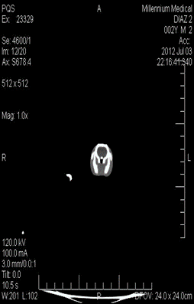
C
Control eSS

Slide 2
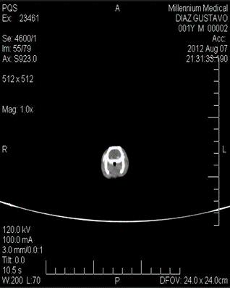
ω6

Slide 3
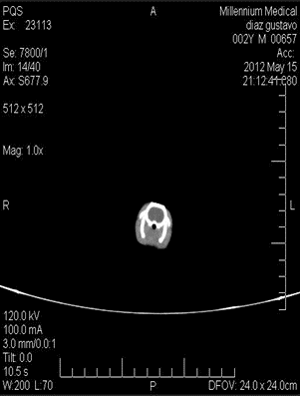
ω6+NDGA

Slide 4
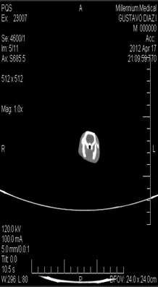
ω3

Slide 5
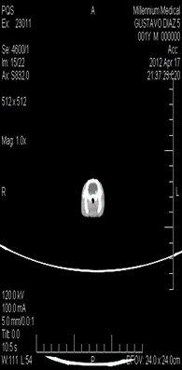
ω3+NDGA

Slide 6
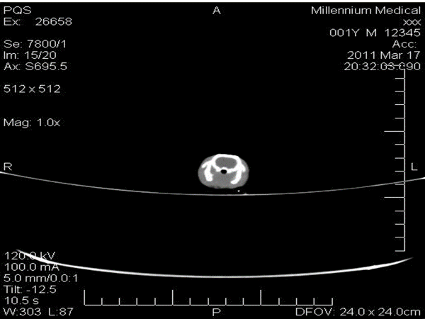
Wistar

Slide 7
Densitometry of tissue homogeneity of brain rats CT images. * Indicate significant difference to Control eSS at 12 month, p≤0.05. Images were analyzed with Fiji ImageJ 1.52i software.

