Slide 1
Cell line | Model | MUC1 RNA expression | GlcNac RNA expression | Adhesion (pN) | Energy (nJ) | Distance (nm)
HEC-1B | B-1 | 1.39 ± 0.15 | 0.090 ± 0.015 | 466 ± 11 | 1.8 ± 0.1 | 465 ± 4
 | B-2 | 2.25 ± 0.31 | 0.329 ± 0.030 | 1076 ± 18 | 7.1 ± 0.2 | 380 ± 3
 | B-3 | 2.20 ± 0.51 | 0.028 ± 0.003 | 352 ± 6 | 1.4 ± 0.02 | 395 ± 3
HEC-1A | A-1 | 0.05 ± 0.01 | 0.169 ± 0.032 | 325 ± 7 | 1.6 ± 0.04 | 343 ± 4
 | A-2 | 0.20 ± 0.02 | 0.240 ± 0.047 | 428 ± 6 | 2.0 ± 0.05 | 370 ± 4
 | A-3 | 0.14 ± 0.03 | 0.038 ± 0.019 | 213 ± 4 | 0.8 ± 0.02 | 349 ± 4
Supplementary Table S1 Molecular determinants of L-selectin affinity to the endometrial HEC-1A and HEC-1B cell surface model. Summary of L-selectin functionalized AFM probe gross binding forces, Adhesion (pN), Adhesion Energy (nJ) and Distance (nm), to the HEC-1B and HEC-1A cell surface models, as measured through SMFS (+/- standard error). The cell models have been modified through TNFα and IFNγ cytokine treatment to alter MUC1 and GlcNac RNA expression

Slide 2
*
*
*
*
*
*
TNFα
Stauro-sporine
IFNγ
Stauro-sporine
TNF α + IFNγ
Stauro-sporine
Supplementary Fig. S1 Stable cell viability in the presence of cytokine mediated alterations in mucin glycoprotein expression. Both HEC-1A and HEC-1B cells were treated either with TNFa (25 ng/ml) and IFNg (200IU) alone or in combination and cell viability monitored using MTT assays compared to the positive control of staurosporine. All data is shown as average and standard deviation from a minimum of three independent biological repeats (* p<0.01)

Slide 3
a)
b)
c)
Supplementary Fig. S2 SMFS control experiments. SMFS assays were performed with (a) anti-GAPDH antibody functionalized AFM probes on HEC-1B and HEC-1A cell surfaces reporting adhesion force and snap off distance (mean and standard error) and (b) non-functionalized and L-selectin functionalized AFM probes on glass reporting adhesion force and snap off distance (mean and standard error). (c) To demonstrate the specificity of L-selectin binding to MUC1 dominated surfaces, HEC-1A and HEC-1B cells were treated with MUC1 specific siRNA and interrogated with L-selectin functionalized AFM probes. All SMFS data shown is total number of events across a minimum of 768 curves, across 3 cells, from 3 biological repeats.

Slide 4
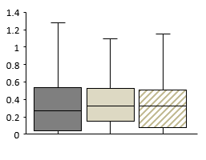
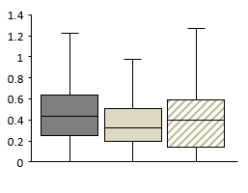
Distance (µm)
B-1
B-2
Distance (µm)
B-3
HEC-1B
Normalised Frequency
Control
Model 1
Model 2
B-1
B-2
B-3
Distance (µm)
A-1
A-2
HEC-1A
Normalised Frequency
A-3
Distance (µm)
Control
Model 3
Model 4
A-1
A-2
A-3
Distance (µm)
Supplementary Fig. S3 L-selectin binding to HEC-1B and HEC-1A endometrial cell surface models (B1-3 & A1-3) through AFM SMFS, resulting in measurements of distance (µm). SMFS data shown as box plots and frequency histograms for a minimum of 8000 curves, 5 cells per sample and minimum of 3 biological repeats

Slide 5
**
*
B-1
B-2
B-3
A-1
A-2
A-3
Control
Control
Supplementary Fig. S4 Mucin Glycoprotein manipulation using inflammatory cytokine combinations. (a+b) MUC16 RNA expression data following treatment with TNFα and IFNγ cytokine treatment alone or in combination. (Models B-1 & A-1 – Control; B-2 - 200IU IFNγ + 25 ng/ml TNFα; B-3 - 25 ng/ml TNFα; A-2 - 200IU IFNγ; A-3 - 25 ng/ml TNFα). All qPCR data shown as average and SD of a minimum 3 repeats. Significance given as * p<0.05, **p<0.001, ***p<0.0001.

Slide 6
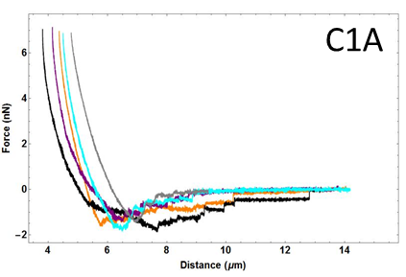
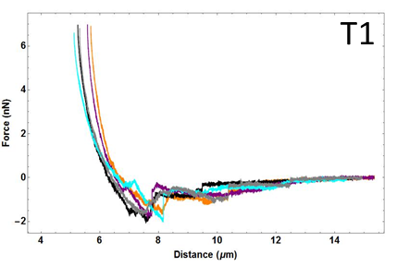
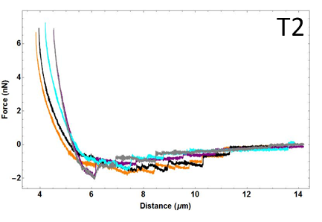
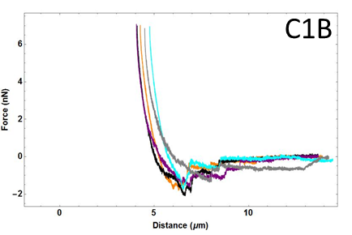
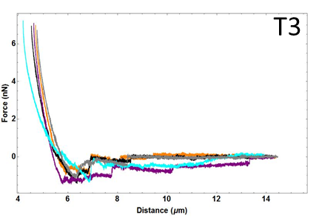
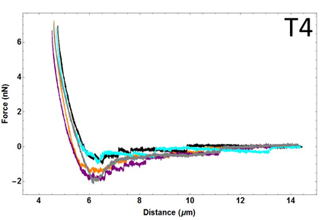
a)
F
Retract curve
Indentation region
Contact region
Non-contact region
0
Z
F_{end}
F_{begin}
Once snap-off event at given distance (mean of T_{start} and T_{end})
T_{start}
T_{end}
b)
c)
d)
6
4
2
0
-2
B-1
6
4
2
0
-2
B-2
6
4
2
0
-2
B-3
HEC-1B
Force (nN)
4 6 8 10 12 14
4 6 8 10 12 14
4 6 8 10 12 14
e)
f)
g)
6
4
2
0
-2
A-1
6
4
2
0
-2
A-2
6
4
2
0
-2
A-3
Force (nN)
HEC-1A
0 5 10
4 6 8 10 12 14
4 6 8 10 12 14
Distance (µm)
Distance (µm)
Distance (µm)
Supplementary Fig. S5 SMFS force distance curve analysis methods. Specific L-selectin probe retraction force curves were analysed for both maximal adhesion events and individual events that occurred as the AFM probe was retracted from the HEC-1A and HEC-1B cell surfaces. (a) These events are analysed and collated from maximal adhesion, step adhesion force, distance and energy and data presented in the Figures 5 and 6. Example force curves from achieved L-selectin functionalized AFM probes binding to HEC-1B (b, c, d) and HEC-1A (e, f, g) endometrial cell surface models are shown. All the SMFS example force curve data shown is raw data with standard baseline corrections applied

