Slide 1
Cerium oxide nanoparticles improve cotton salt tolerance by enabling better ability to maintain cytosolic K⁺/Na⁺ ratio
Jiahao Liu¹, Guangjing Li¹, Linlin Chen¹, Jiangjiang Gu², Honghong Wu^{1,*}, Zhaohu Li^{1,3}
¹ MOA Key Laboratory of Crop Ecophysiology and Farming System in the Middle Reaches of the Yangtze River, College of Plant Science & Technology, Huazhong Agricultural University, Wuhan, China, 430070
² College of Science, Huazhong Agricultural University, Wuhan, China, 430070
³ College of Agronomy and Biotechnology, China Agricultural University, Beijing, China, 100083
* Corresponding author: honghong.wu@mail.hzau.edu.cn

Slide 2
Table S1
Table S1. The used primers for the investigated genes in this study.
Gene Names | Sense primers (5′-3′) | Antisense primers (5′-3′)
GhHKT1 | AGCAGGGAAGAGCATTTTGGA | CGGGCCGGGATTAAAGAGAA
GhKOR | ATGGGAGACATTGGGAGGAGTA | TTTGTTTCCTTCTCTGAAGTCCTCAA
GhNHX1 | CATGCTGTTTGGGGCTGTTG | AGTGAATTGAGGTGCTTCGCT
GhSOS1 | TGGGAAGGATTGGTGATGGC | GGACCAGCAAGCAGAACCAT
GhGADPH | TGATGCCAAGGCTGGAATTGCTT | GTGTCGGATCAAGTCGATAACACGG
GhUBQ7 | GAAGGCATTCCACCTGACCAAC | CTTGACCTTCTTCTTCTTGTGCTTG

Slide 3
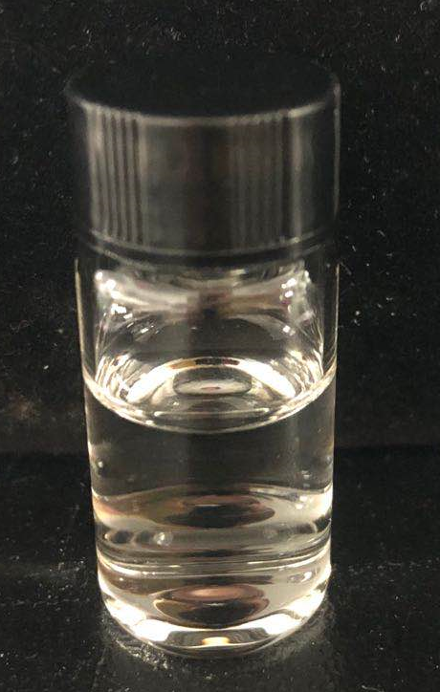
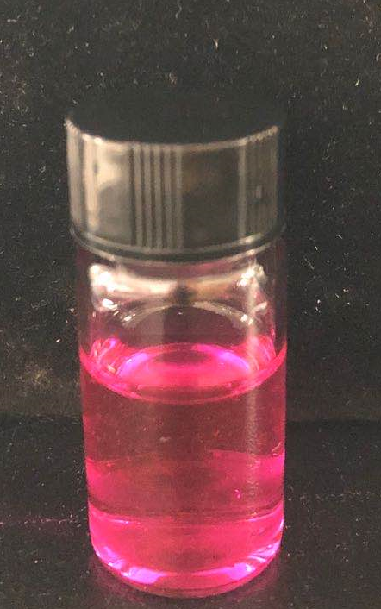
Figure S1
a
Absorbance (a.u.)
b
c
PNC
DiI-PNC
Wavelength (nm)
Figure S1. The absorbance spectra and colour of PNC and DiI-PNC. a, the absorbance spectrum of the synthesized PNC and DiI-PNC. b and c, the colour of the synthesized PNC (b) and DiI-PNC (c).

Slide 4

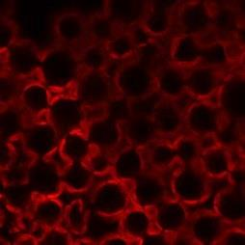
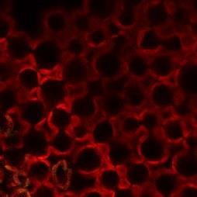

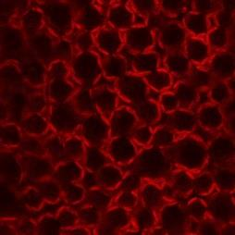
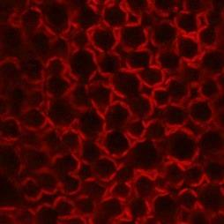
Figure S2
DiI
Chloroplast
Overlay
1st leaf
20 μm
Silwet L-77
2nd leaf
Figure S2. Confocal imaging of DiI fluorescence signals in Silwet-L77 treated cotton leaves. No DiI fluorescence signal was detected in cotton leaves treated with the surfactant Silwet-L77.

Slide 5
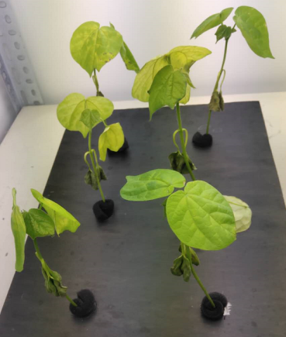
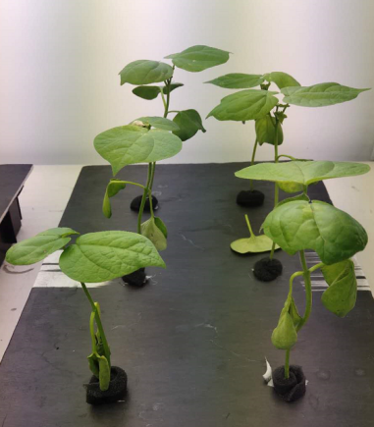
Figure S3
200 mM NaCl
c
*
a
b
*
Height (cm)
200 mM NaCl
C
Silwet L-77
Silwet L-77+PNC
200 mM NaCl
200 mM NaCl
d
e
a
a
ab
b
b
Dry weight (g/plant)
c
Whole plant (g/plant)
b
a
Figure S3. The performance of salt stressed (200 mM NaCl, 5 days) cotton plants with and without PNC treatment. a and b, phenotypic performance of salt stressed cotton plants without (a) and with (b) PNC treatment. c and d, the plant height (c), and leaf dry weight (d) of the first and second true leaves of salt stressed cotton plants with and without PNC treatment. e, the whole plant fresh and dry weight of salt stressed cotton plants with and without PNC treatment. Mean ± SE (n = 12). Different lower-case letters indicate the significance level at 0.05. * means P < 0.05.

Slide 6
Figure S4
a
200 mM NaCl
b
200 mM NaCl
a
a
b
Chlorophyll a content (mg/g)
b
Chlorophyll b content (mg/g)
c
c
c
d
Figure S4. The chlorophyll content of salt stressed (200 mM NaCl, 5 days) cotton plants with and without PNC treatment. a and b, chlorophyll a (a) and chlorophyll b (b) content in the first and second true leaves of salt stressed cotton plants with and without PNC treatment. Mean ± SE (n = 6-12). Different lower-case letters indicate the significance level at 0.05.

Slide 7
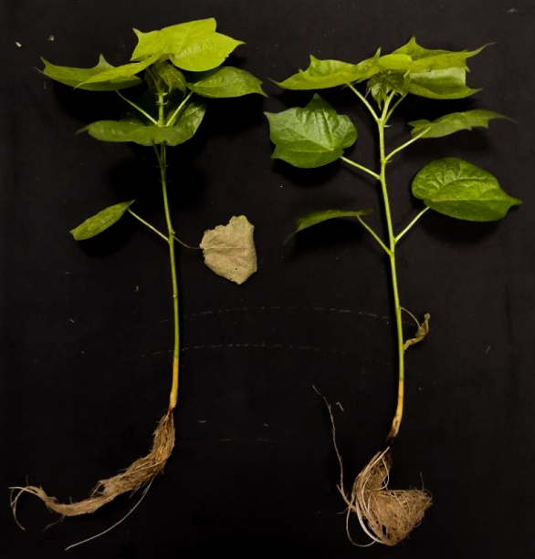
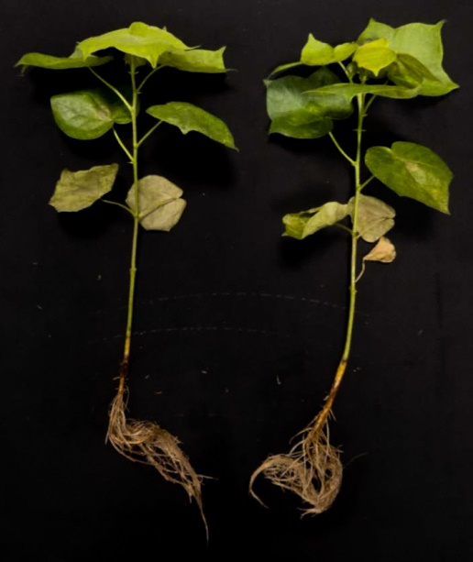
No salinity
Figure S5
a
b
10 cm
Sliwet L-77
Sliwet L-77+PNC
c
NS
Chlorophyll content index (arb. unit)
No salinity
Figure S5. The compatibility of PNC in cotton plants under non-saline condition. a and b, the phenotypic performance of cotton plants with and without PNC treatment, under non-saline condition after 28 days. c, CCI (chlorophyll content index) readout of the first and second true leaves of cotton plants with and without PNC treatment, under non-saline condition after 28 days. Mean ± SE (n = 8). NS means no significant difference.

Slide 8
Figure S6
200 mM NaCl
a
b
200 mM NaCl
a
a
b
SOD activity (U/g, FW)
c
b
c
CAT activity (mmol_{H2O2}/mg _{protein}/min)
c
c
200 mM NaCl
c
a
b
a
POD activity (μmol _{tetra-gualacol} /mg _{protein} /min)
c
Figure S6. The antioxidant enzyme activities in salt stressed (200 mM NaCl, 5 days) cotton plants with and without PNC treatment. a-c, superoxide dismutase activities (a), catalase activities (b), and peroxidase activities (c) of the first and second true leaves of salt stressed cotton plants with and without PNC treatment. Mean ± SE (n = 12). Different lower-case letters indicate the significance level at 0.05.

