Slide 1
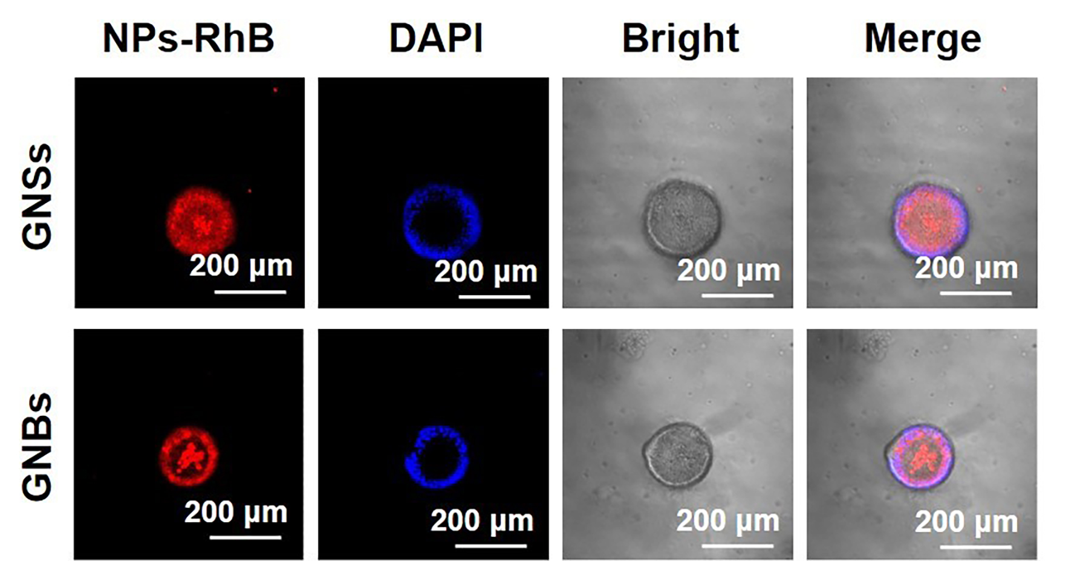
Additional Figure 4. CLSM single-layer images showing the accumulation of GNSs and GNBs in the cavity at 12 h.

