Slide 1
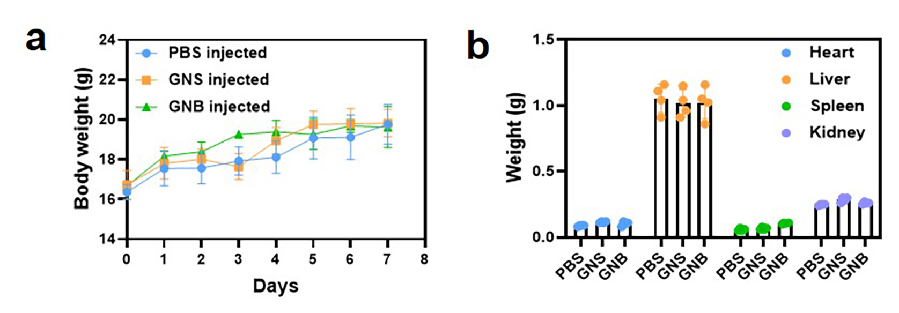
Additional Figure 7. (a) Body weight variations as a function of the time periods after the injection of GNSs and GNBs. (b) Weight results of heart, liver, spleen, and kidney of mice sacrificed after 7 days. (the black dots represent the number of samples)

