Slide 1
Figure S1
Ministry of Health Segmentation Framework
Description
Healthy
Free from chronic diseases, occasional acute self-limiting ailments.
Serious acute illness but curable
Able to return to healthy state with minimal suffering and disruption.
Stable chronic
Chronic disease that does not interfere with / restrict usual function or sufficient to trigger care seeking
Complex chronic
One/more chronic disease(s) that is/are poorly controlled and may lead to hospital admission
End of life
Those with a terminal condition that has become advanced, progressive, and incurable.
Healthy
Serious acute illness but curable
Stable chronic
Complex chronic
End of life

Slide 2
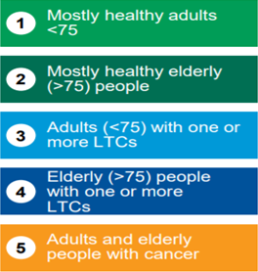
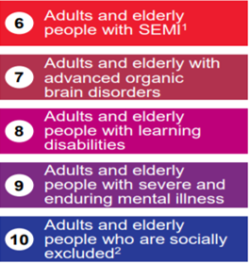
Northwest London Segmentation Model
Figure S2

Slide 3
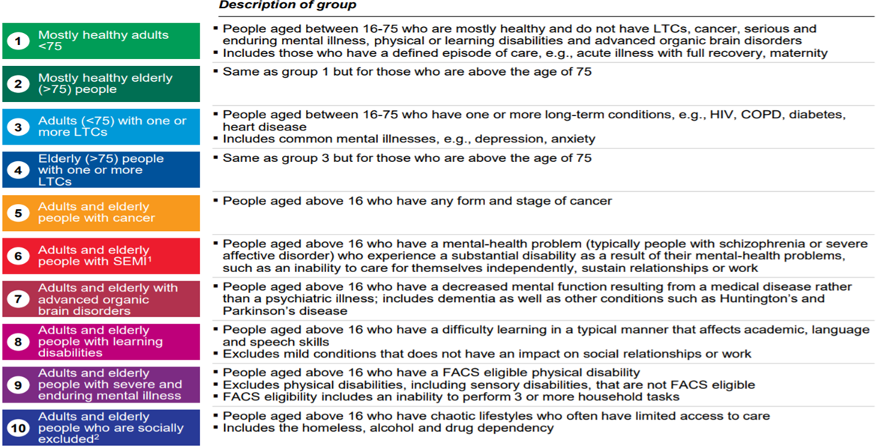
Figure S2
Description for Northwest London Segmentation Model

Slide 4
Bridges to Health Model
Figure S3
Healthy
Maternal and infant health
Acutely ill, with
likely return to health
Chronic conditions, with “normal” function
Significant but
stable disability (include mental)
Long course of decline,
from dementia and/or frailty
“Dying” with short
decline
Limited reserve and
serious exacerbations

Slide 5
Figure S3
Scenario for Bridges to Health Model
Healthy
Mr. Smith usually books an
appointment with his primary care physician each
year for an annual checkup. He also may contact his
physician’s office for acute, self-limiting problems
such as a sore throat.
Maternal and infant health
Mrs. Brown had regular contact with her gynecologist for contraception and health monitoring until deciding to become pregnant. Her newborn’s checkups and immunizations
follow national guidelines.
Acutely ill, with
likely return to health
Tom broke his bone while playing football. Following an uneventful surgical procedure, Tom received physical therapy to rehabilitate his leg
and maintain his body strength. He returned to school eight weeks later.
Chronic conditions, with “normal” function
Mrs. Gomez has hypertension
and diabetes. Although the levels were largely normal, she still finds that both are occasionally out of control She had regular checkups, and monitoring for possible
complications.
Significant but
stable disability (include mental)
Mr. White is paralysed due to a spine injury. He has a motorized wheelchair for shopping and outings. He has been suicidal at various times. He uses a medical home team for continuity healthcare treatment.
“Dying” with short
decline
Mrs. Black found she had
metastatic ovarian carcinoma and is now fatigued and losing weight. After unsuccessful treatment regimens, she has accepted services to ensure that she can stay home to the end of her life. The hospice clinicians manage her symptoms to alleviate pain.
Limited reserve and
serious exacerbations
Mr. Simon, lives with activity limitations due to emphysema. He has home oxygen and a complex treatment regimen. He and his family have learned how to manage his condition but also have a nurse practitioner on call 24/7 for urgent home visits.
Long course of decline,
from dementia and/or frailty
Mrs. Evans has dementia with incontinence and inability to communicate verbally and a serious pressure ulcer. She attends adult day care three days a week for full baths, and caregiver relief. The daughter has authority to make decisions and has decided to forgo resuscitation and to avoid hospitalization

