Slide 1
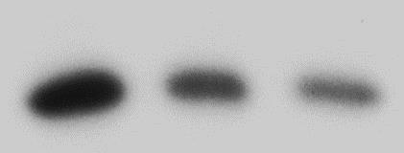
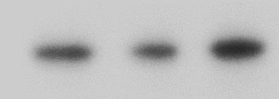
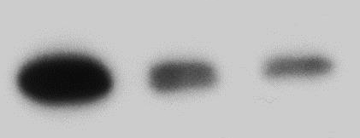
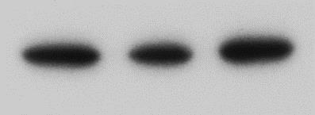
A
B
C
Mouse 2
Donor 2
Mouse1
Mouse 3
Donor 1
Donor 3
35-
AIP
35-
AIP
65-
p65
65-
p65
Additional file 2 AIP is expressed in primary mouse and human T cells. (A) AIP is expressed in primary human T cells. T cells of three human donors were isolated and cell lysates analyzed by western blotting. (B) AIP is expressed in primary mouse T cells. T cells of three mice were isolated and cell lysates analyzed by western blotting. (C) AIP mRNA levels do not significantly change in response to CD3/CD28 stimulation. T cells of three mice were isolated and CD3/CD28 stimulated for the indicated time points. RNA was isolated and AIP transcript levels analyzed by quantitative RT-PCR. Bars show average and standard deviation of three analyzed mice.
Additional file 2
Notes:
Figure 3: AIP regulates IL-2 production and NF-kB activity in Jurkat T cells

