Slide 1


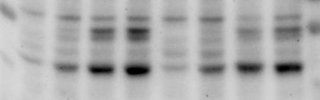
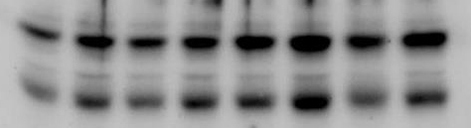


siGFP
siAIP1
0
12
20
40
0
12
20
40
P/I (min)
35-
pERK 1/2
35-
ERK 1/2
55-
pJNK p54
40-
pJNK p46
55-
JNK 1/2
40-
AIP
35-
p65
65-
Additional file 3 Effects of AIP on MAP kinase activation. JNKp54 phosphorylation is diminished after AIP knockdown, while ERK phosphorylation is untouched. Jurkat T cells were transfected with siGFP or siAIP1 and stimulated with P/I as indicated. ERK and JNK phosphorylation was analyzed by western blotting.
Additional file 3

