Slide 1
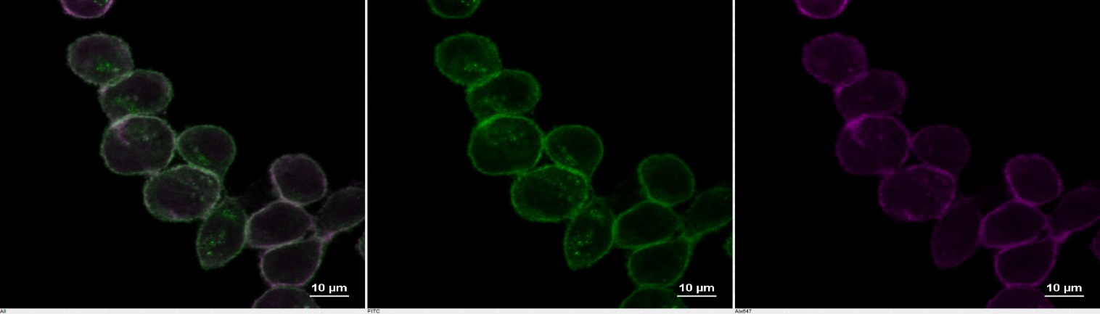
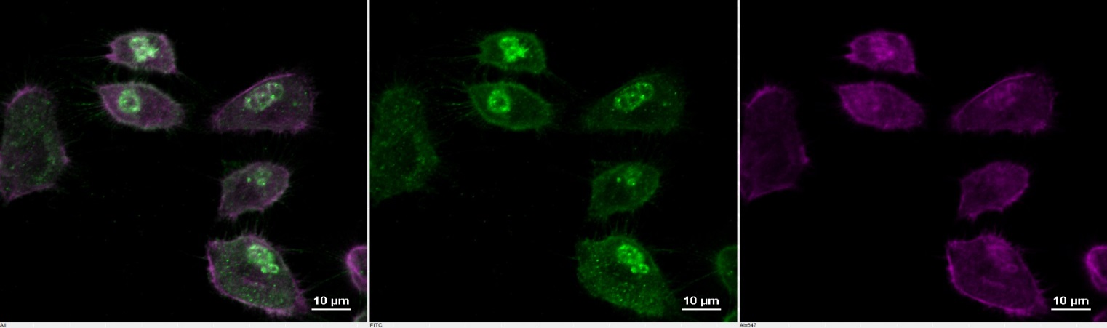
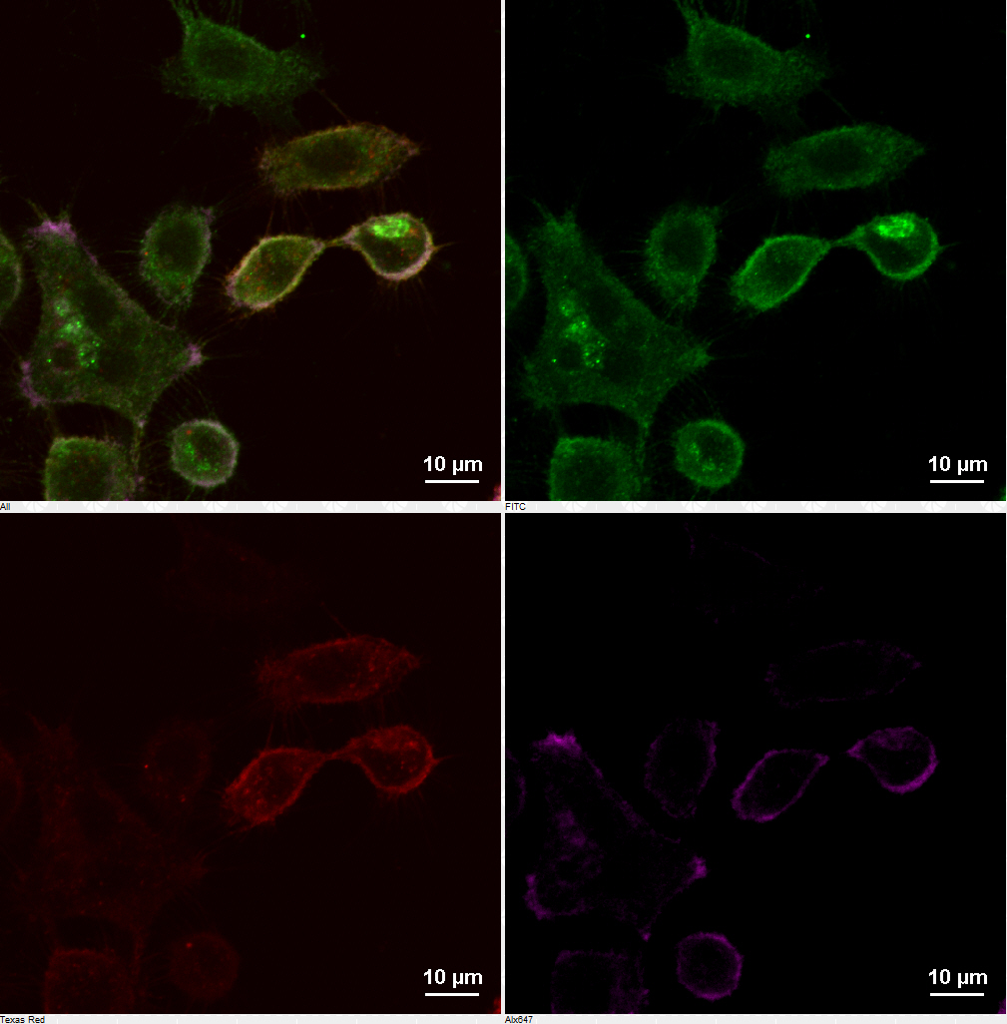
Merged
EphA2
Phalloidin
CLDN4KD/rescued CLDN4KD 2008/SCB
Merged
EphA2
Mcherry-CLDN4
Phalloidin
Figure S1. Knockdown of CLDN4 alters EphA intracellular distribution. The distribution of EphA2 (green) in the 2008/SCB, CLDN4KD and CLDN4KD/rescued cells was visualized by immunofluorescent staining using anti-EphA2 antibody. Phalloidin (purple) was used to stain actin. Red fluorescence is from the mCherry-CDLN4.

