Slide 1
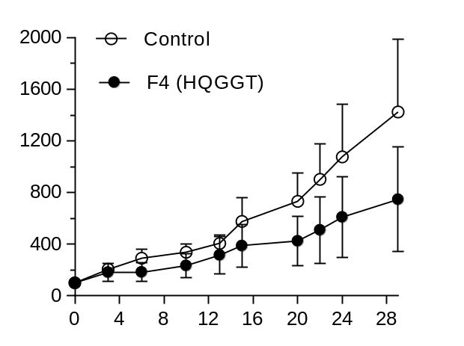
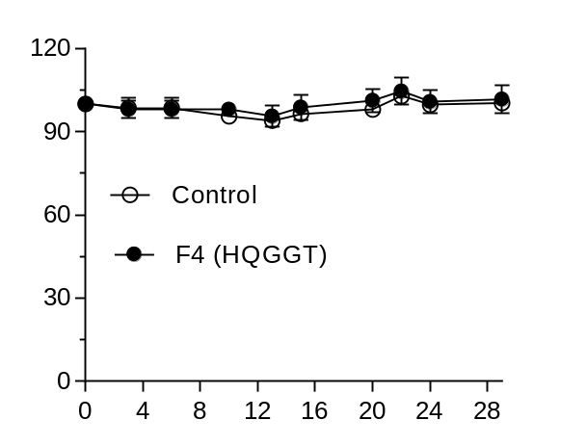
Fig. S1
Initial tumor volume (%)
Initial body weight (%)
**
Days
Days

Slide 2
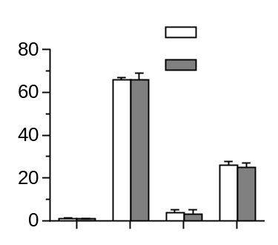
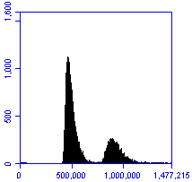
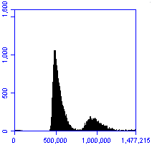

Fig. S2
a
b
Untreated HQGGT
Untreated
HQGGT
Cell cycle
distribution (%)
Cell counts
Sub G0
G0/G1
S
G2/M
PI
Untreated
HQGGT
MW (kDa)
PARP
-100
-75
TS
-37
-25
GAPDH
-37

Slide 3
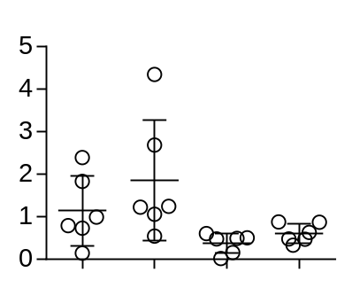
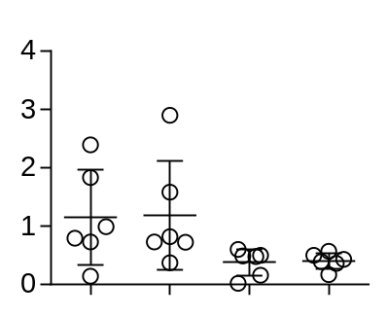
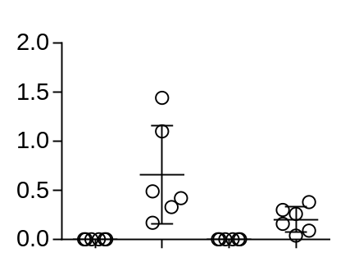
Fig. S3
a
b
Control 5-FU HQGGT HQGGT + 5-FU
1 2 3 4 5 6 1 2 3 4 5 6 1 2 3 4 5 6 1 2 3 4 5 6
*ITC-
Free TS-
*
α-tubulin
p = 0.051
p = 0.054
p = 0.060
p = 0.051
p = 0.07
p = 0.056
Total TS/α-tubulin
Free TS/α-tubulin
ITC/α-tubulin
5-FU
HQGGT
5-FU
5-FU
Control
HQGGT+5-FU
Control
HQGGT
Control
HQGGT
HQGGT+5-FU
HQGGT+5-FU

