Slide 1
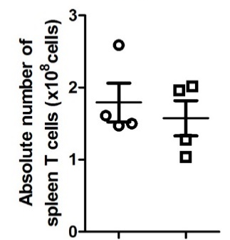
Figure S1
A
B
ns
ns
Ctrl αPD-L1
Ctrl αPD-L1
Supplemental Figure S1. Absolute number assessed by flow cytometry of spleen granulocytes (A) and T-cells (B) in control CD19_Cre (Ctrl) and transgenic LMP1/CD40-expressing mice. ns, non-significant.

Slide 2
Figure S2
0
-1
-2
IL-10 mRNA
Log(fold change)
-3
-4
-5
PHA-408
10 µM
Ruxolitinib
1,5 µM
Ibrutinib
1 µM
Supplemental Figure S2. IL-10 mRNA expression in splenocytes from LMP1/CD40-expressing mice treated with the PHA-408, ruxolitinib and ibrutinib inhibitors. Results are expressed in logarithm of fold change by comparison with the control.

Slide 3
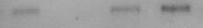
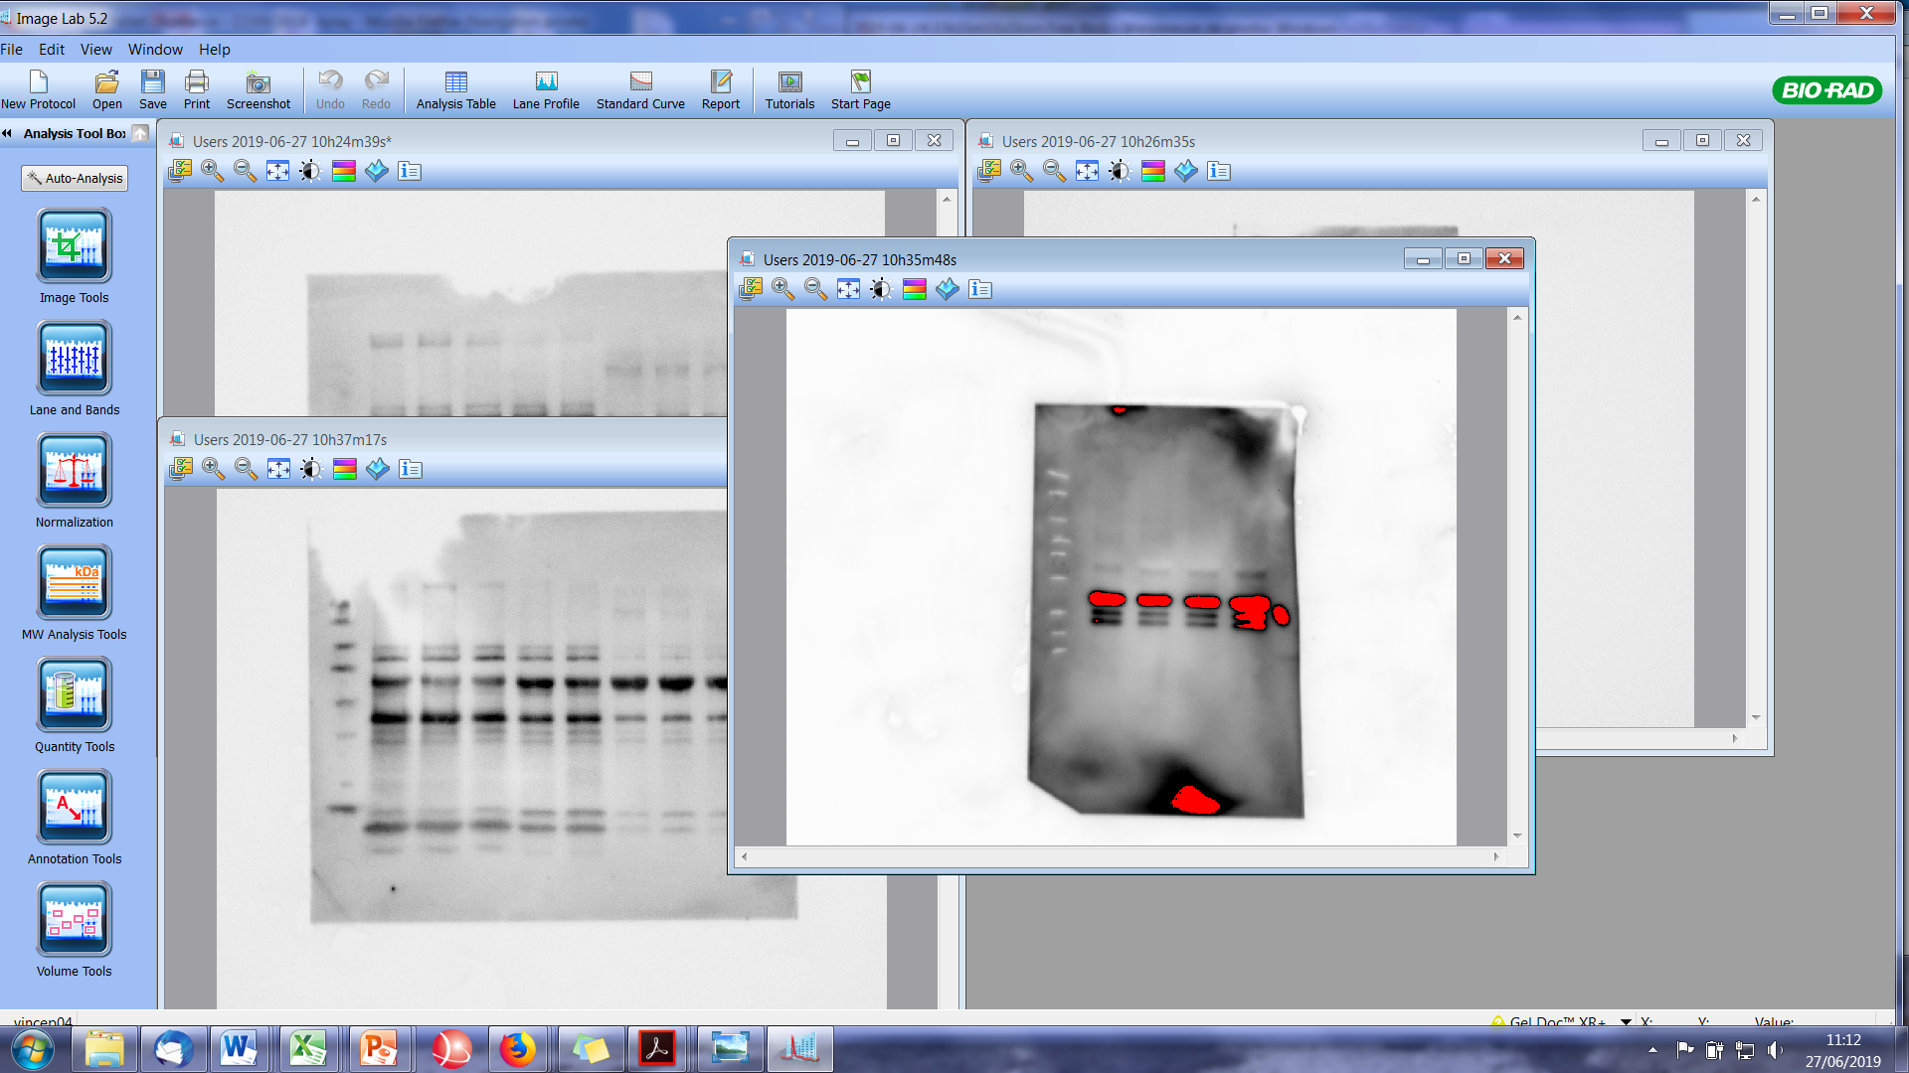
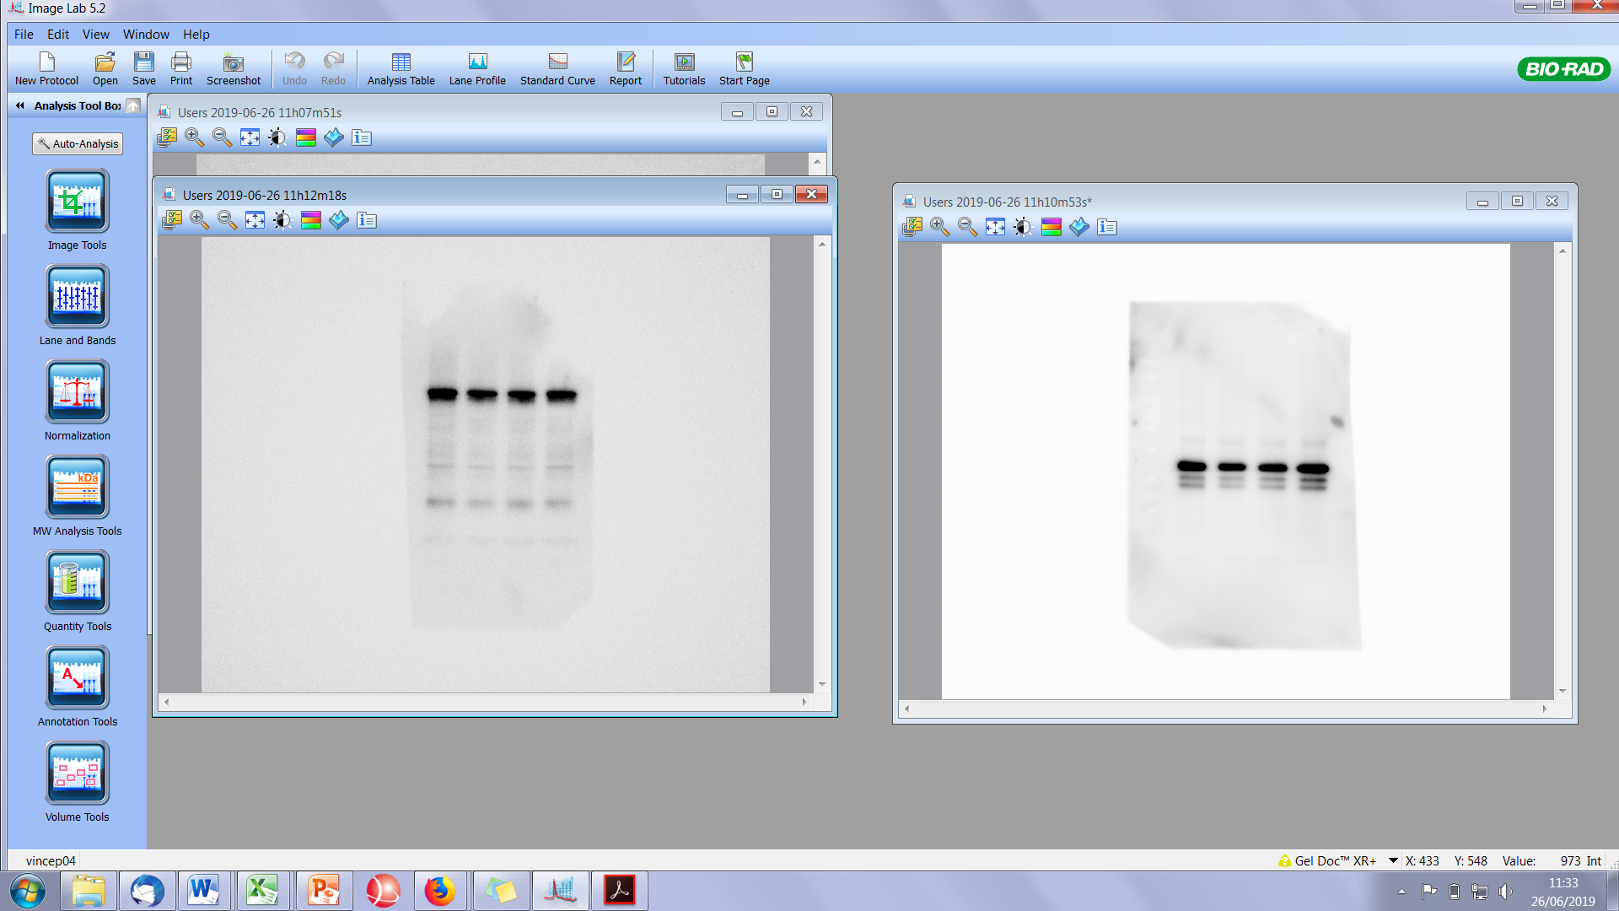
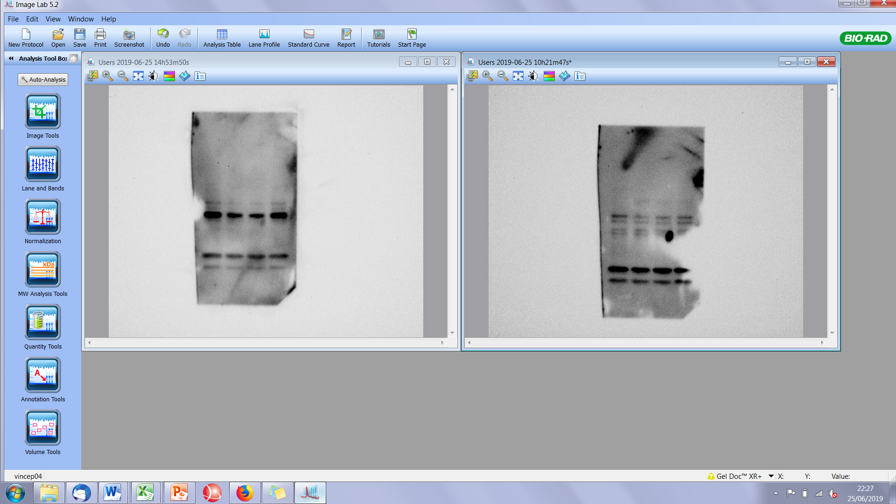
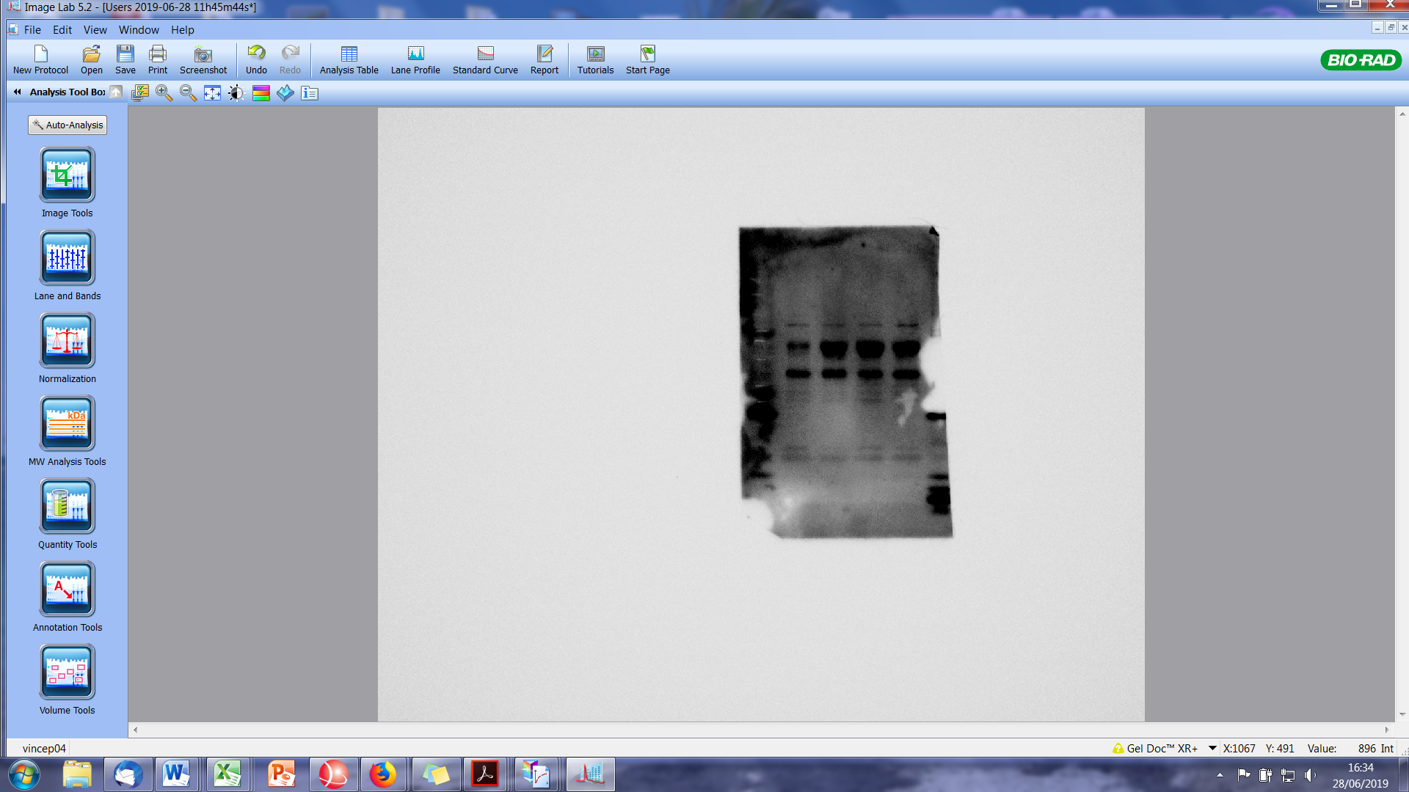
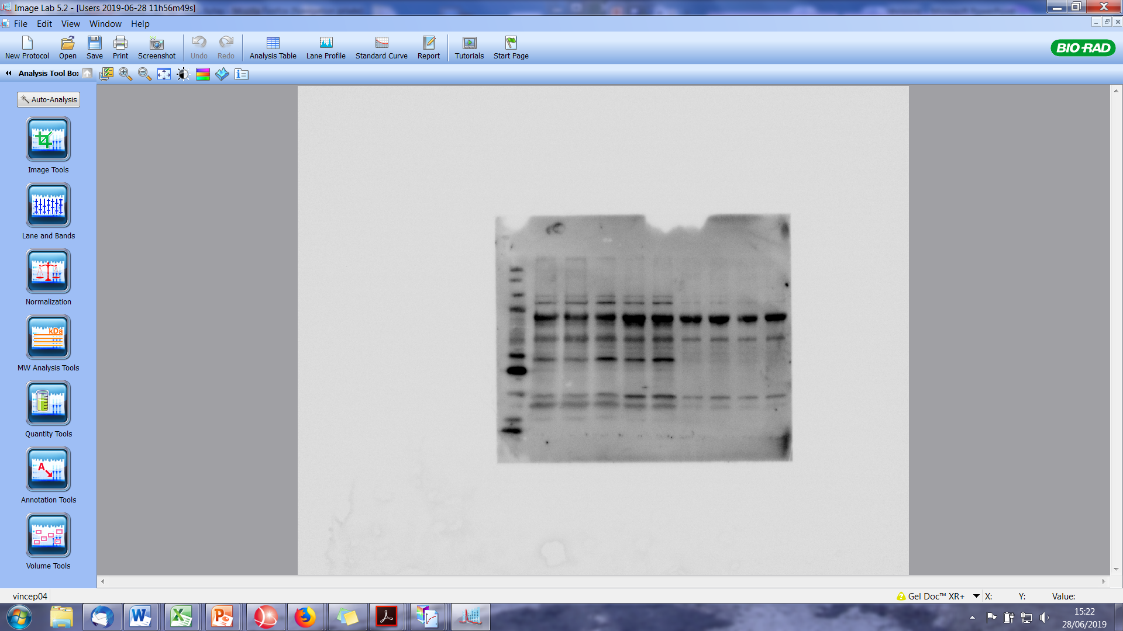
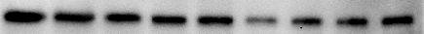
Figure S3
Ruxolitinib 1,5 µM
PHA-408 10 µM
Ctrl
Ibrutinib 1 µM
TRAF1
P-STAT3
STAT3
P-ERK
ERK
PD-L1
GAPDH
CD19_Cre
Supplemental Figure S3. Analysis of NF-κB/TRAF1, JAK/STAT3, and ERK pathways by western blot of protein extracts from splenocytes of control CD19_Cre mice after 48 hours in vitro treatment with the PHA-408, ruxolitinib and ibrutinib inhibitors. GAPDH was used as loading control.
Figure S4
α-CD40
α-CD40/IL-4
IL-10
α-IgM
PHA 408
Ruxolitinib
Ibrutinib
+ - - - + - - -
- + - - - + - -
- - + - - - + -
- - - + - - - +
- - - - + + - -
- - - - - - + -
- - - - - - - +
PD-L1
GAPDH
1
2
3
4
5
6
7
8
9
CD19_Cre
Supplemental Figure S4. Analysis of PD-L1 expression by western blot of protein extracts from splenocytes of CD19_Cre mice i) after 48 hours in vitro CD40 (R&D Systems), CD40 plus IL-4 (Peprotech), IL-10 (R&D Systems), IgM (Jackson ImmunoResearch) stimulations (lane 2 to 5), and ii) after 24 hours in vitro CD40, CD40 plus IL-4, IL-10, IgM stimulations followed by 24 hours treatment with the PHA-408, ruxolitinib and ibrutinib inhibitors (lanes 6 to 9). GAPDH was used as loading control.

