Slide 1
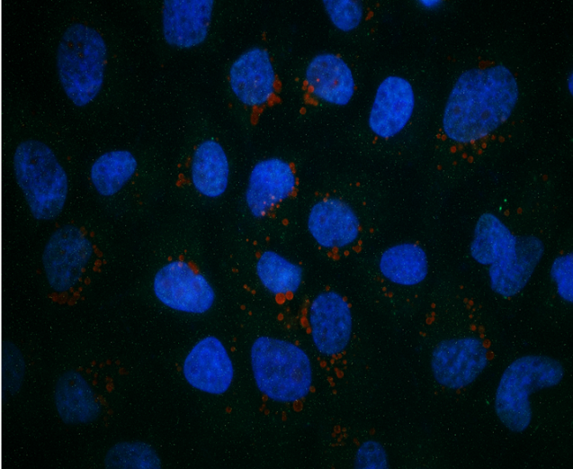
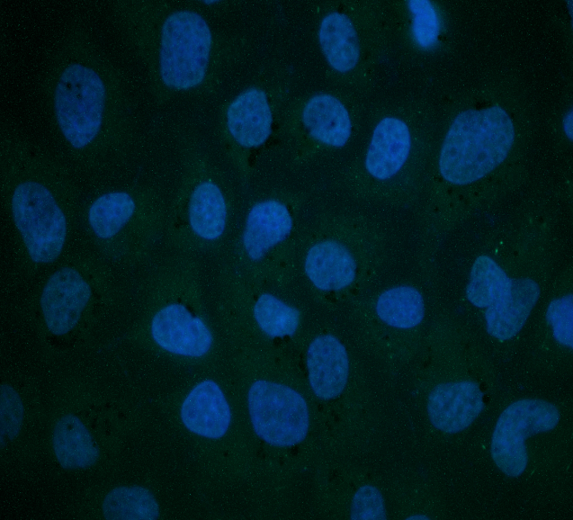
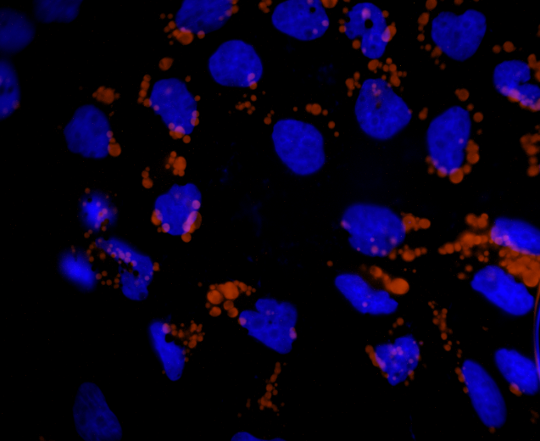
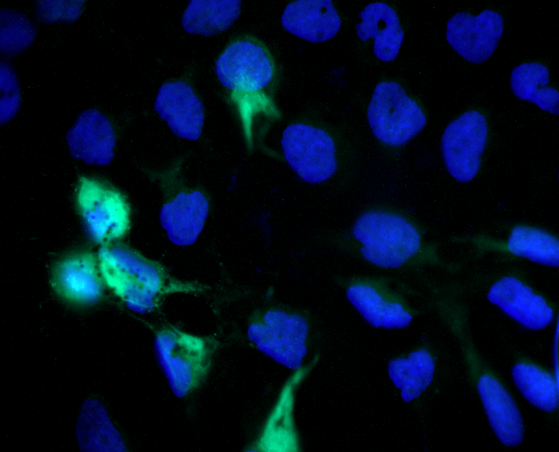
A
LD
E Protein
B
*
Mock
*
Zika
C
r = 0.9749
Stoyanova et al, Fig. S1 up
Notes:
Supplemental figure 1S

Slide 2

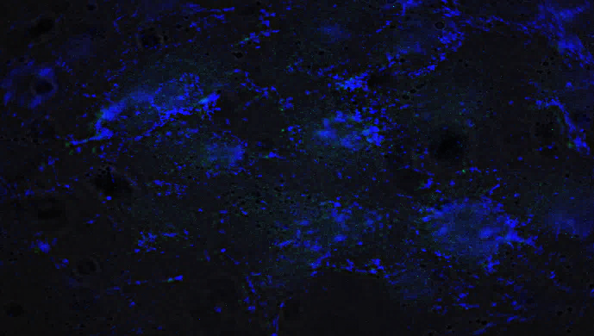
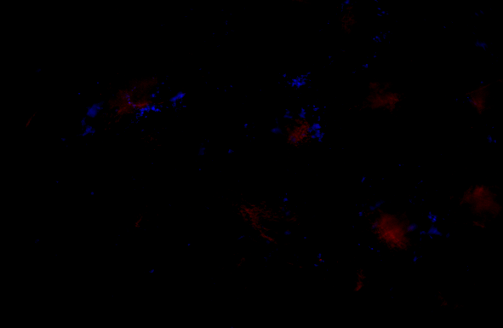

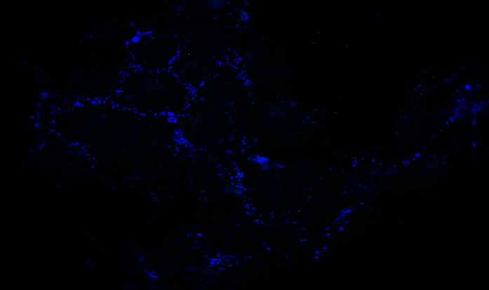
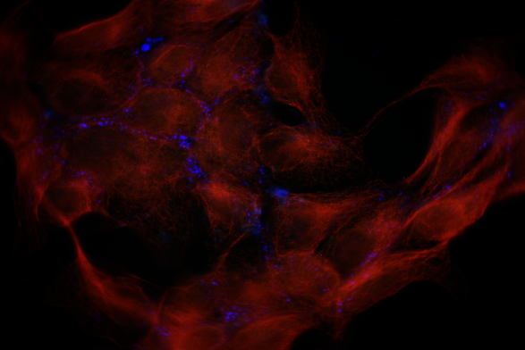
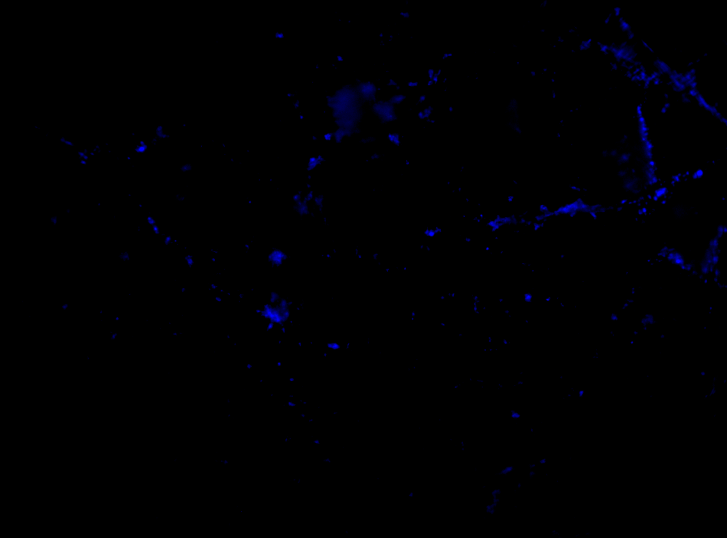
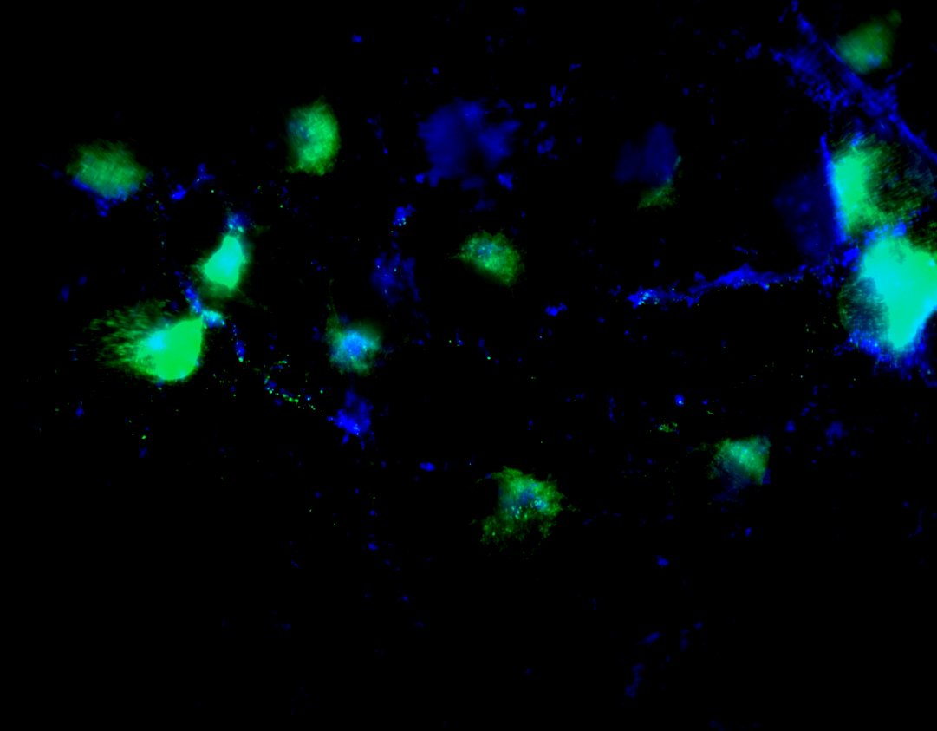
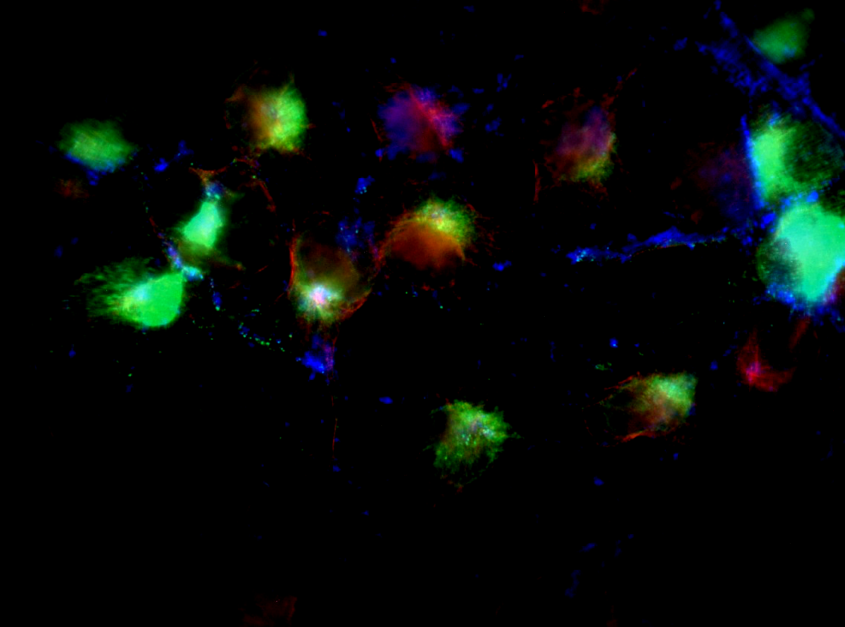
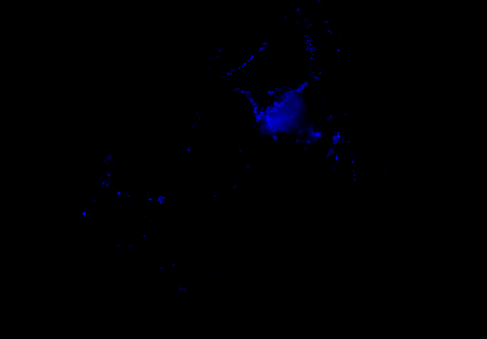
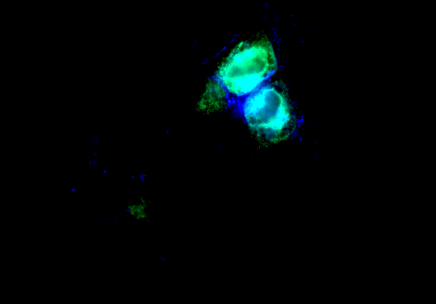
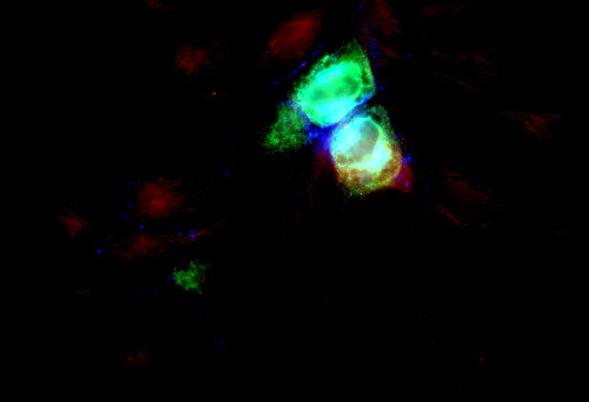
Filipin
Filipin E Protein
Filipin E Protein Tubulin
Mock
ATV
Zika
Zika+ATV
Stoyanova et al, Fig. 2S up
Notes:
Supplemental figure 2S

Slide 3
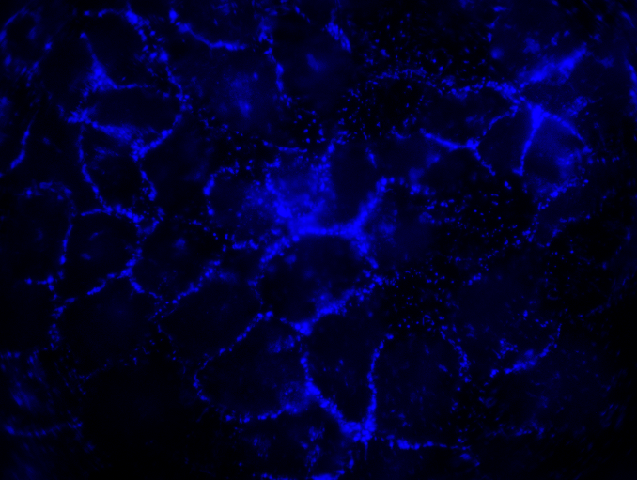
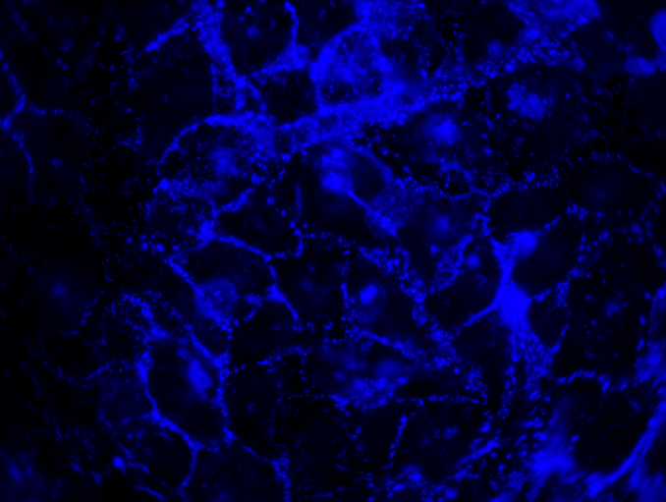
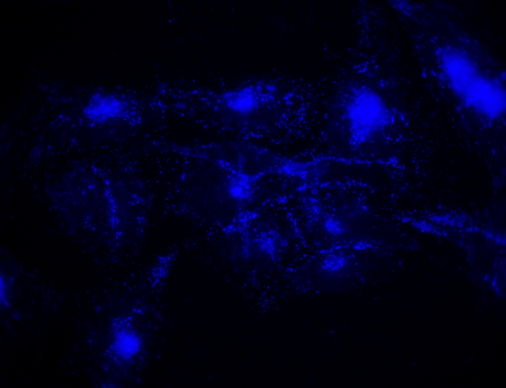
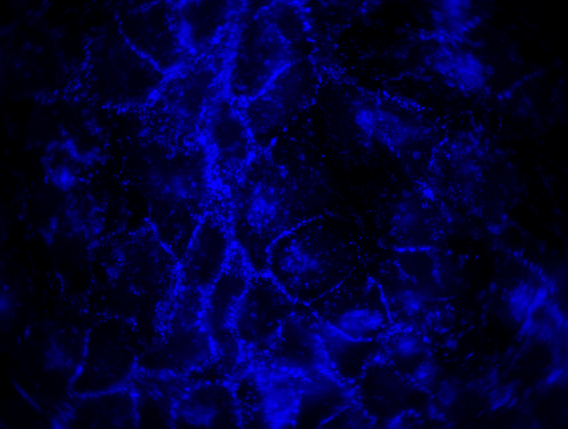
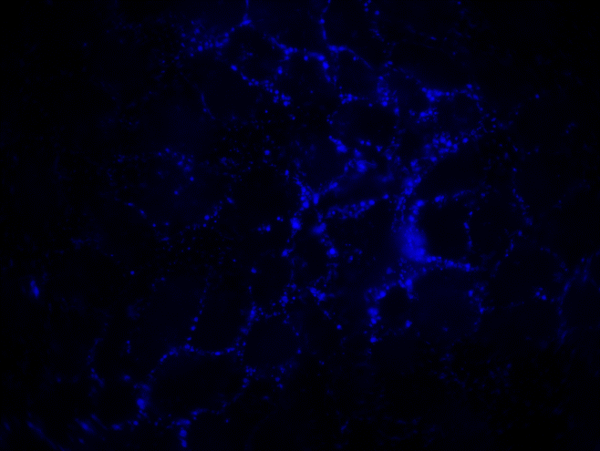
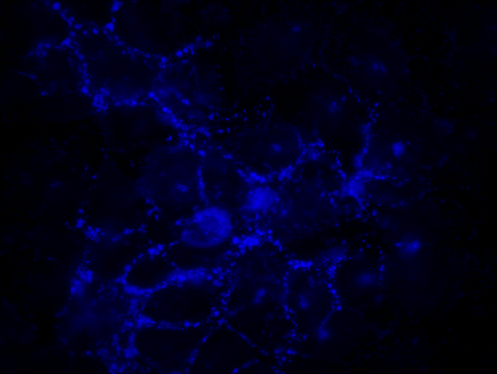
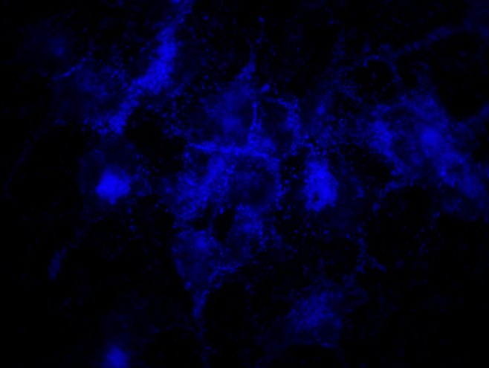
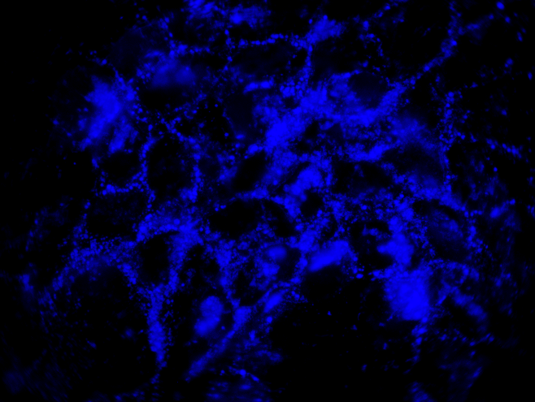
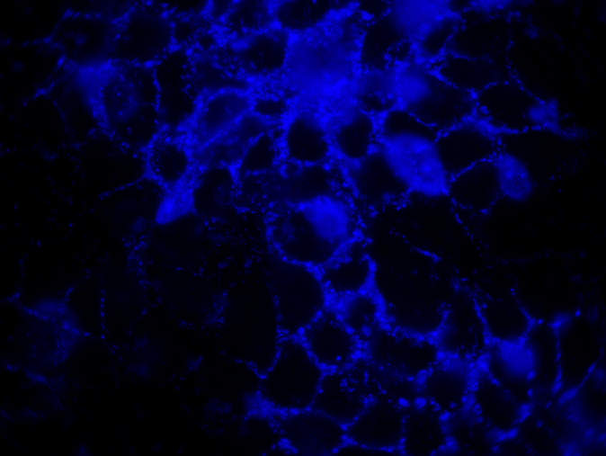
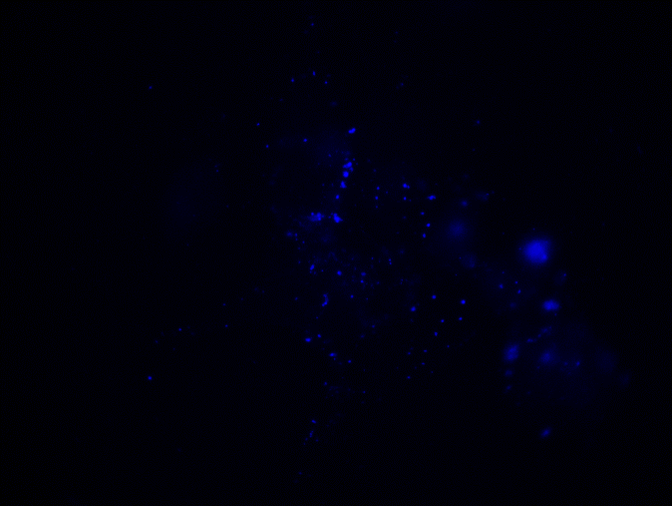
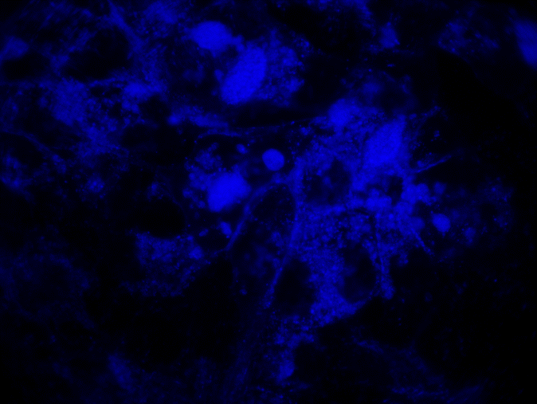
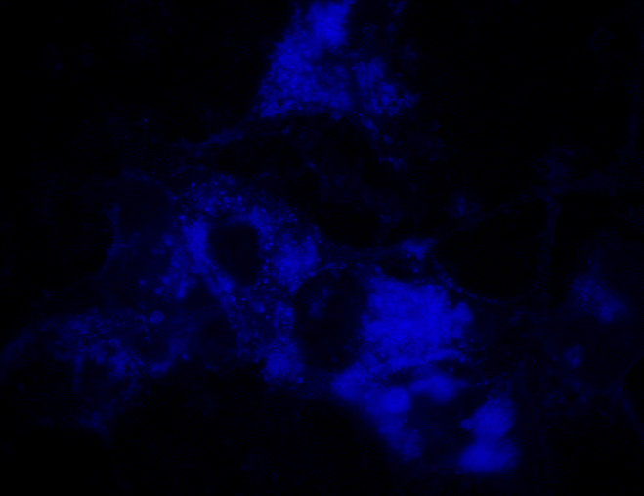

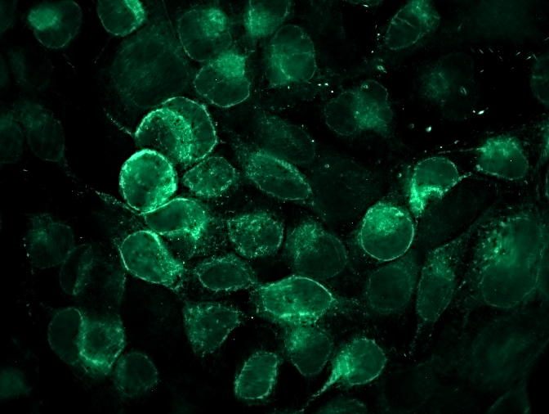

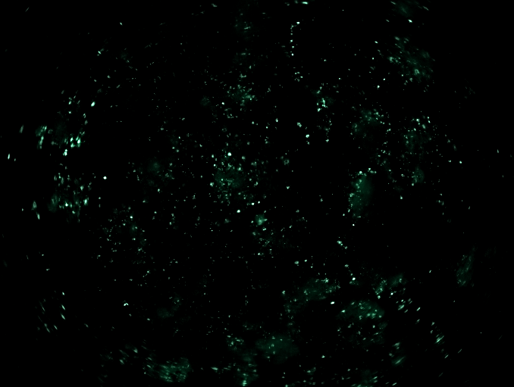

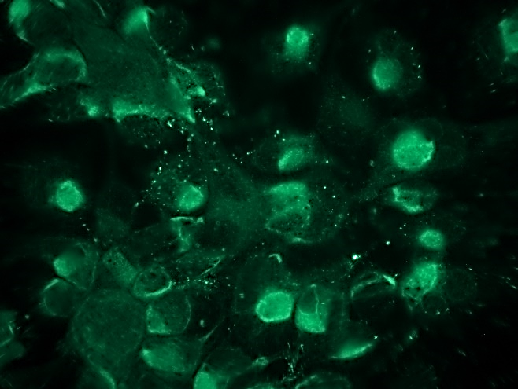
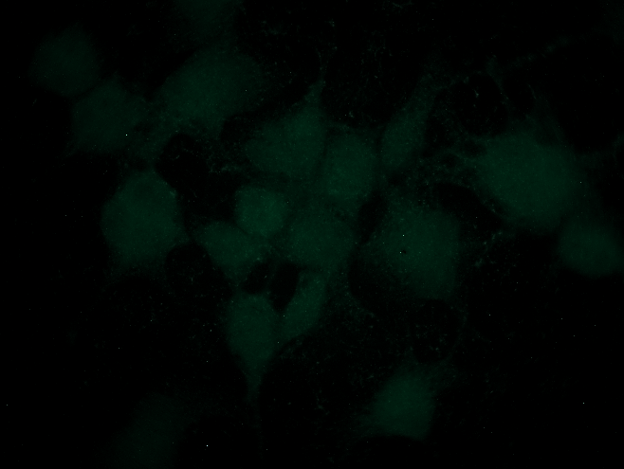
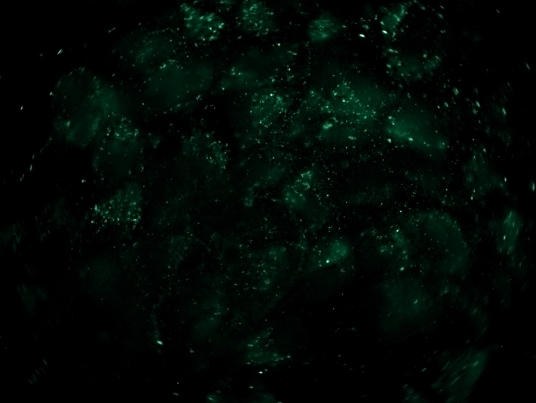

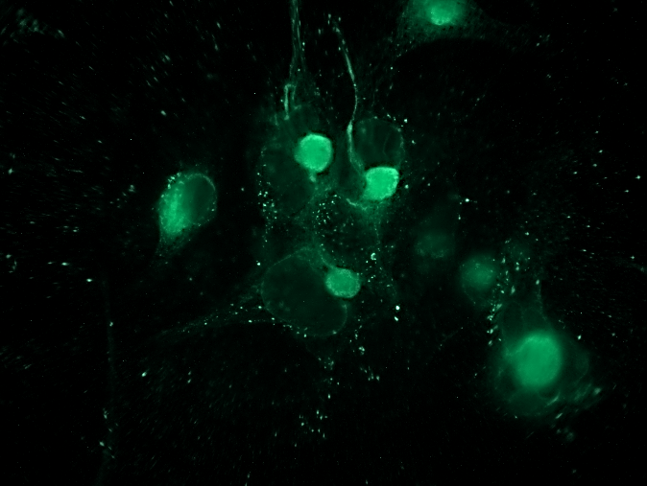
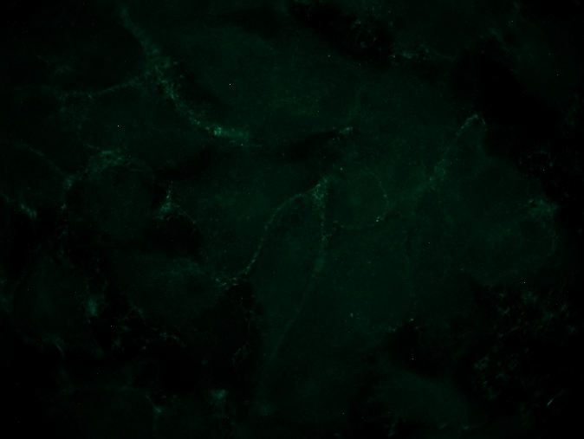
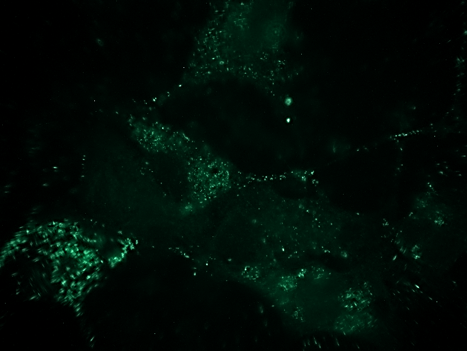
Mock
Zika
Baf
Baf + Zika
12H
Filipin
24H
48H
12H
E Protein
24H
48H
Stoyanova et al, Fig. 3S up
3
Notes:
Supplemental figure 3S

Slide 4
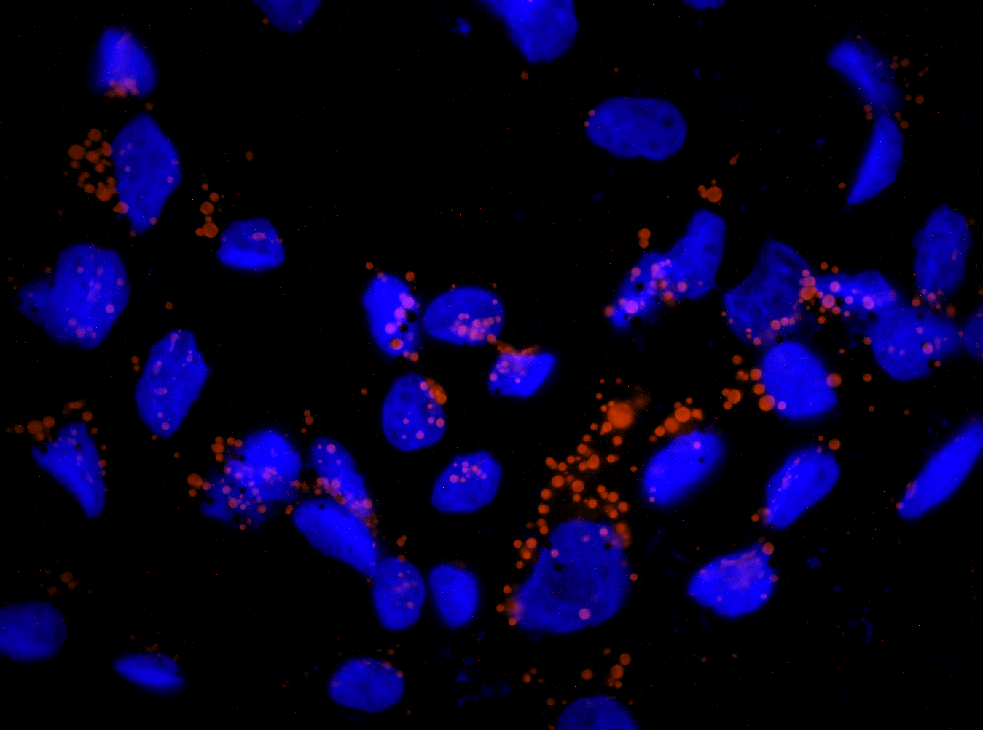
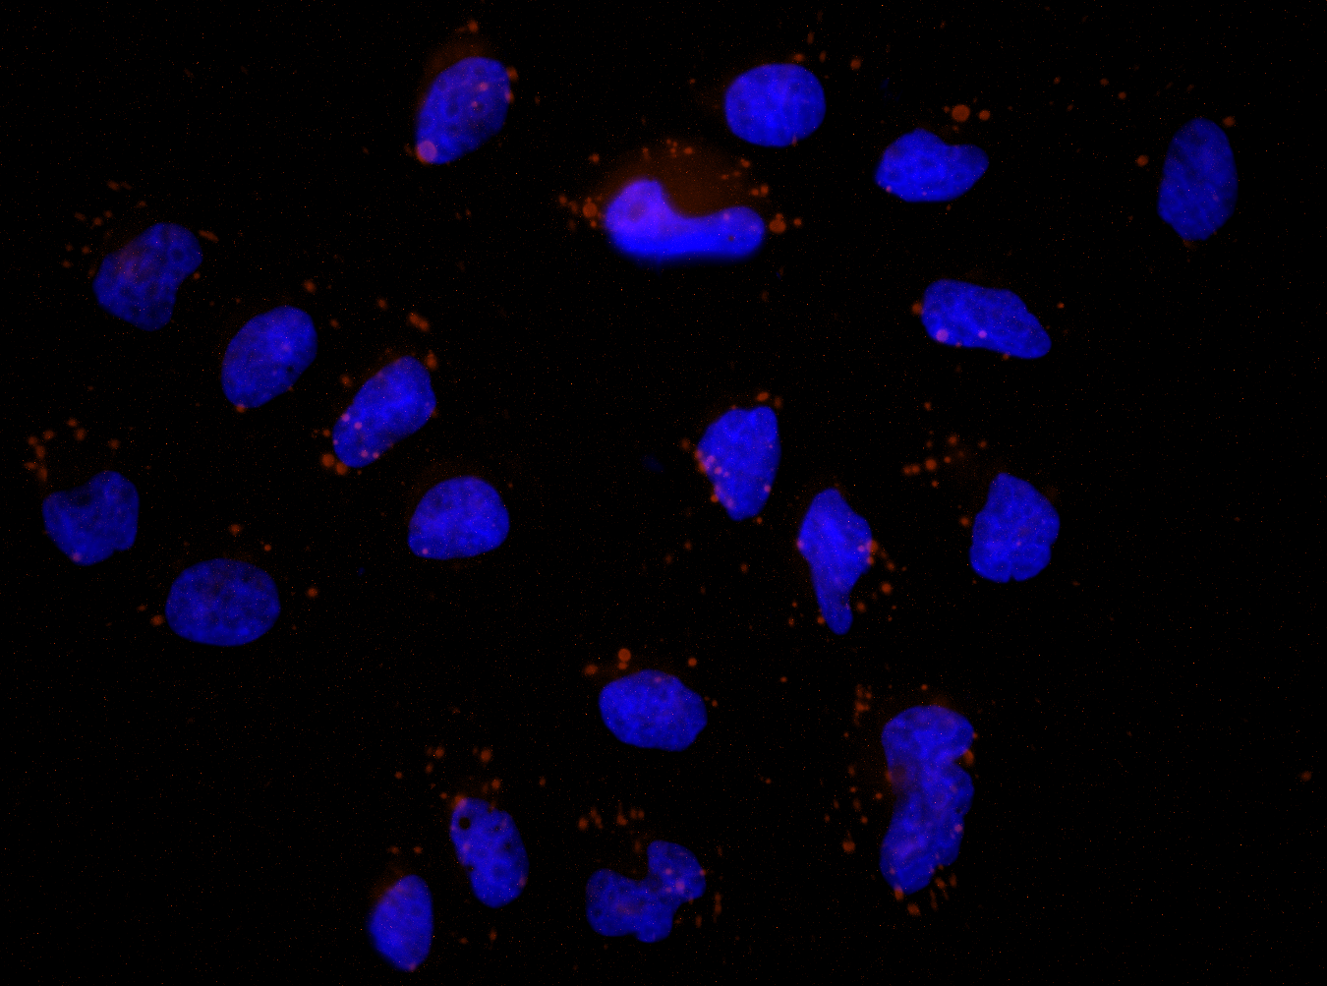
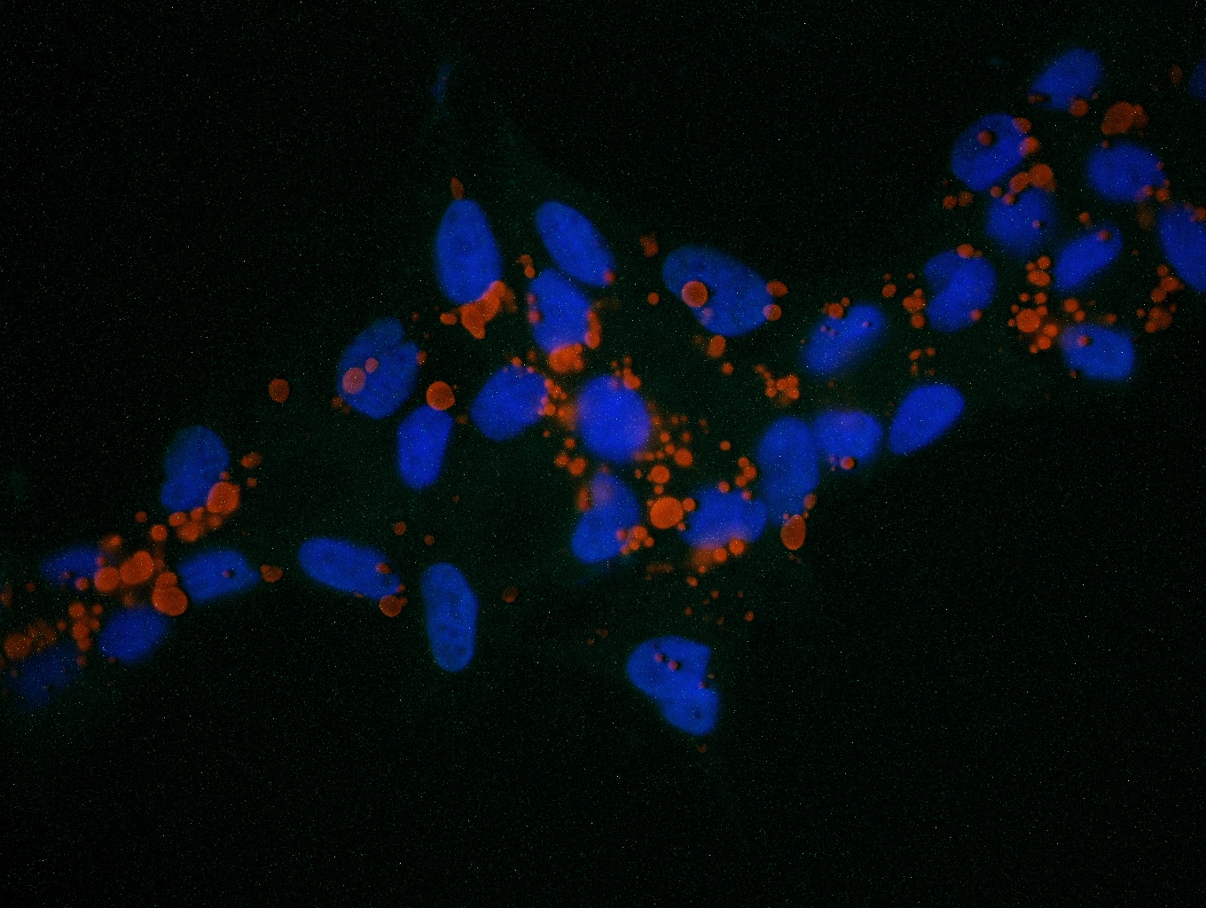
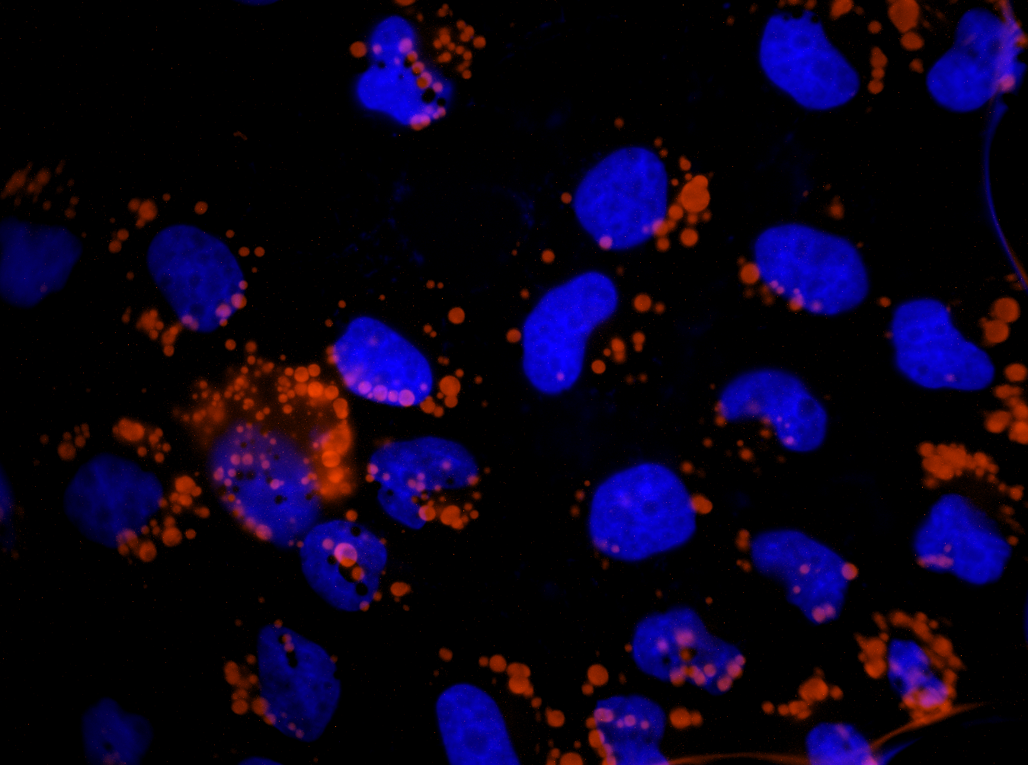
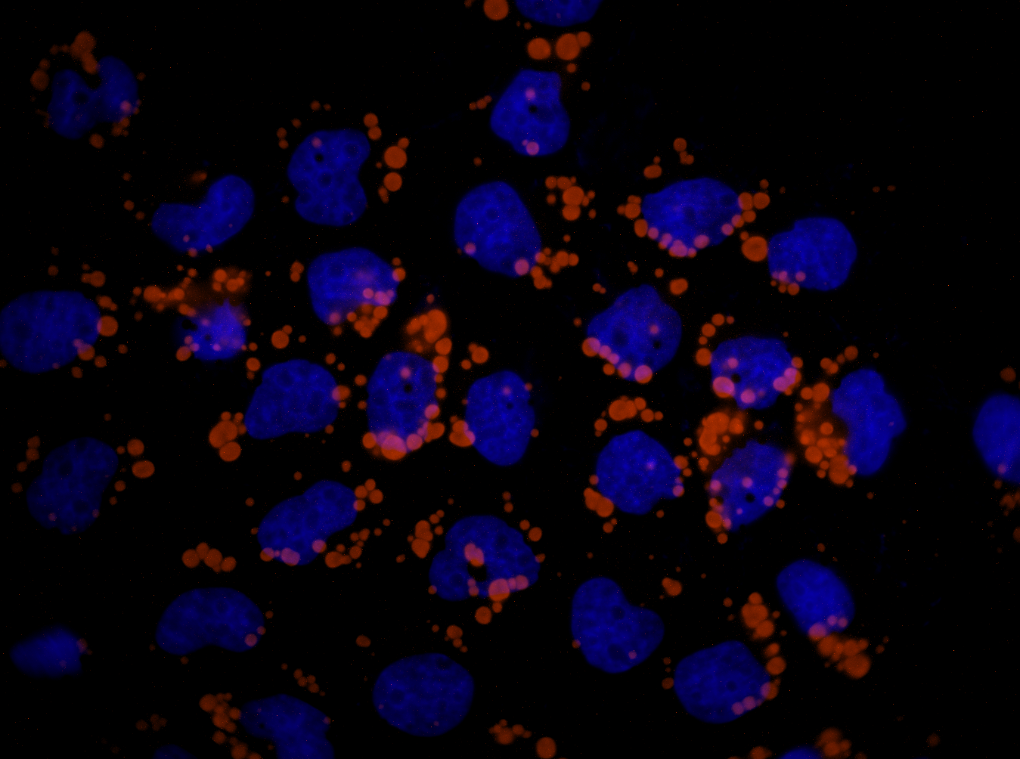
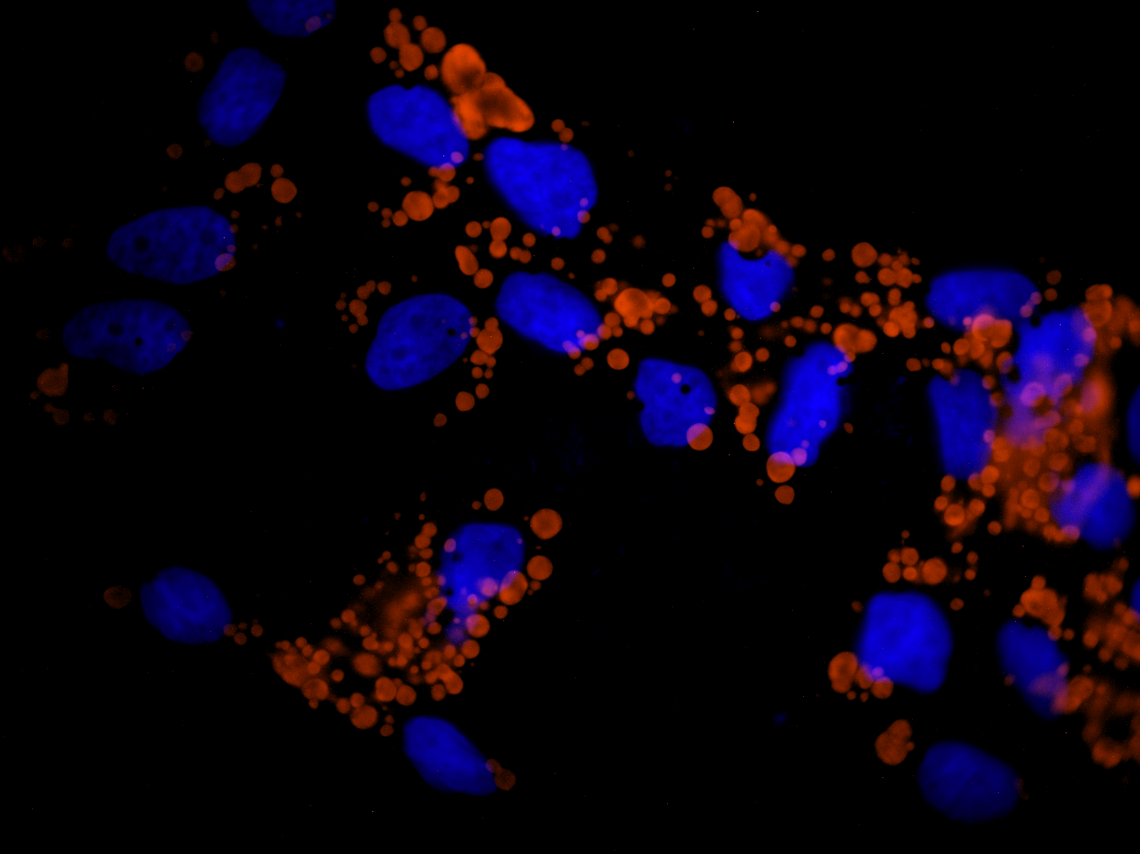
A
- Zika
+ Sal
+ Tunica
Mock
+ Zika
B
Stoyanova et al, Fig. 4S up
Notes:
Supplemental figure 4S

Slide 5
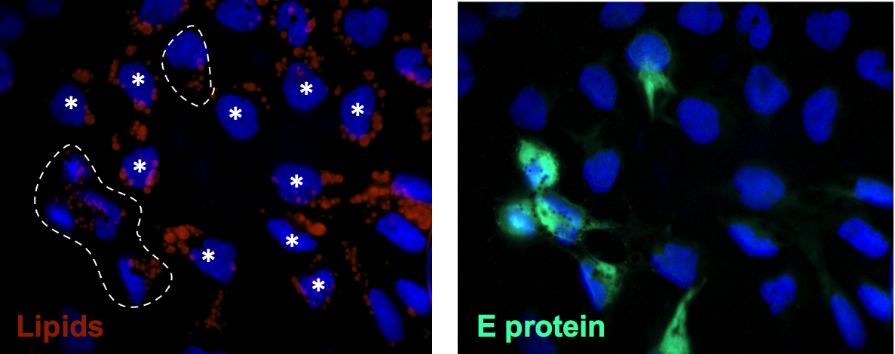
Stoyanova et al, Fig. 5S up
Notes:
Supplemental Fig. 5

Slide 6
Materials
Antibody (Ab) | Dilution | Company and Catalog no.
Anti-Zika E-protein rabbit polyclonal Ab | 1:200 | Absolute antibody # Ab00230-23.0
Anti-LC3B polyclonal rabbit Ab | 1:100 | Sigma #L7543
Anti β-tubulin mouse monoclonal Ab | 1:1000 | Sigma # T5293
Alexa Fluor 488-conjugated goat anti-rabbit IgG secondary antibody | 1:1000 | Invitrogen # A-11008
Alexa Fluor 555-conjugated donkey anti-mouse IgG secondary antibody | 1:1000 | Invitrogen # A31570
Alexa Fluor 488-conjugated goat anti-rabbit IgG secondary antibody | 1:1000 | Invitrogen # A21428
Alexa Fluor 488-conjugated goat anti-mouse IgG secondary antibody | 1:1000 | Invitrogen # A11001
Stoyanova et al, Fig. 6S up
Notes:
Supplemental Fig. 6

