Slide 1
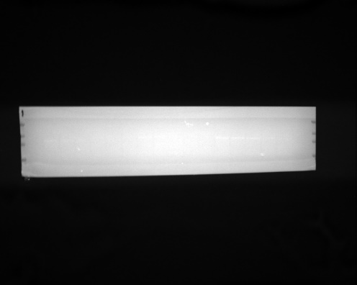
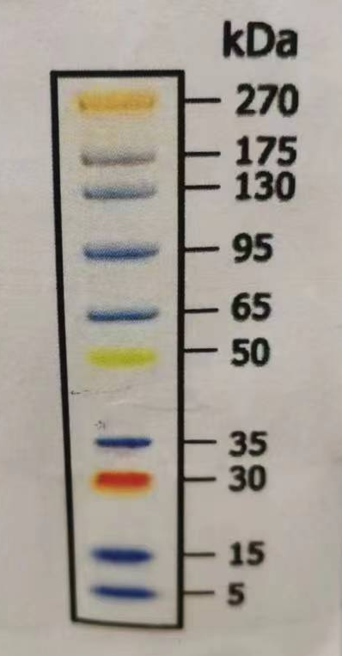
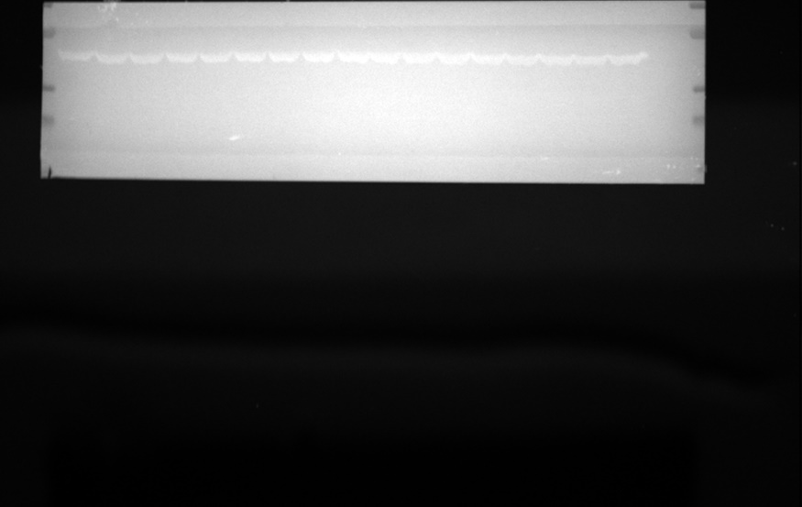
Supplementary Materials for western blot of P-TYK2
Supplementary Figure S1
Jurkat
A
QL-1200186
BMS986165
NDI-034858
[Cpds]
0.4
2
10
0.4
2
10
0
0
50
50
250
250
250 nM
0.4
[IFNα]
_
+
+
+
+
+
+
+
+
+
+
+
+
2
10
50
+
+
+
+
PTYK2 -134kDa
C
270 kDa
175 kDa
130 kDa
95 kDa
Jurkat
65 kDa
D
50 kDa
B
QL-1200186
BMS986165
NDI-034858
35 kDa
[Cpds]
0.4
30 kDa
2
10
0.4
2
10
0
0
50
50
250
250
250 nM
0.4
[IFNα]
_
+
+
+
+
+
+
+
+
+
+
+
+
2
10
50
+
+
+
+
β-actin- 45kDa
Figure S1: QL-1200186 blocked IFNα-stimulated phosphorylation of TYK2 in Jurkat cells in a concentration-dependent manner. Cells were co-cultured with QL-1200186, BMS-986165 or NDI-034858 for 1 h and stimulated with recombinant human IFNα (1000 U/mL) for 15 min. The phosphorylation level of TYK2 in Jurkat cells was detected by western blotting. The PVDF membrane was clipped at 65kda. The upper membrane incubated P-TYK2 (A) and the lower membrane incubated β-actin. (C) and (D) are the corresponding maker photos of PTYK2 and β-actin, respectively.

