Slide 1
The raw data of Western blot

Slide 2
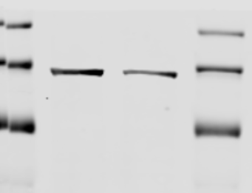
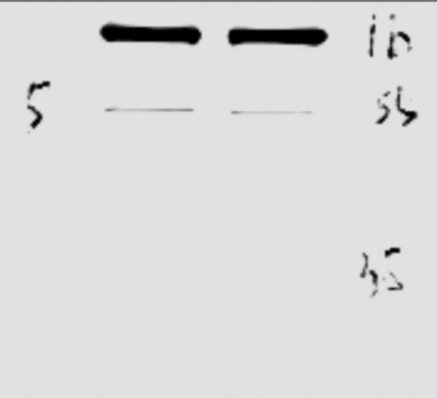
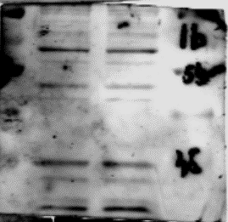
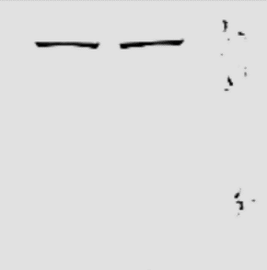
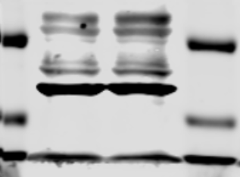
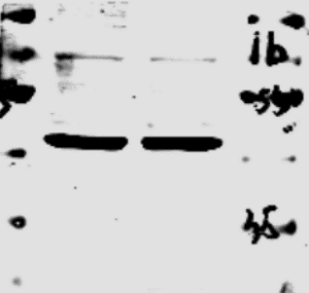
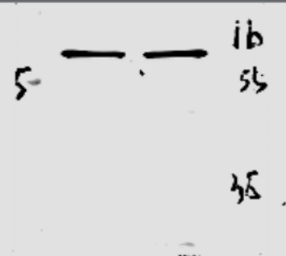
Figure.1D
NAT10
METTL3
METTL14
IGF2BP1
siNC
siNAT10
siNC
siNAT10
siNC
siNAT10
kDa
siNC
siNAT10
kDa
kDa
kDa
70
170
130
55
55
55
40
100
40
40
35
70
35
35
β-actin
β-actin
YTHDF1
siNC
siNAT10
siNC
siNAT10
siNC
siNAT10
kDa
kDa
kDa
100
55
70
55
55
40
40
40
35
35
35

Slide 3
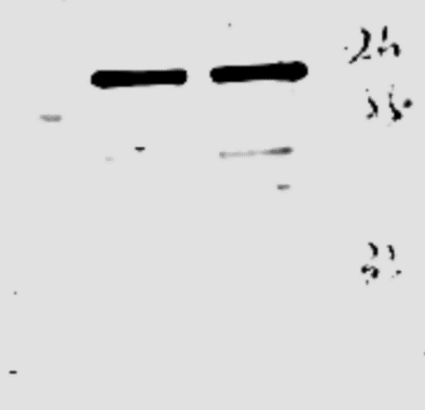
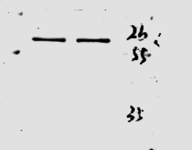
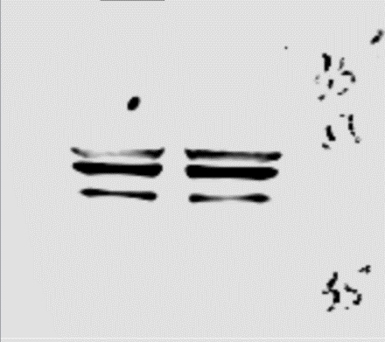
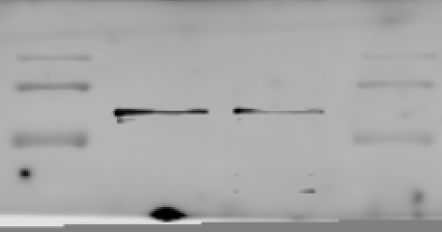
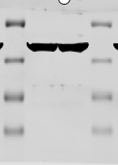
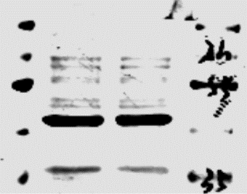
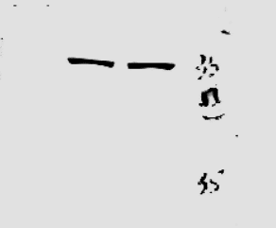
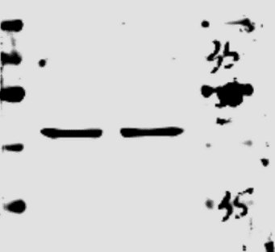
Figure.1D
YTHDF2
IGF2BP2
ALKBH5
YTHDC1
siNC
siNAT10
siNAT10
siNC
siNAT10
kDa
siNC
siNAT10
siNC
kDa
kDa
70
55
170
55
55
130
40
40
40
100
35
35
35
β-actin
siNAT10
siNC
kDa
β-actin
IGF2BP3
β-actin
siNC
siNAT10
kDa
siNC
siNAT10
kDa
siNC
siNAT10
kDa
40
100
100
70
70
35
70
55
55
55
40
40
25
40
35
35
35
15

Slide 4
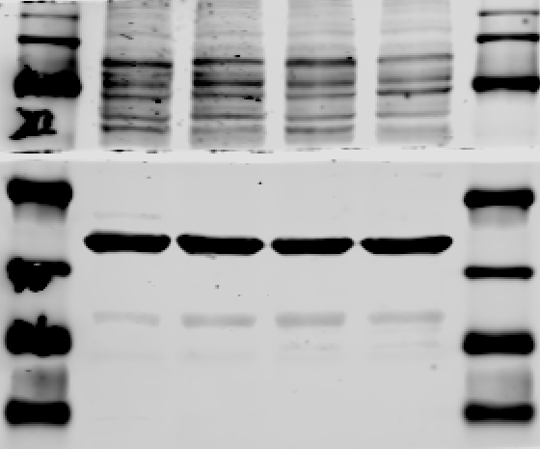
Figure.1J
siNC
siNAT10
CHX (hrs)
0
8
0
8
kDa
170
YTHDC1
130
100
70
β-actin
55
40
35
25

Slide 5
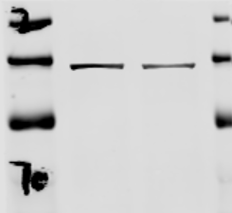
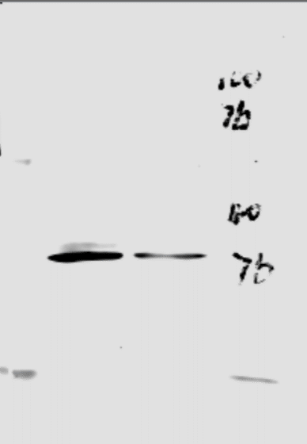
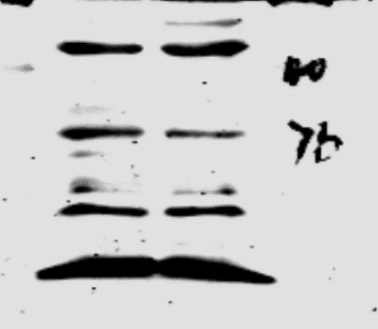
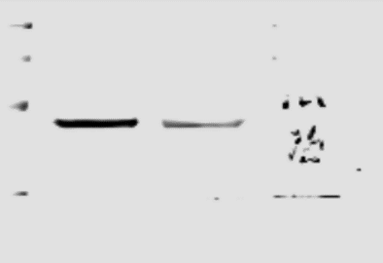
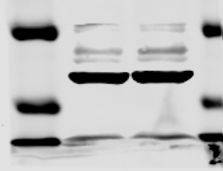
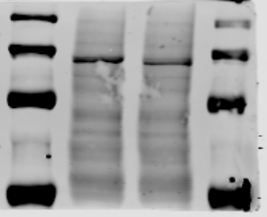
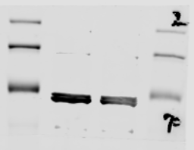
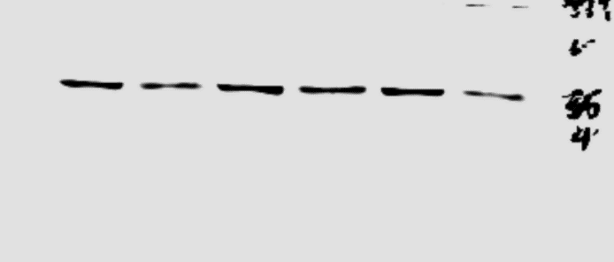
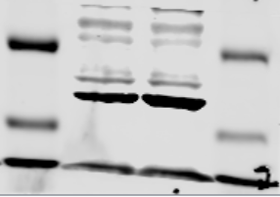
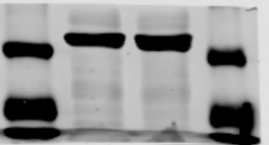
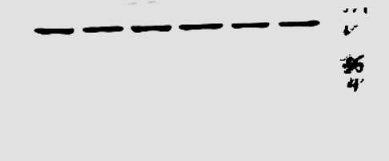
siNC
siNAT10
Figure.3E
NAT10
kDa
170
LDHA
β-actin
130
siNAT10
PFKM
siNC
kDa
siNC
siNAT10
kDa
100
siNC
siNAT10
kDa
70
170
40
siNC
siNAT10
130
40
U2OS
β-actin
kDa
100
35
70
55
55
35
25
40
25
35
siNAT10
siNAT10
siNC
siNAT10
siNC
siNC
kDa
kDa
NAT10
PFKM
LDHA
kDa
170
130
170
130
100
35
100
143B
70
70
siNAT10
55
siNC
siNAT10
siNC
siNC
siNAT10
kDa
β-actin
kDa
β-actin
kDa
β-actin
55
40
35
40
35
35

Slide 6
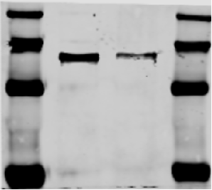
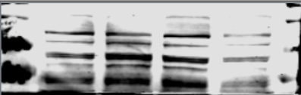
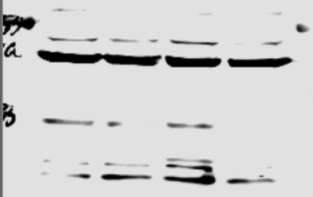
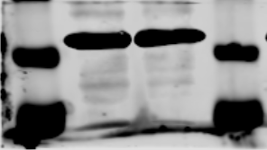
Figure.4C
U2OS
143B
siNC
siNC
siYTHDC1
kDa
siYTHDC1
kDa
YTHDC1
170
YTHDC1
170
130
130
100
100
70
70
siNC
siYTHDC1
55
β-actin
55
siNC
siYTHDC1
β-actin
kDa
40
40
35
35

Slide 7
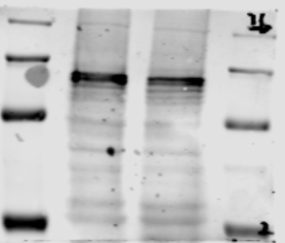
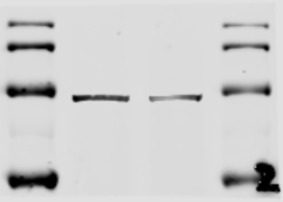
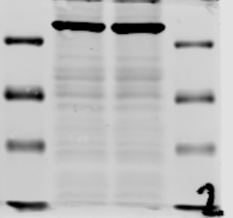
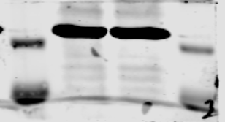
Figure.5D
U2OS
143B
siNC
siYTHDC1
siNC
siYTHDC1
kDa
YTHDC1
kDa
YTHDC1
170
170
130
130
100
100
70
70
55
55
siNC
siYTHDC1
kDa
siNC
siYTHDC1
β-actin
kDa
40
β-actin
40
35
25
35
15

Slide 8
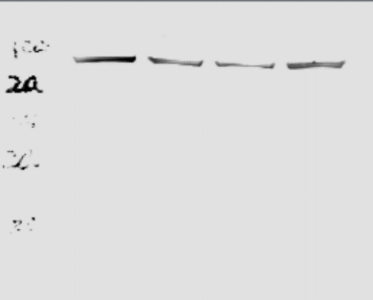
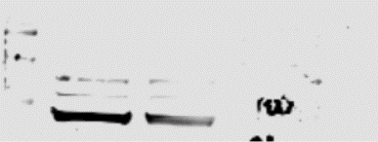
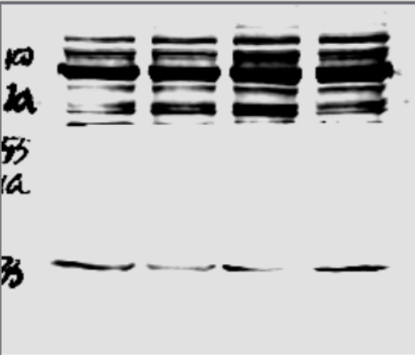
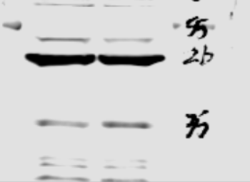
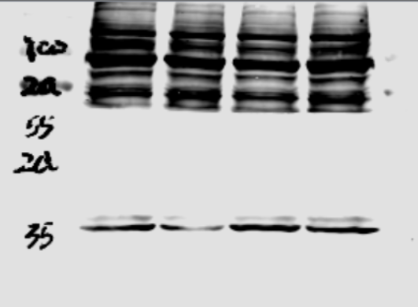
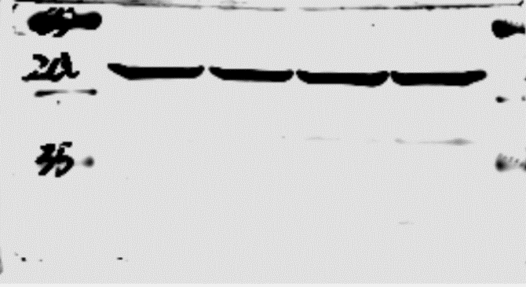
Figure.5D
siYTHDC1
U2OS
siNC
143B
143B
kDa
siYTHDC1
PFKM
siNC
siYTHDC1
siNC
PFKM
100
kDa
kDa
70
170
LDHA
55
130
100
40
100
55
35
siYTHDC1
40
siNC
siYTHDC1
β-actin
siNC
55
35
kDa
LDHA
40
100
siYTHDC1
70
35
siNC
55
kDa
40
β-actin
55
35
40
kDa
35
β-actin
55
40
35

Slide 9
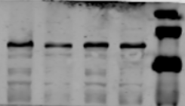
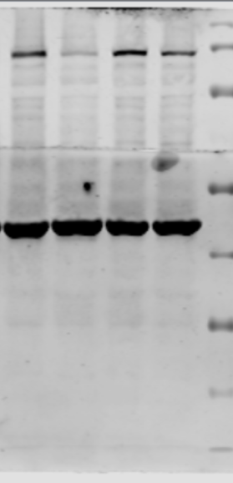
Lenti-
shNAT10
Lenti-shNAT10
+ Lenti-YTHDC1
Figure 6G
CHX (hrs)
0
0
8
8
NAT10
kDa
170
130
100
70
YTHDC1
170
130
100
70
55
β-actin
40
35
25
15

Slide 10
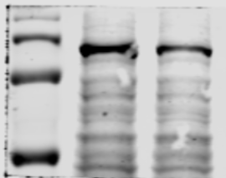
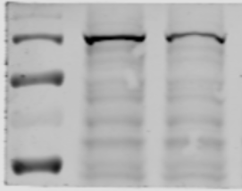
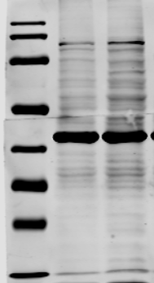
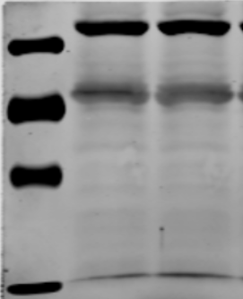
Supplementary Figure 2A、B
Lenti-empty
Lenti-shNAT10
kDa
YTHDC1
170
130
100
70
Lenti-empty
Lenti-YTHDC1
55
kDa
NAT10
170
YTHDC1
130
170
130
100
100
70
70
55
55
β-actin
β-actin
40
40
35
35
25
25
15
15

