Slide 1
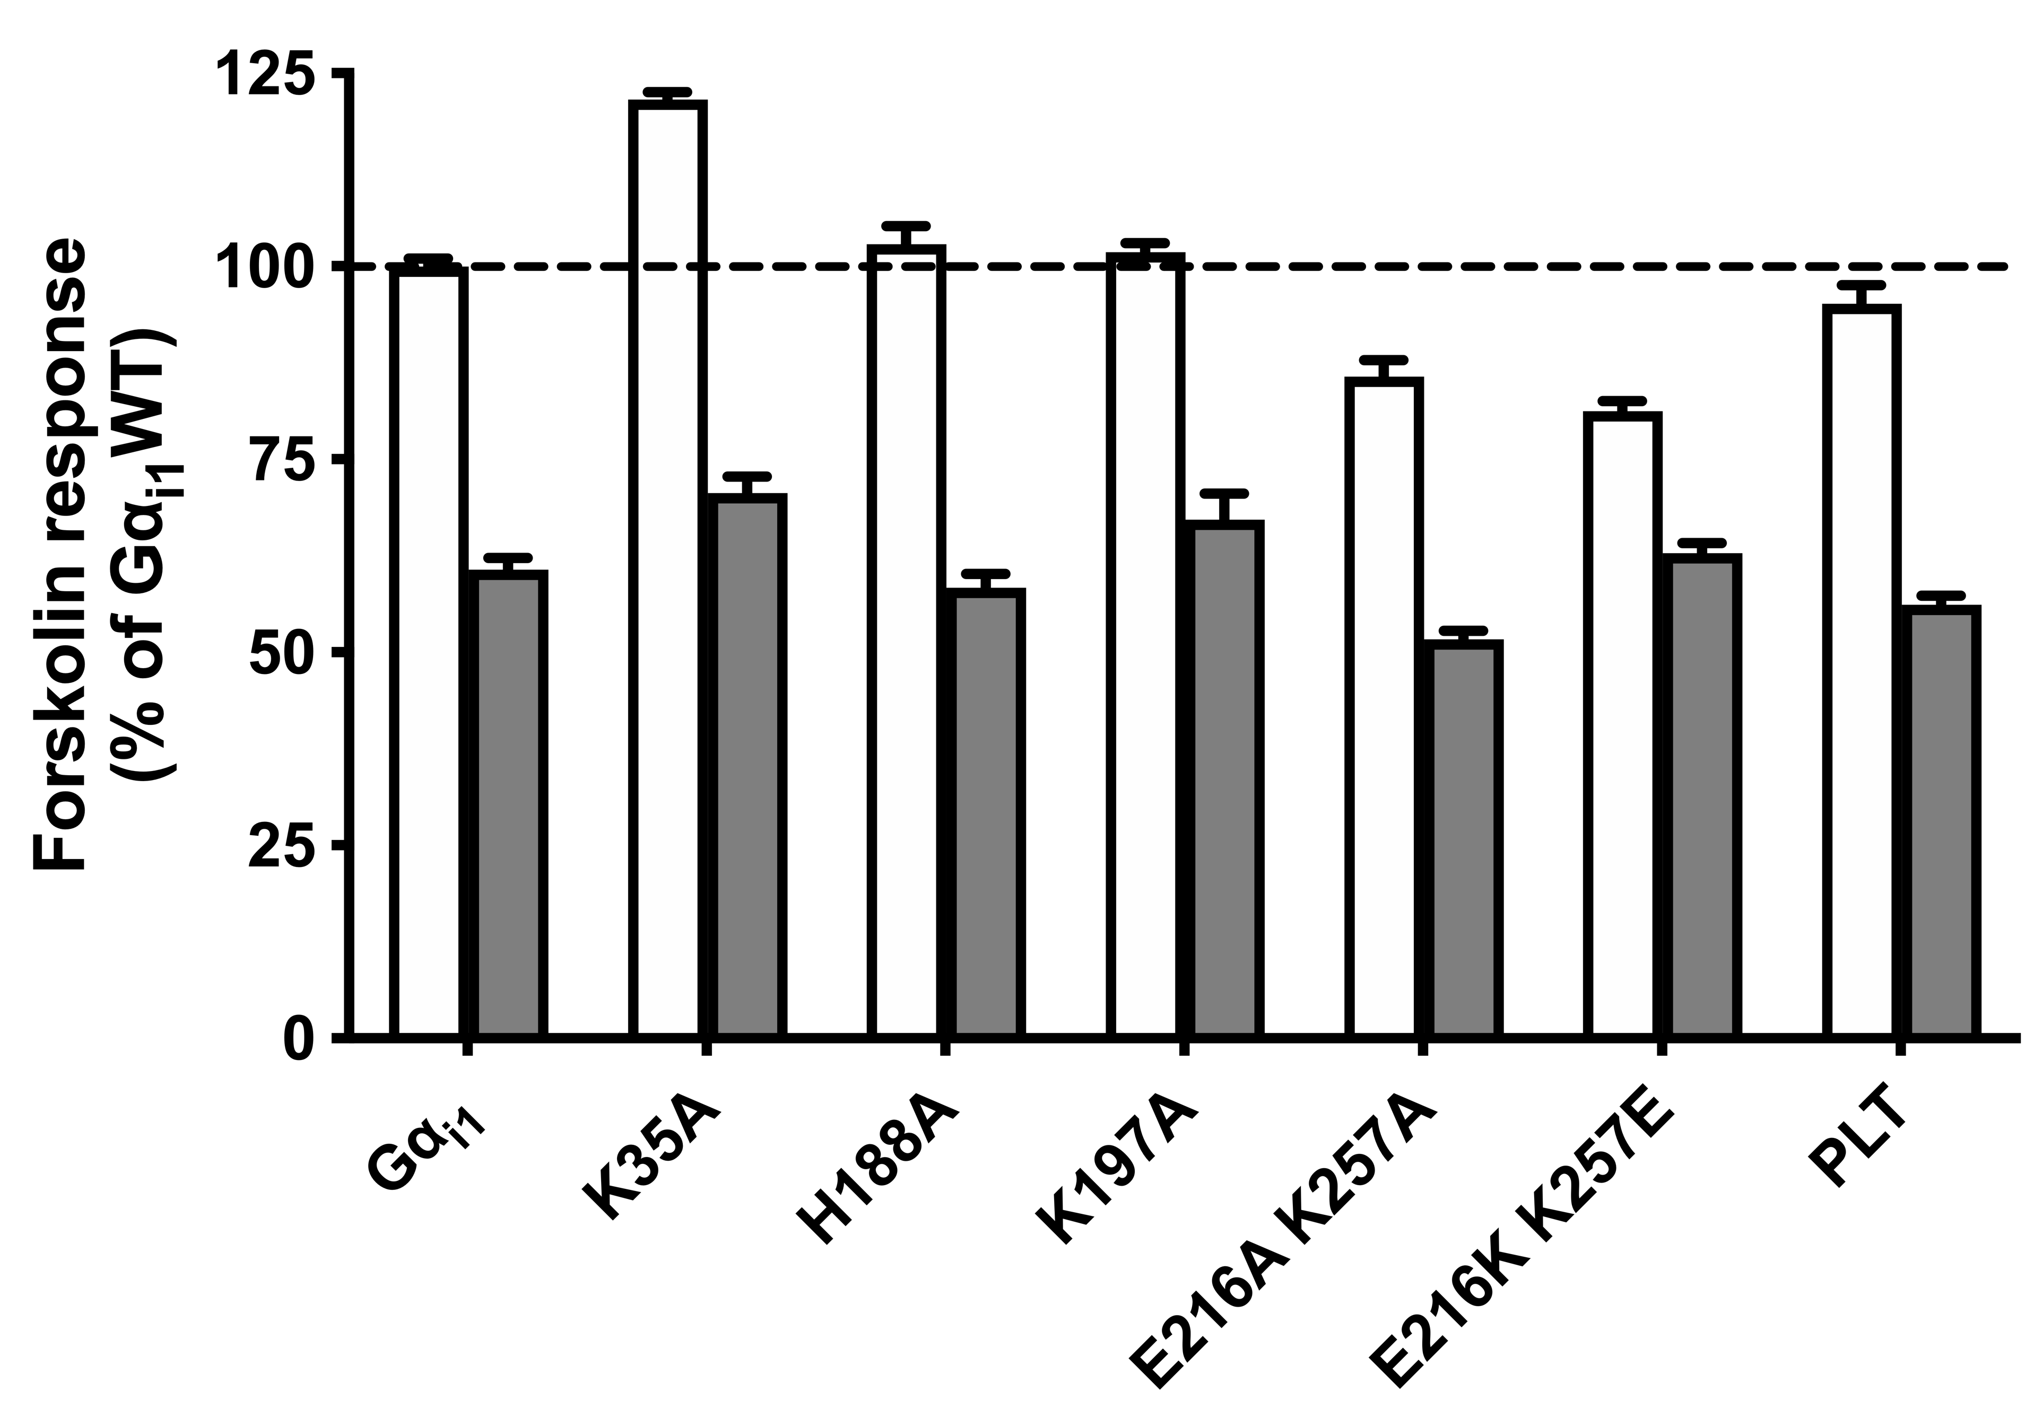
†
#
WT
QL
†
†
†
†
†
†
*
*
Notes:
Fig. S5. Title…???? HEK293 cells were transfected with other QL-bearing Gα_{i1} constructs (not mentioned in the results part) and assayed similarly to Fig. 3B. The relative activities of the constitutively active chimeras are expressed as a percentage of cAMP accumulation of Gα_{i1}. Data shown are mean ± SEM (n=3). Bonferroni t test, p < 0.05; †, significant inhibition, #, significantly higher than the control, *, significantly lower than the control.

