Slide 1
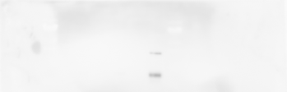
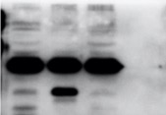
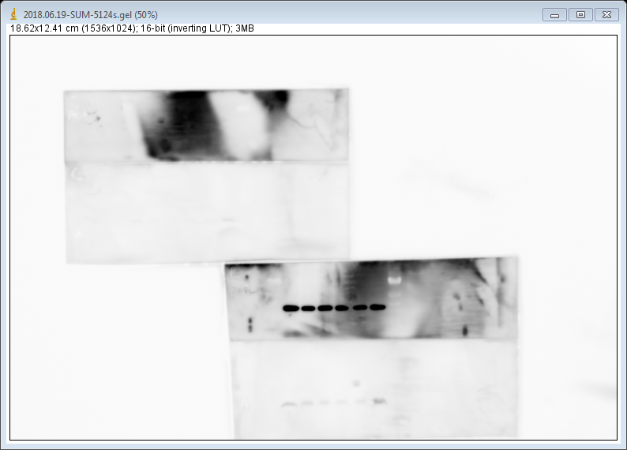
DMSO
SAL
Dar
AA
Enz
Bic
DMSO
SAL
Enz
PSA
*
unspecific
PSA
ANG
Long exposure
Figure S1. The secretion of ANG, a SASP key factor, is differently regulated by AR-agonist and -antagonists.
Figure S1

