Slide 1
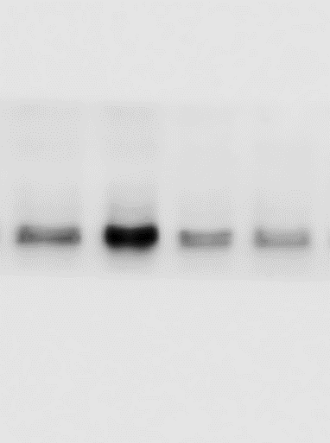
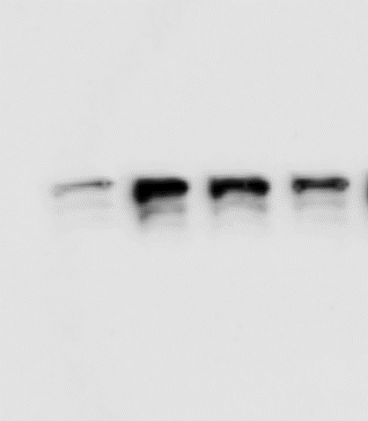
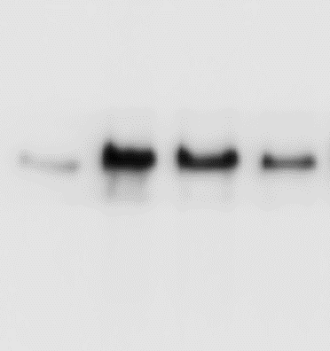
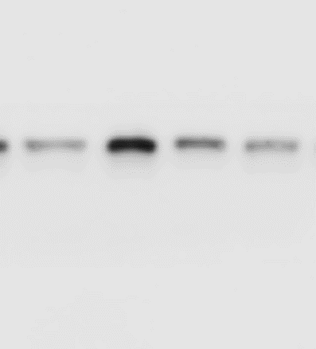
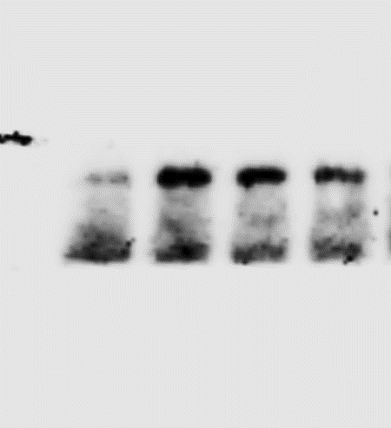
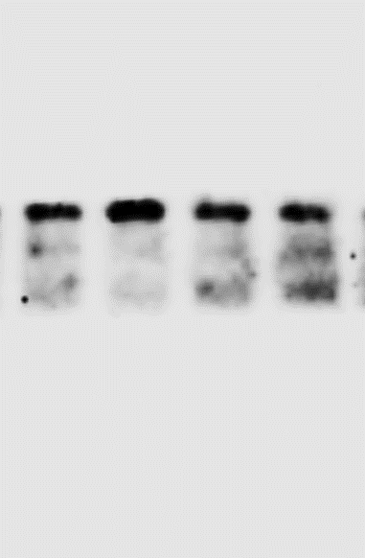
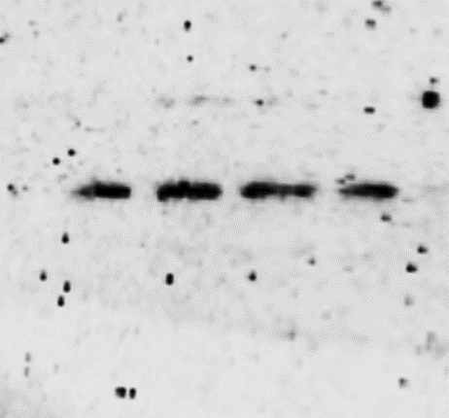
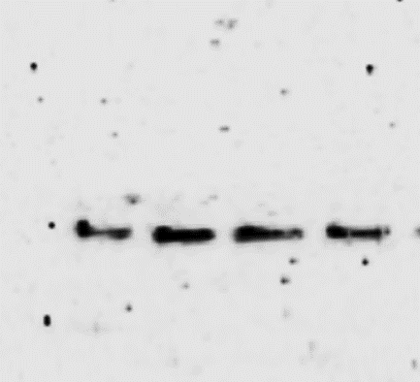
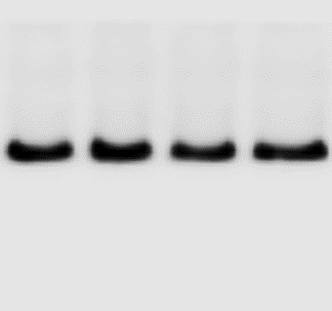

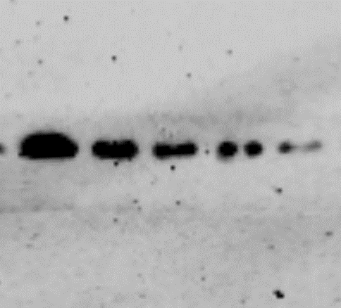
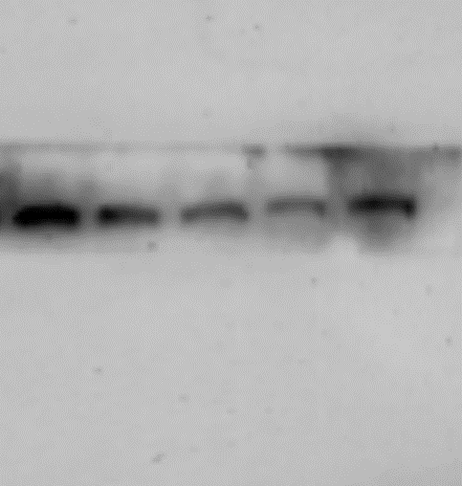
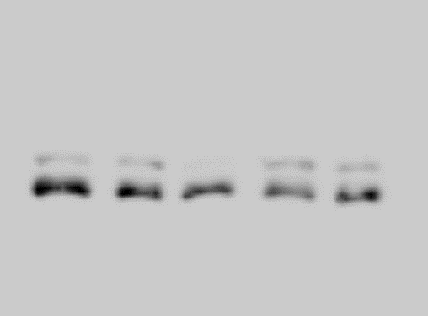

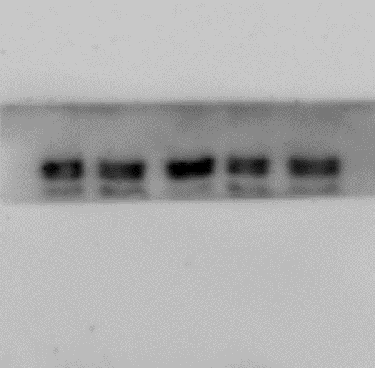
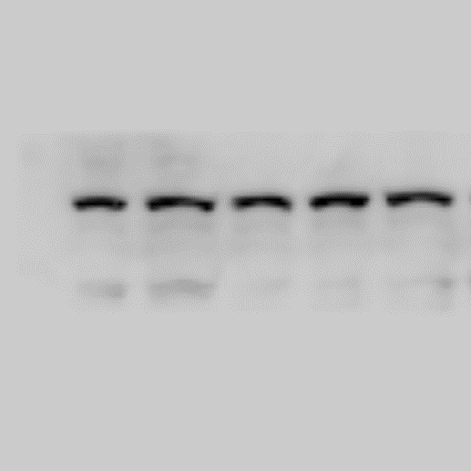
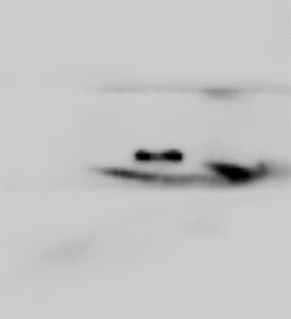
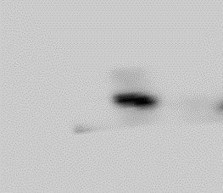
Figure 1F
PTZ
-
+
PTZ
-
+
+
+
PTZ
-
+
+
+
CA
-
-
+
+
CA
-
-
10
20
CA
-
-
10
20
10
20
TNF-α
-35
TNF-α
-35
TNF-α
-35
IL-1β
-40
IL-1β
-40
IL-1β
-40
β-Actin
-40
β-Actin
-40
β-Actin
-40
Figure 2G
LPS
+
LPS
+
+
+
+
+
LPS
+
+
+
+
+
+
+
+
+
CA (μM)
-
-
-
-
-
CA (μM)
-
-
-
50
100
CA (μM)
-
50
100
50
100
-
-
-
-
CA-P (μM)
50
100
-
-
-
CA-P (μM)
50
100
-
-
CA-P (μM)
50
100
TNF-α
-35
TNF-α
-35
TNF-α
-35
IL-1β
-40
IL-1β
-40
IL-1β
-40
β-Actin
-40
β-Actin
-40
β-Actin
-40
Figure 4A
CA
-
-
+
CA
-
-
+
CA
-
-
+
CA-P
-
+
+
CA-P
-
+
+
CA-P
-
+
+
Pull-down-ACOD1
-55
Pull-down-ACOD1
-55
Pull-down-ACOD1
-55

Slide 2
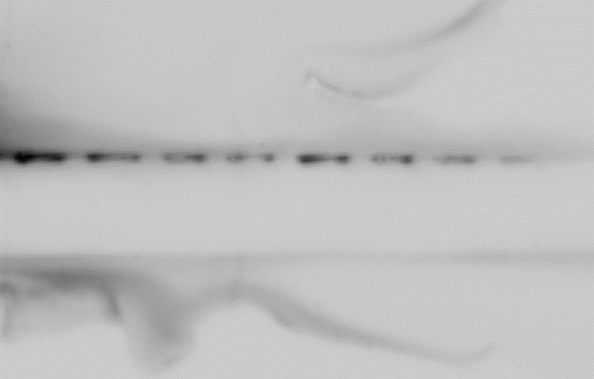
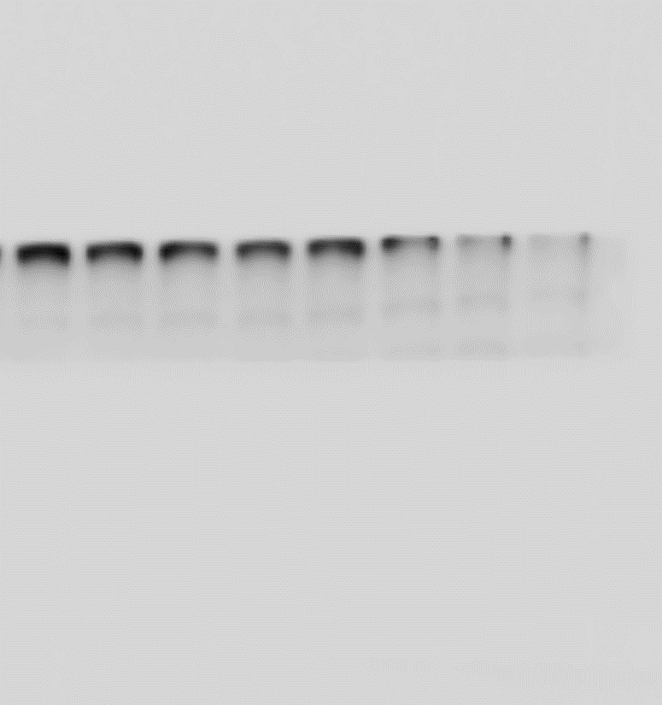
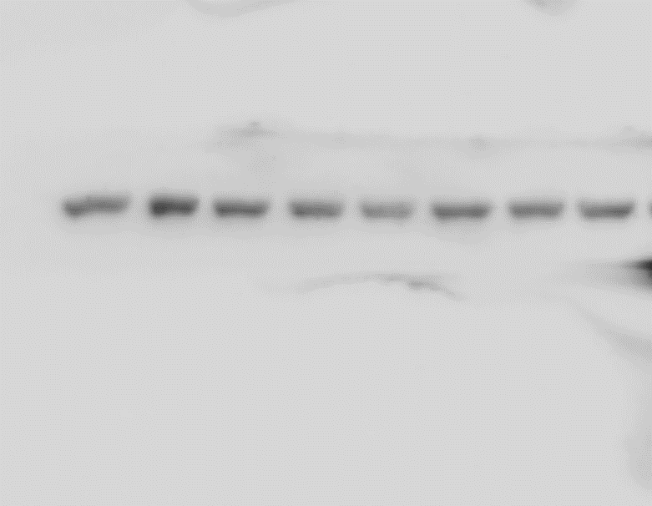
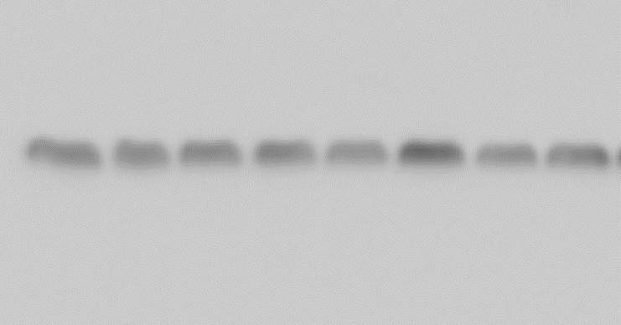
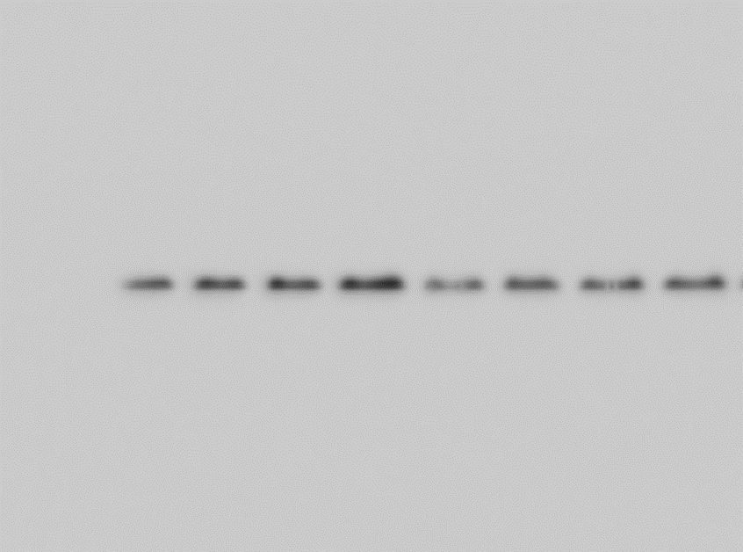
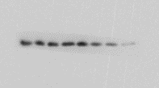
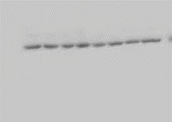
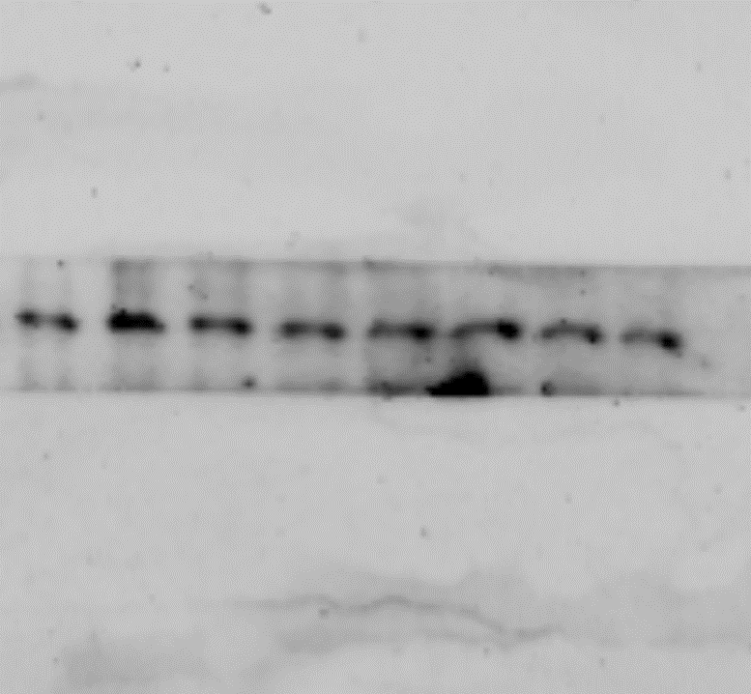

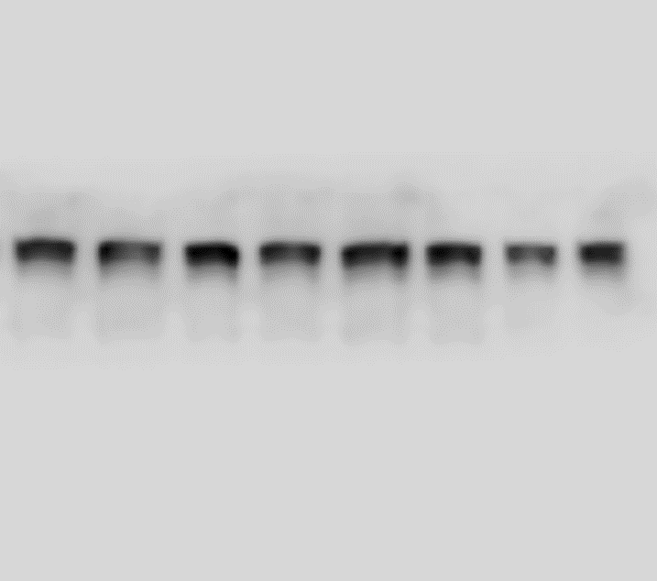
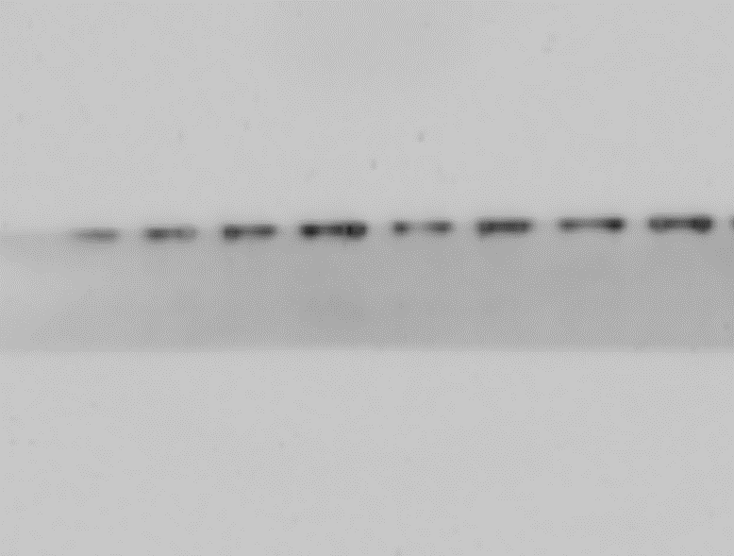
Figure 4E
Temperature （℃）
Temperature （℃）
37 42 47 52 57 62 67 72
37 42 47 52 57 62 67 72
ACOD1
-55
ACOD1
-55
Control
-40
CA
GAPDH
GAPDH
-40
Temperature （℃）
Temperature （℃）
37 42 47 52 57 62 67 72
37 42 47 52 57 62 67 72
ACOD1
-55
ACOD1
-55
Control
-40
CA
GAPDH
GAPDH
-40
Temperature （℃）
Temperature （℃）
37 42 47 52 57 62 67 72
37 42 47 52 57 62 67 72
ACOD1
-55
ACOD1
-55
Control
-40
CA
GAPDH
GAPDH
-40

Slide 3
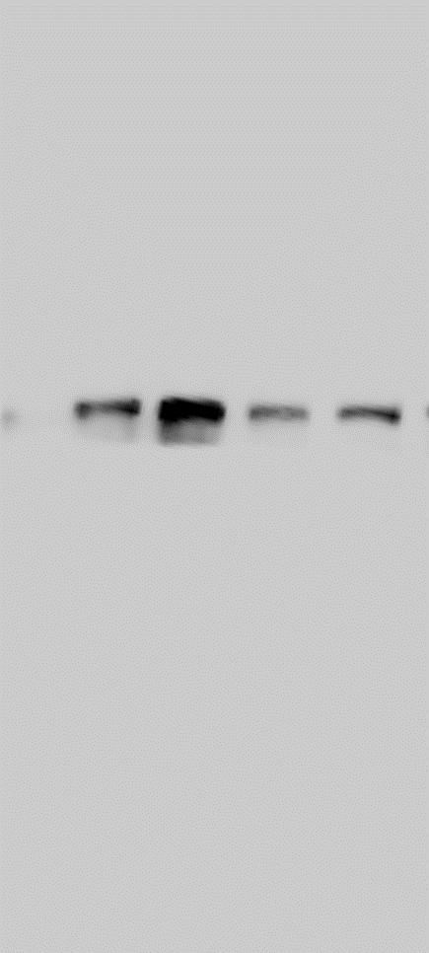

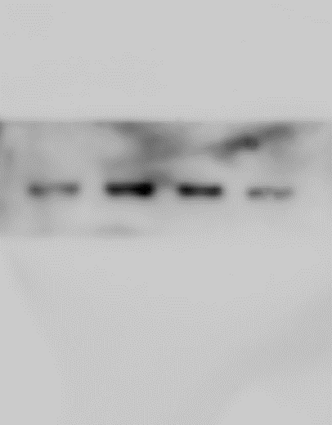

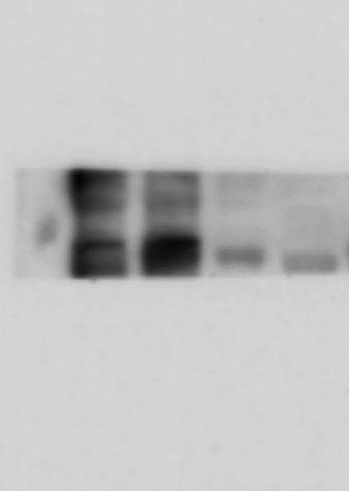
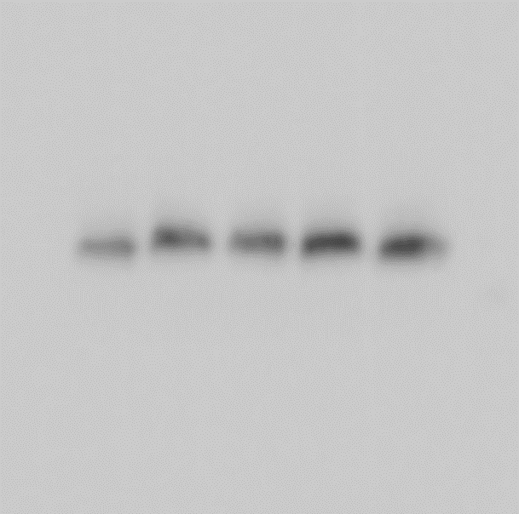
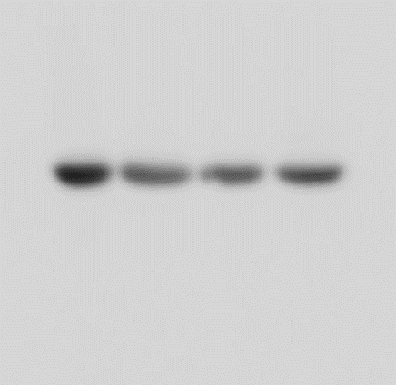
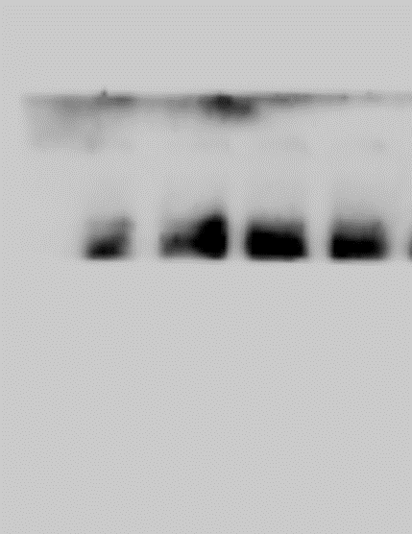
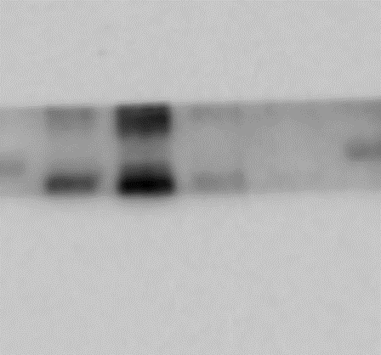


Figure 6A
CA (μM)
-
-
50
100
CA (μM)
-
-
50
100
LPS (1μg/ml)
-
+
+
+
LPS (1μg/ml)
-
+
+
+
TNF-α
TNF-α
-35
-35
p-PERK
-130
p-PERK
-130
NF-κB p65
-70
NF-κB p65
-70
β-Actin
-40
β-Actin
-40
CA (μM)
-
-
50
100
CA (μM)
-
-
50
100
LPS (1μg/ml)
-
+
+
+
LPS (1μg/ml)
-
+
+
+
TNF-α
-35
NF-κB p65
-70
p-PERK
-130
β-Actin
-40

Slide 4
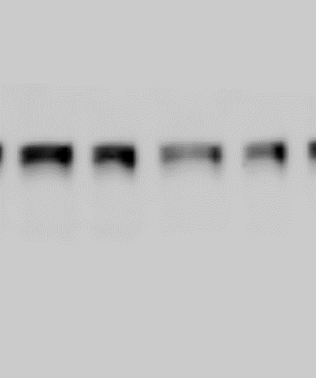
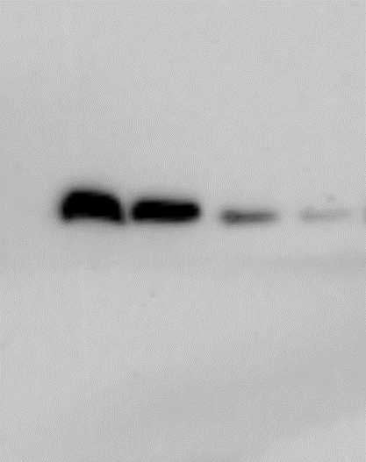
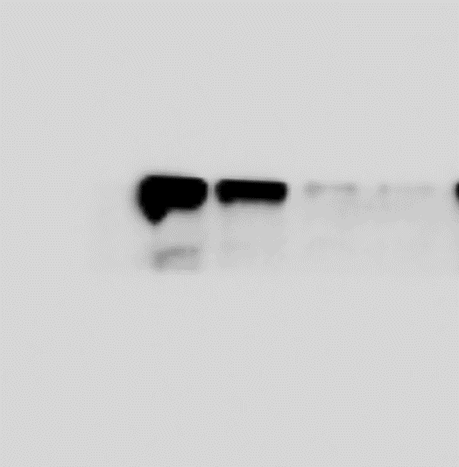
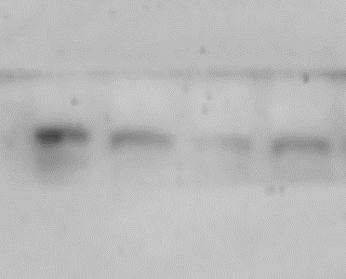
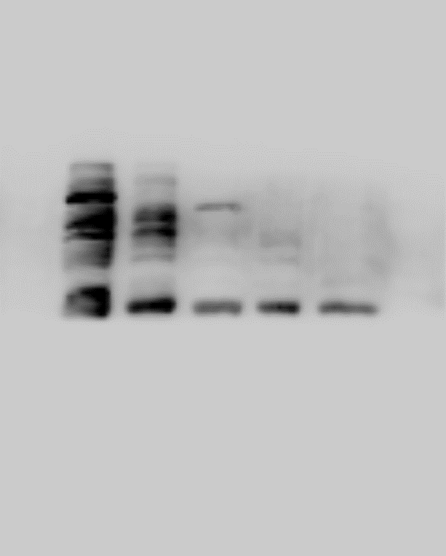
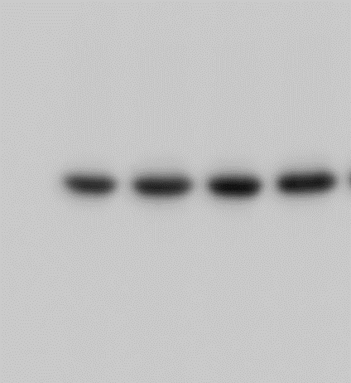

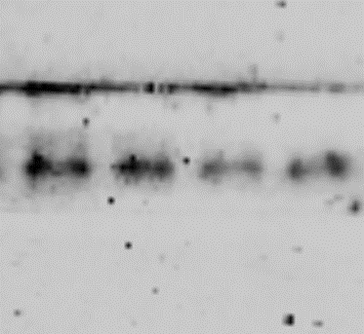
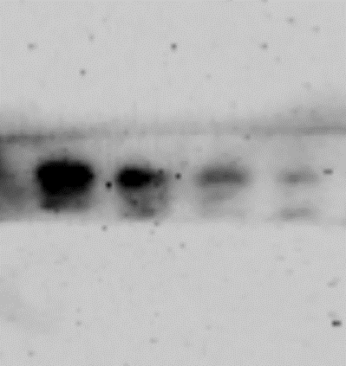
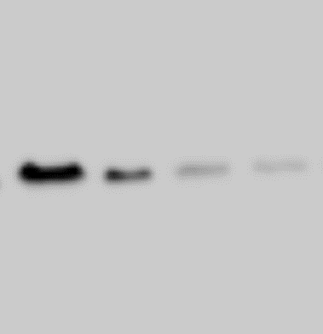
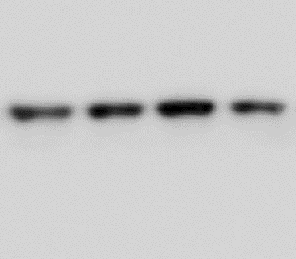
Figure 6E
CA
-
+
-
+
CA
-
+
-
+
ACOD1 SiRNA
-
-
+
+
ACOD1 SiRNA
-
-
+
+
ACOD1
-55
ACOD1
-55
TNF-α
-35
TNF-α
-35
p-PERK
-130
p-PERK
-130
NF-κB p65
-70
NF-κB p65
-70
β-Actin
-40
β-Actin
-40
Figure 6E
CA
-
+
-
+
CA
-
+
-
+
ACOD1 SiRNA
-
-
+
+
ACOD1 SiRNA
-
-
+
+
p-PERK
-130
ACOD1
-55
NF-κB p65
-70
TNF-α
-35
β-Actin
-40

