Slide 1
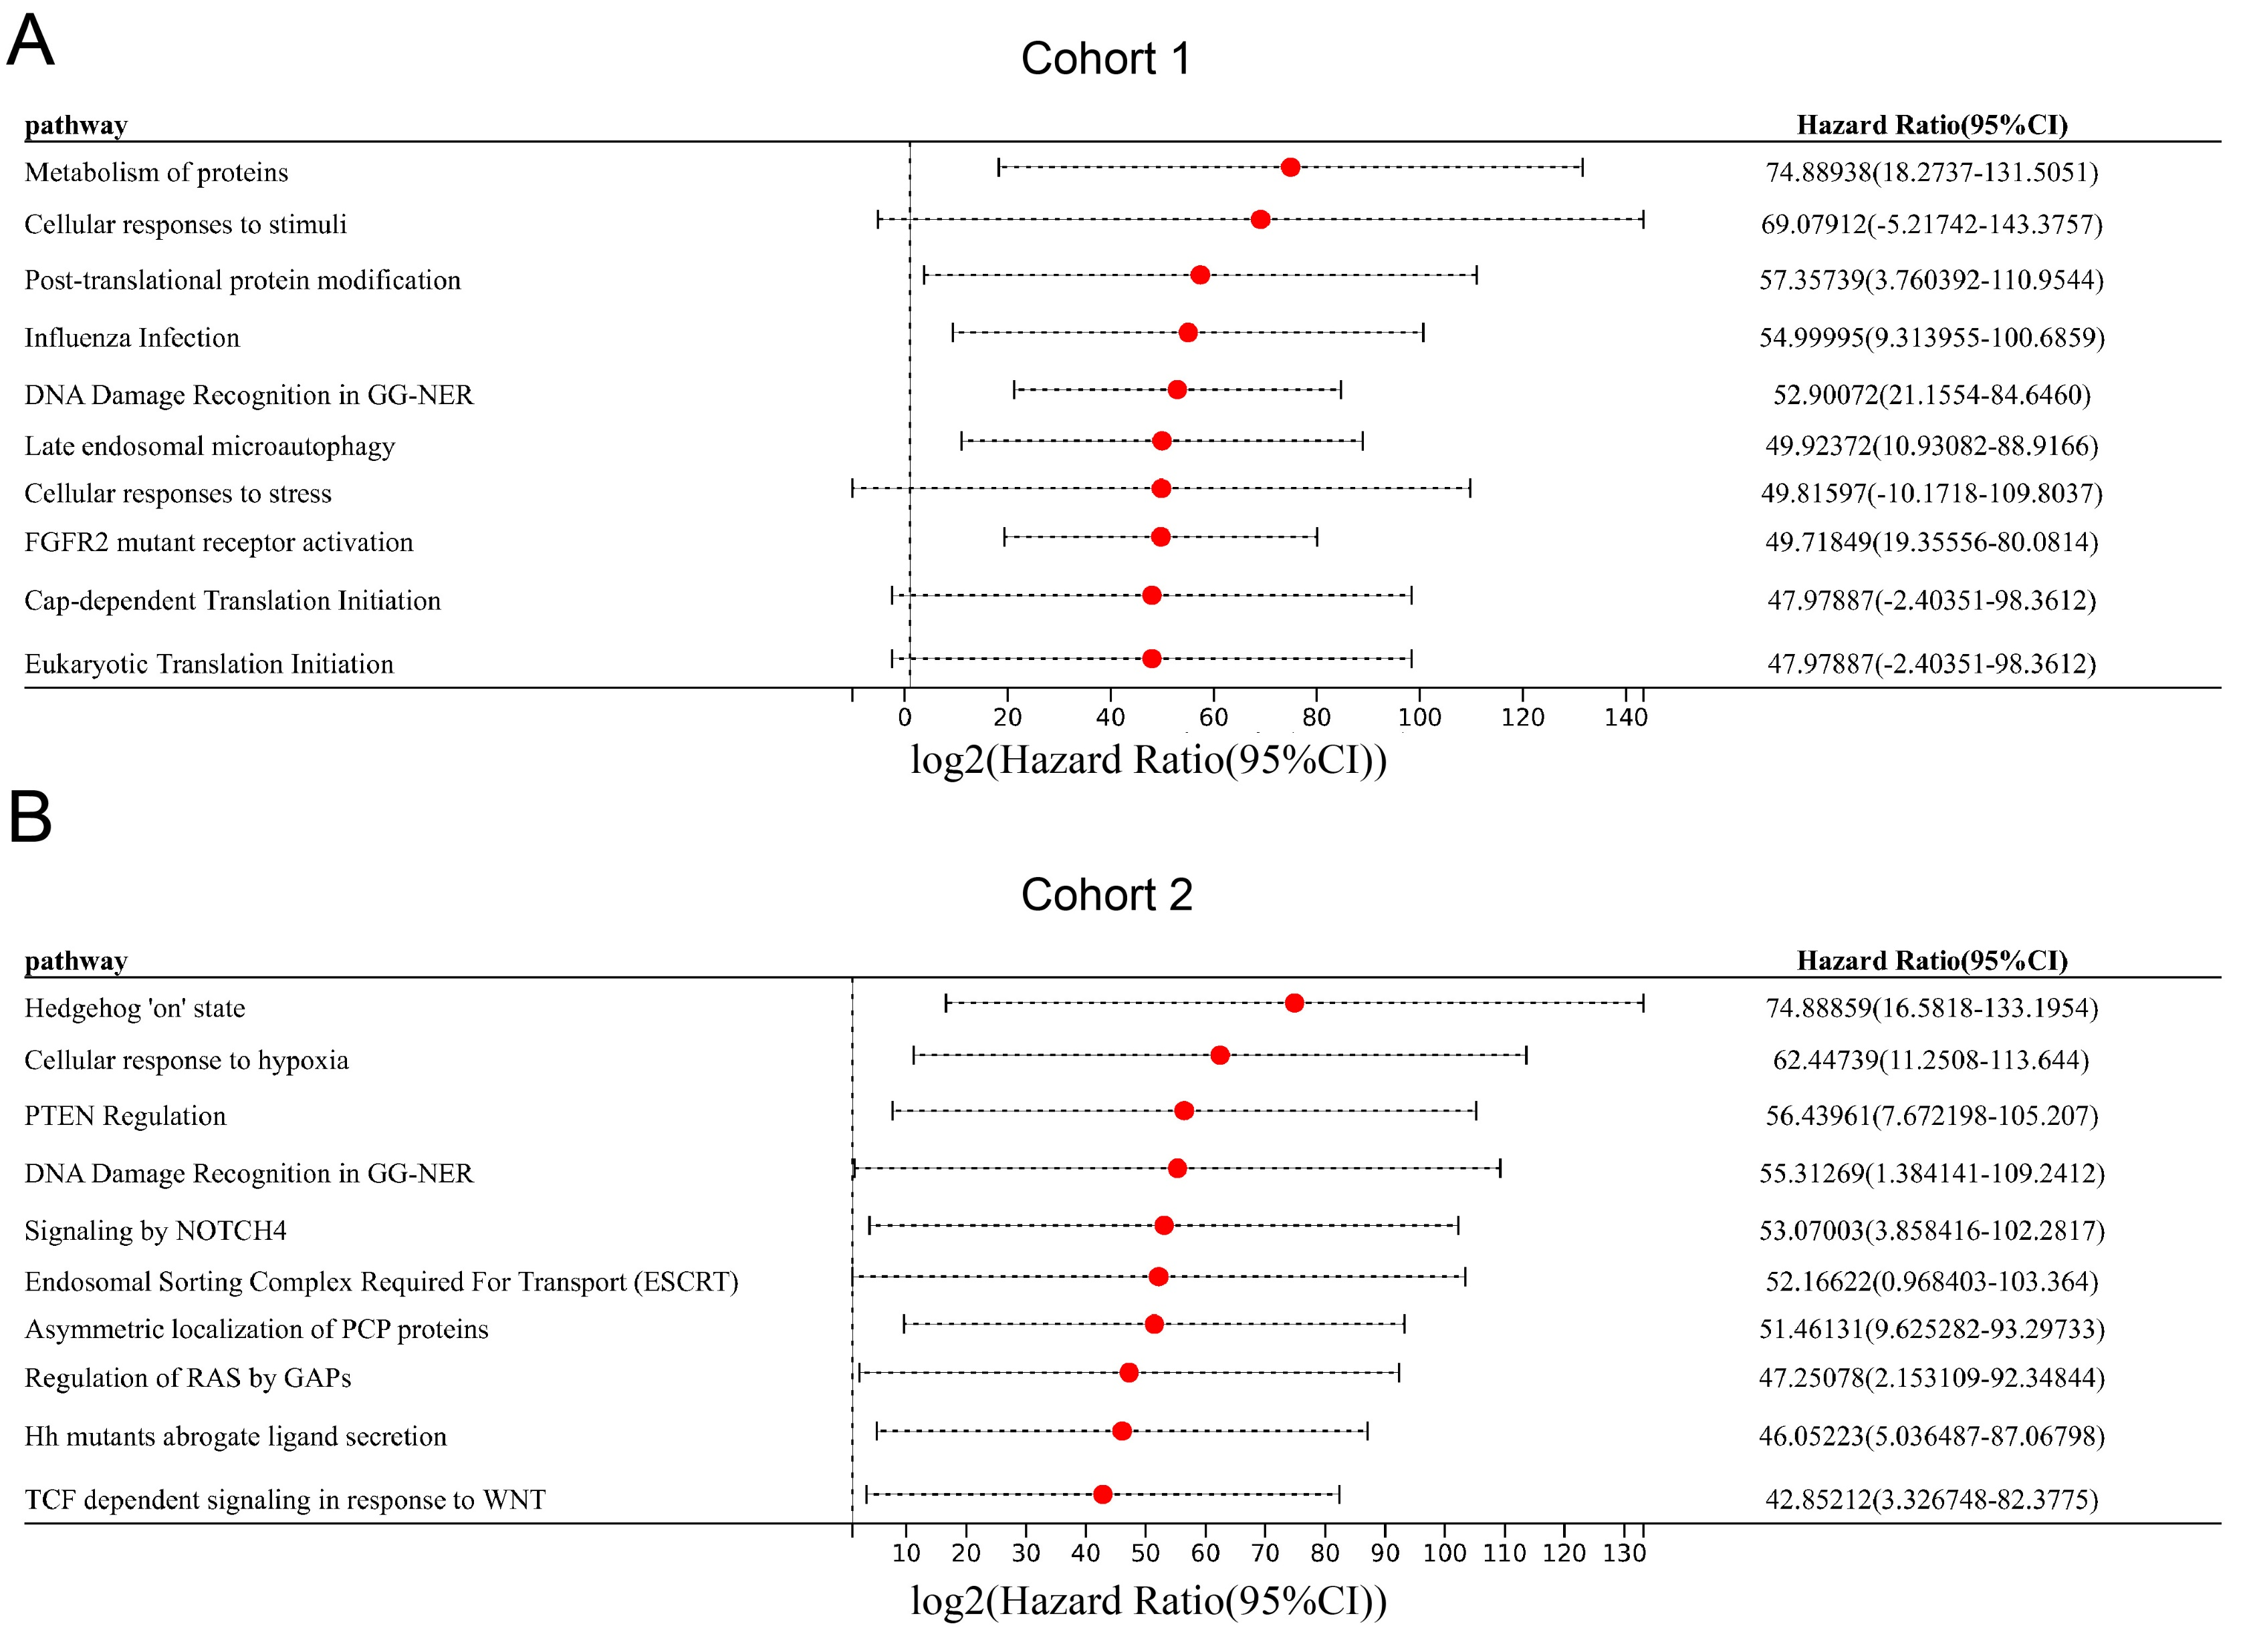
Supplementary Figure 1. Analysis of hazardous signaling pathways in cohort 1 and cohort 2. A. Forrest plot analysis of TOP 10 risk signaling pathways in cohort 1. B. Forrest plot analysis of TOP 10 risk signaling pathways in cohort 2.

Slide 2
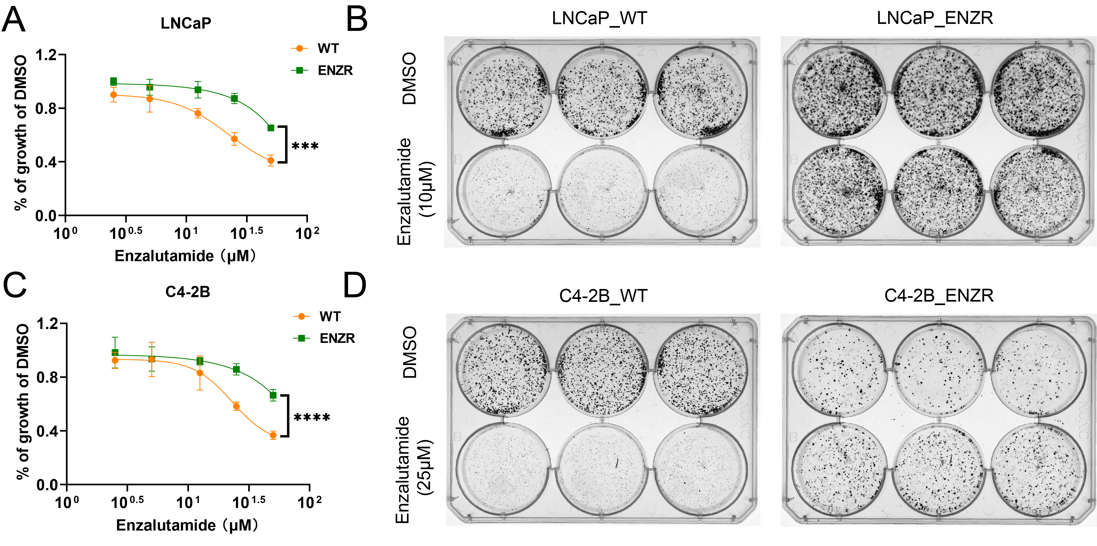
Supplementary Figure 2. Validation of enzalutamide-resistant prostate cancer cell lines. A&B. CCK-8 and plate cloning assays to detect the sensitivity to enzalutamide between Wild-type and resistant LNCaP cell lines. C&D. CCK-8 and plate cloning assays to detect the sensitivity to enzalutamide between Wild-type and resistant C4-2B cell lines.

Slide 3
A
B
Supplementary Figure 3. Inhibitory role of HAMNO on Enzalutamide-resistant PCa cell lines. A&B. CCK-8 assay to detect the inhibitory effects of the GG-NER inhibitor HAMNO on LNCaP_ENZR and C4-2B_ENZR cells.

Slide 4
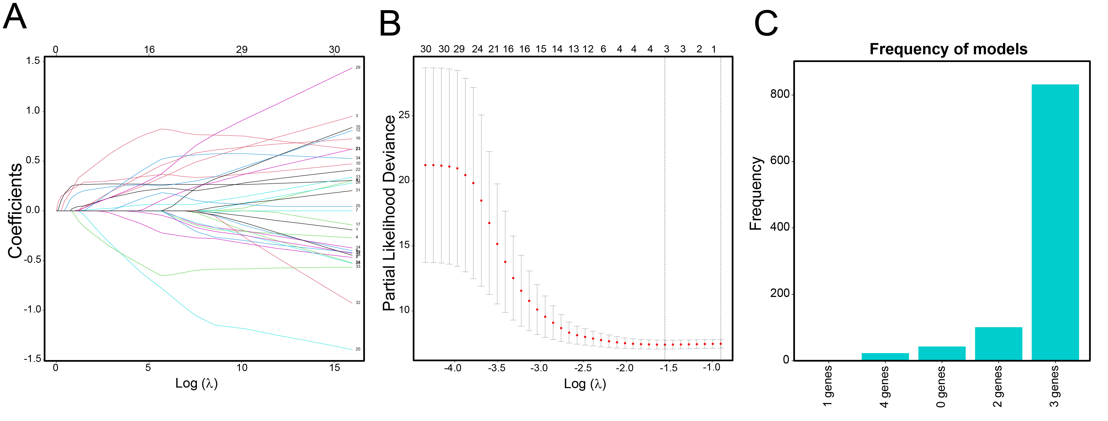
Supplementary Figure 4. Construction of NECGS model for ARSI response in cohort 1. A. Process of variable selection in LASSO regression with 10-fold cross-validation. B. Partial likelihood deviance in every lambda of LASSO regression. C. Frequency of models with different variables.

Slide 5
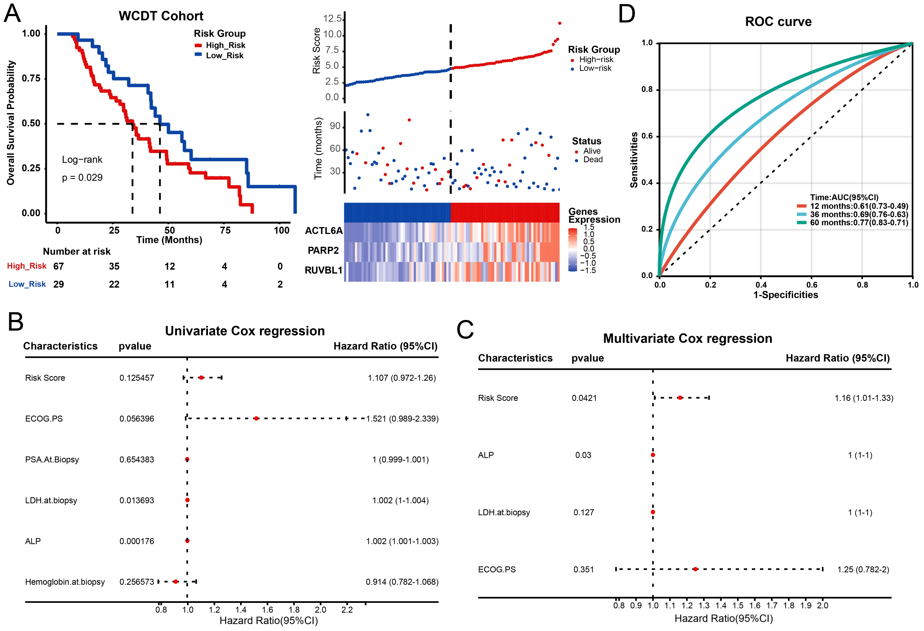
Supplementary Figure 5. Validation of the NECGS model in the WCDT cohort. A. Kaplan-Meier plots and risk curves demonstrating the association between NECGS scores and overall survival. B&C. Univariate and multivariate Cox regression analyses assessing the impact of NECGS on prognosis within this cohort. D. ROC curve analysis illustrating the predictive accuracy of NECGS for patient prognosis.

Slide 6
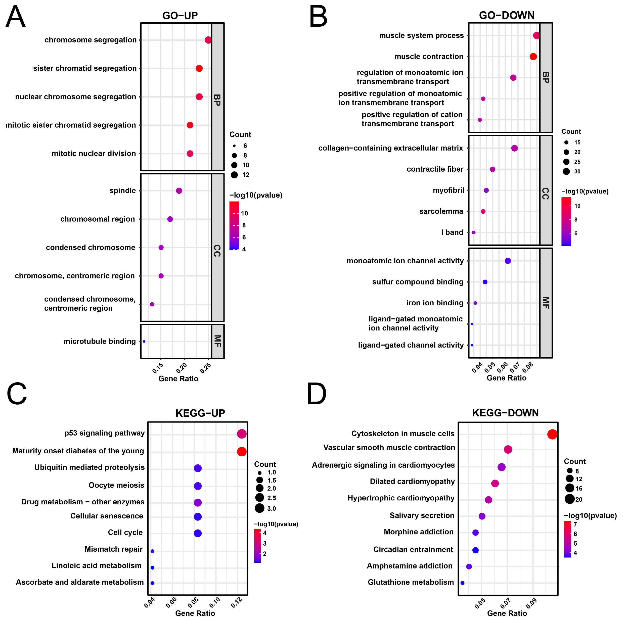
Supplementary Figure 6. Functional enrichment analysis in TCGA-PRAD. A&B. GO analysis of upregulated and downregulated pathways in the high-risk group, categorized by biological process (BP), cellular component (CC), and molecular function (MF). C&D. KEGG analysis of upregulated and downregulated pathways in the high-risk group.

Slide 7
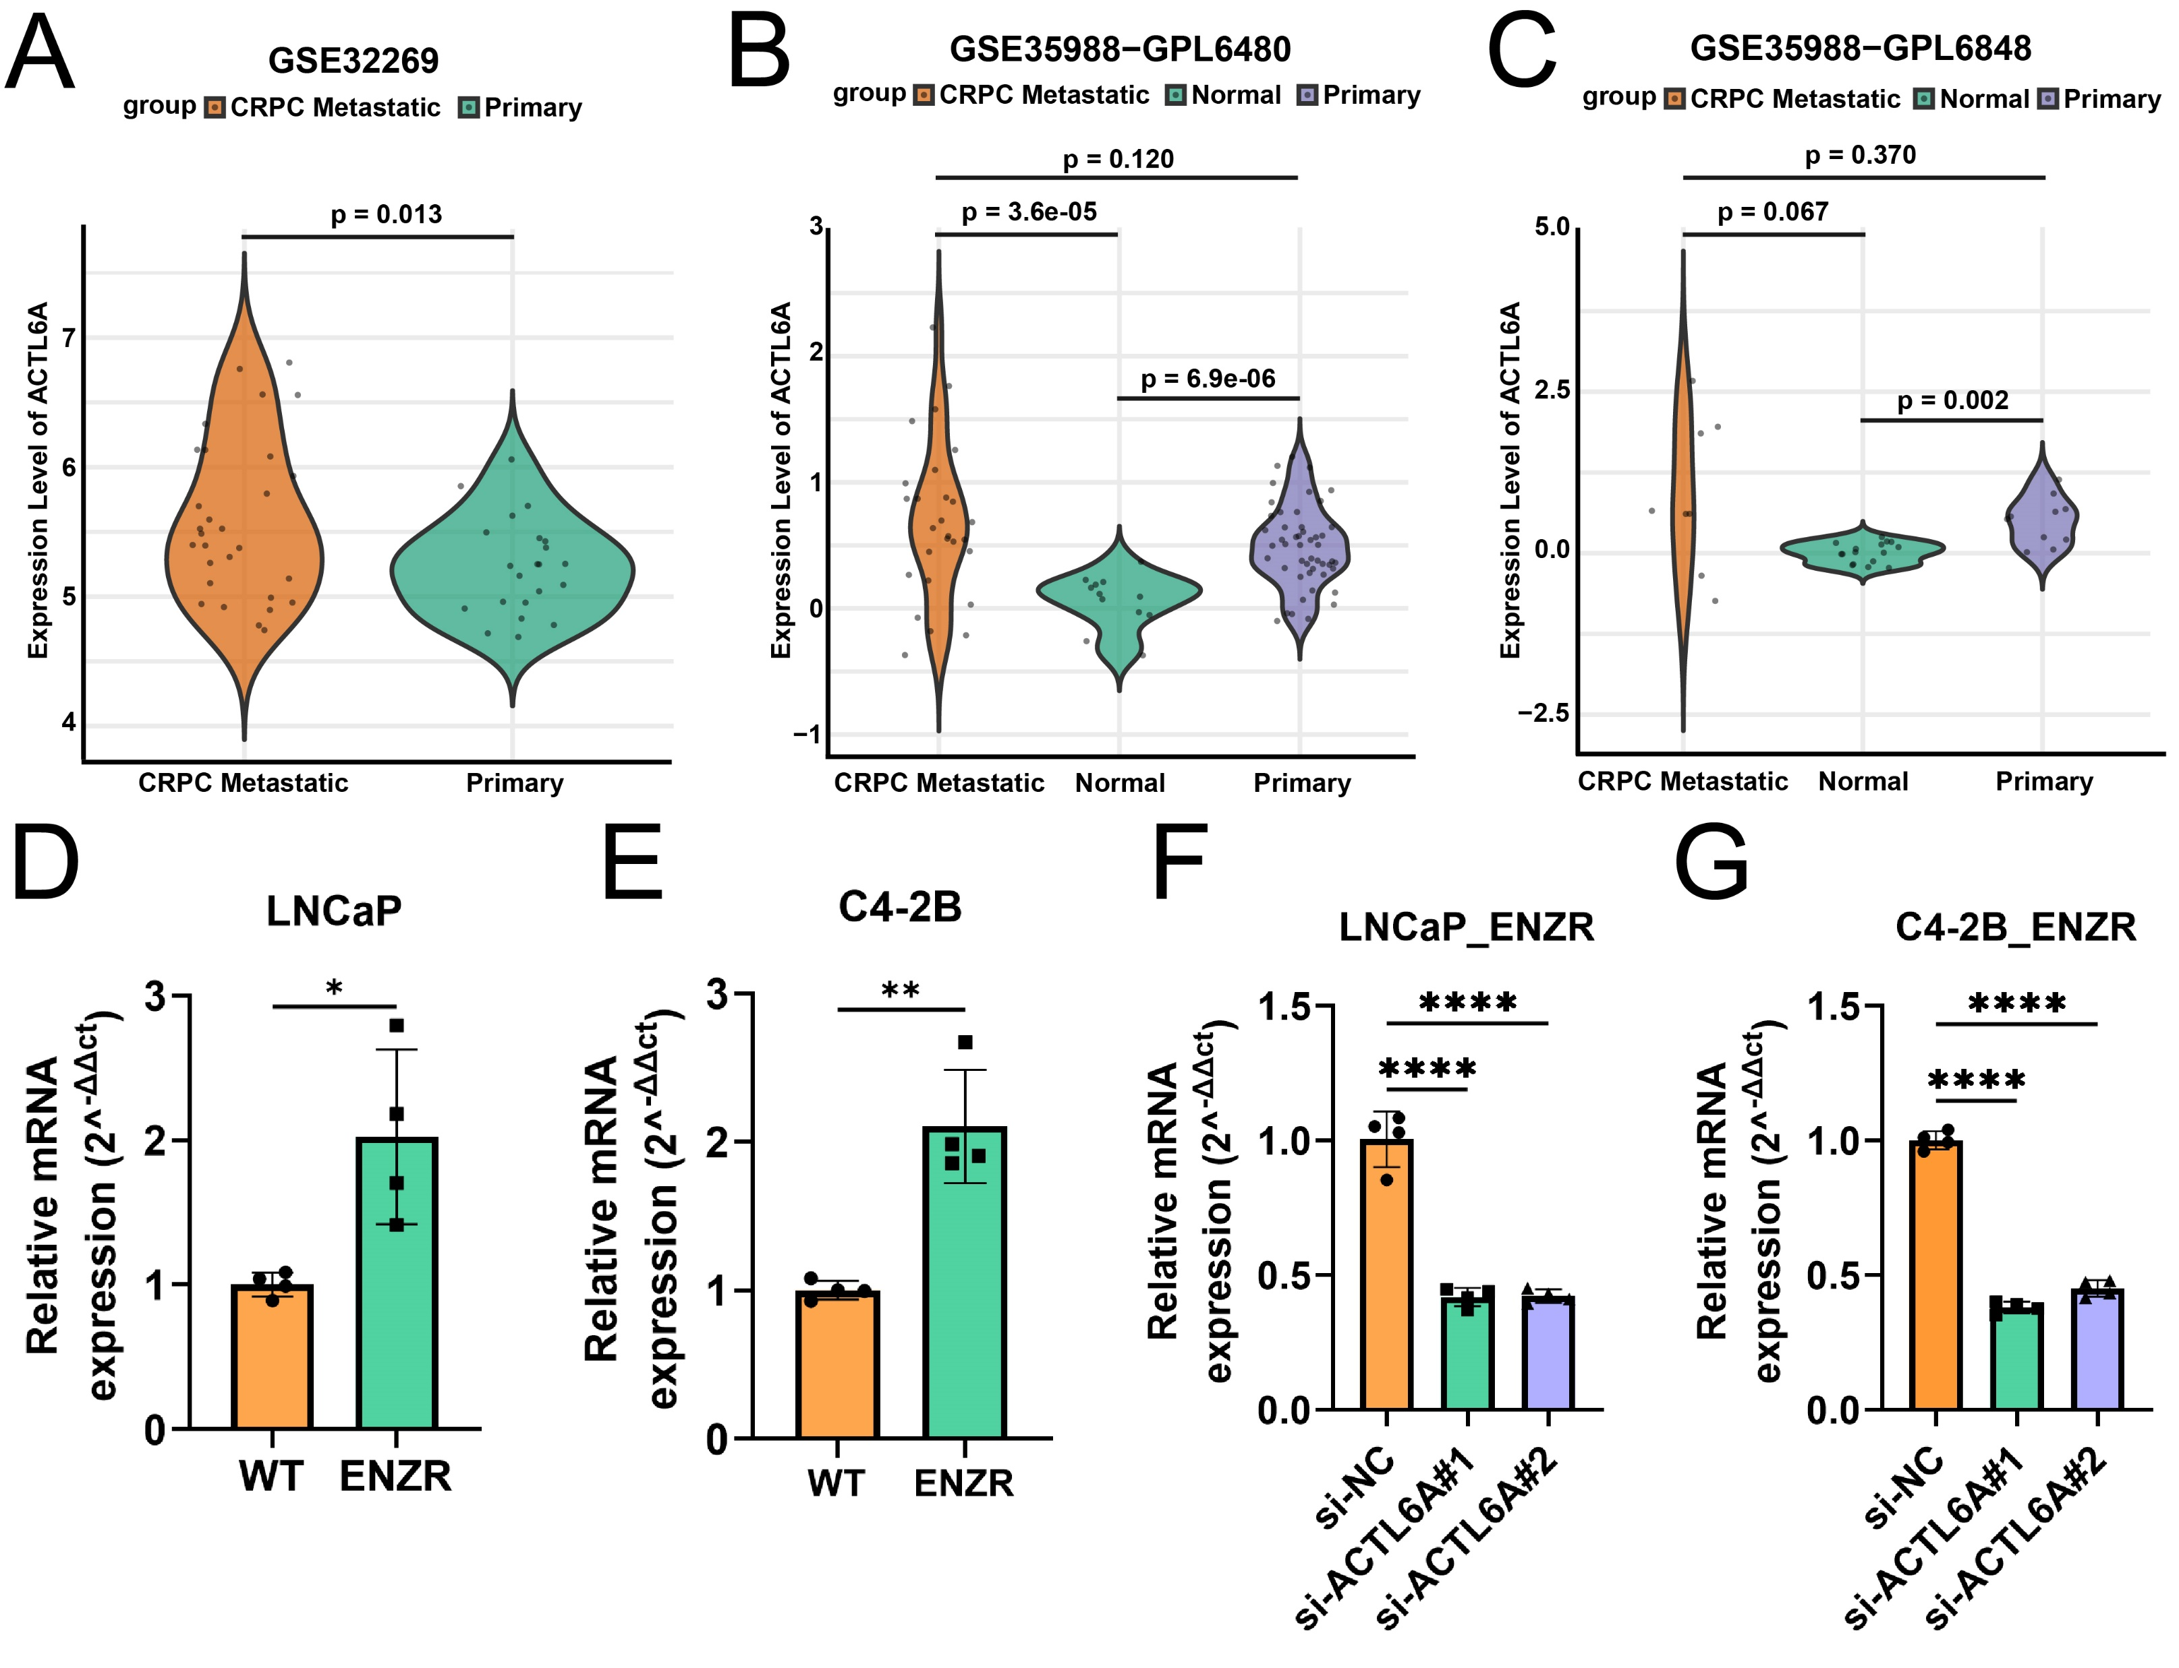
Supplementary Figure 7. Expression analysis of ACTL6A and validation of its knockdown efficiency. A-C. Expression levels of ACTL6A across normal prostate tissue, primary prostate cancer (PCa), and metastatic castration-resistant prostate cancer (CRPC) from datasets GSE32269 and GSE35988 (GPL6480, GPL6848). D&E. Differential expression of ACTL6A between wild-type and enzalutamide-resistant cell lines (LNCaP/C4-2B WT vs. ENZR). F&G. Validation of ACTL6A knockdown efficiency using siRNA in LNCaP_ENZR and C4-2B_ENZR cells.

Slide 8
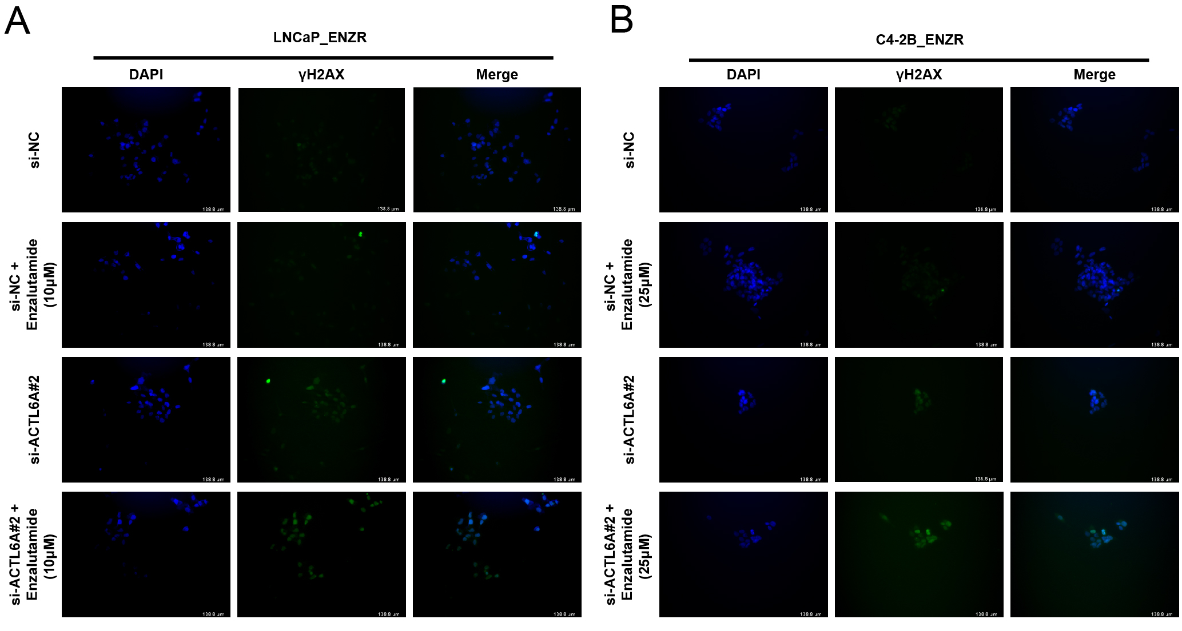
Supplementary Figure 8. Detection of γH2AX expression following ACTL6A knockdown with or without enzalutamide treatment. A&B. Immunofluorescence detection of the DNA damage marker γH2AX in LNCaP_ENZR and C4-2B_ENZR cells following ACTL6A knockdown and enzalutamide treatment.

Slide 9
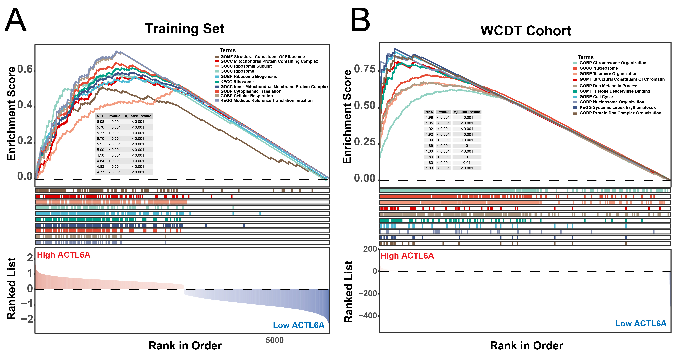
Supplementary Figure 9. Functional enrichment analysis of ACTL6A in the training set and WCDT cohort. A&B. GSEA analysis of enriched signaling pathways in high-ACTL6A groups within the training set and WCDT cohort.

