Slide 1
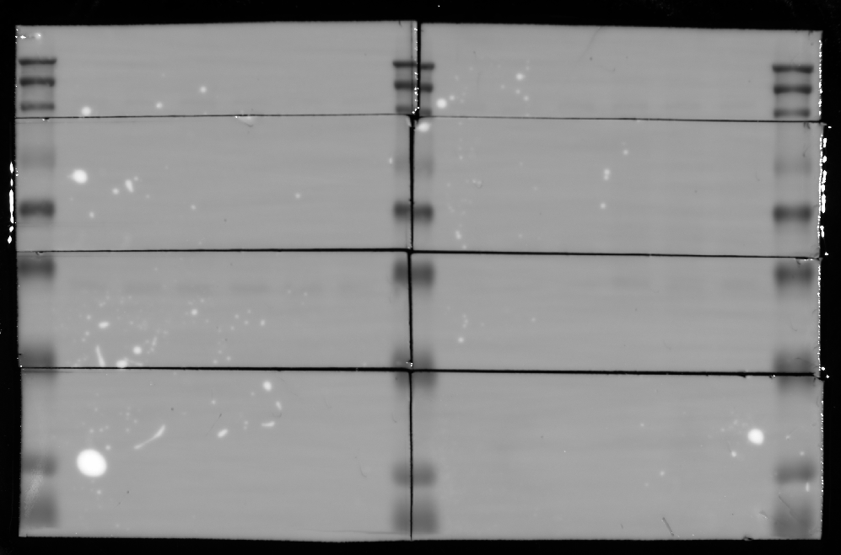
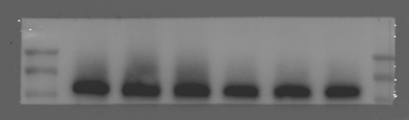
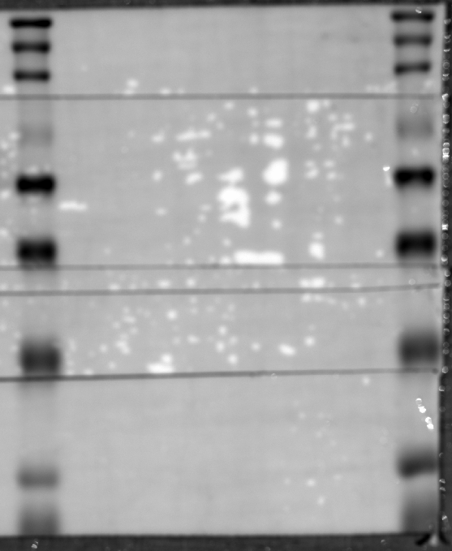
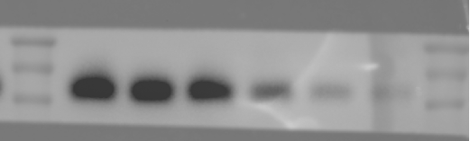
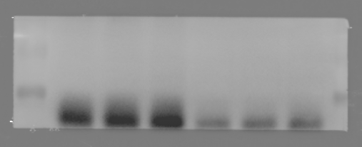
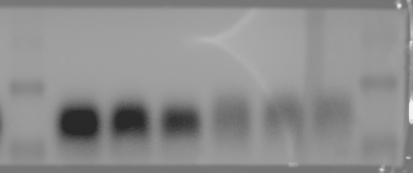
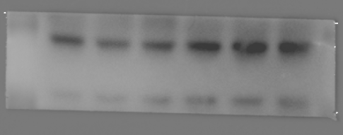
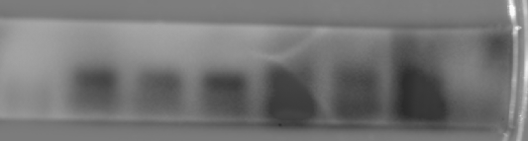
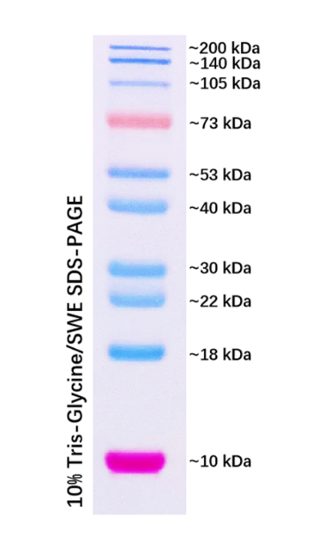
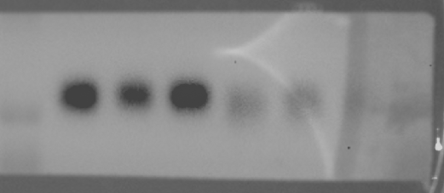
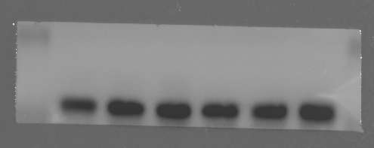
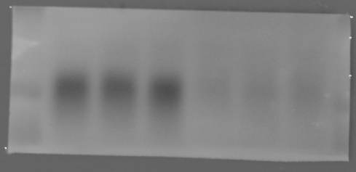
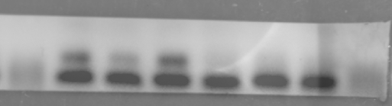
Figure 1F
Figure 1H
Sham
CLP
Sham
CLP
BSEP
BSEP
FXR
FXR
MyD88
MyD88
FGF15
GAPDH
GAPDH
FGF15

Slide 2
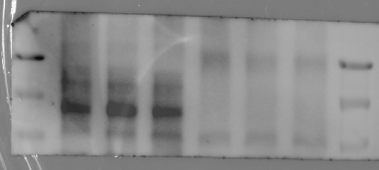
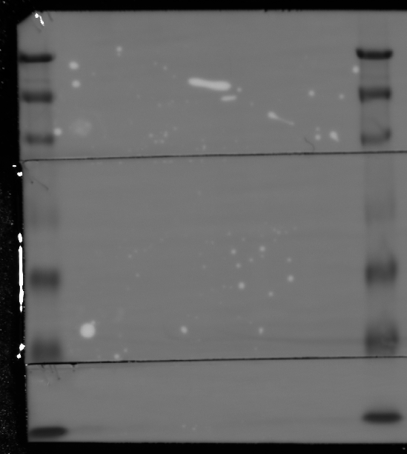
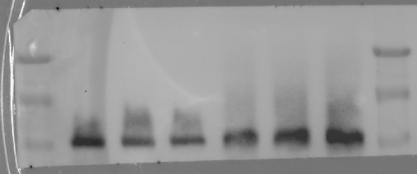
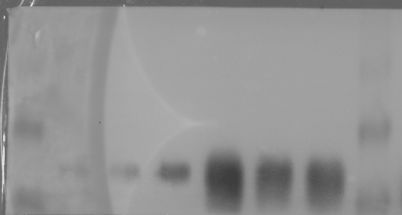
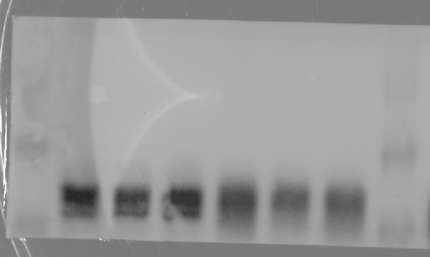
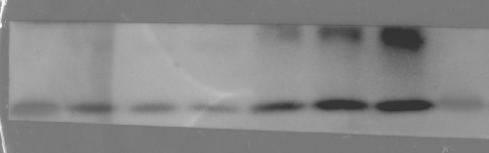
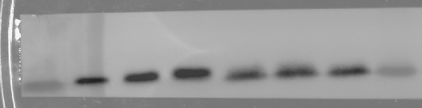
Figure 2C
Sham
CLP
ZO-1
CD45
cyp7α1
FXR
MyD88
GAPDH

Slide 3
Figure 4A
Sham
CLP
ZO-1
CD45
cyp7α1
FXR
MyD88
GAPDH

Slide 4
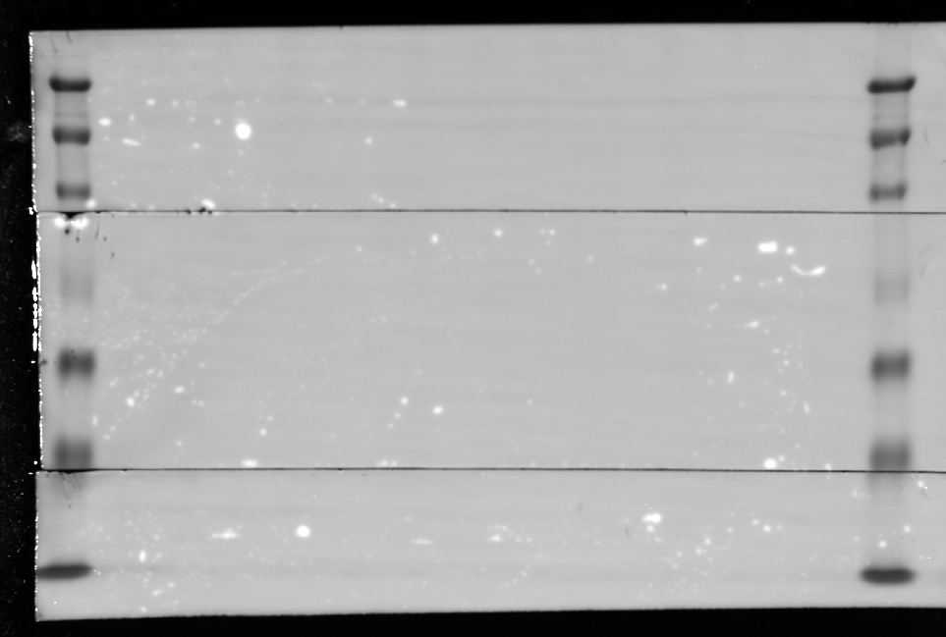
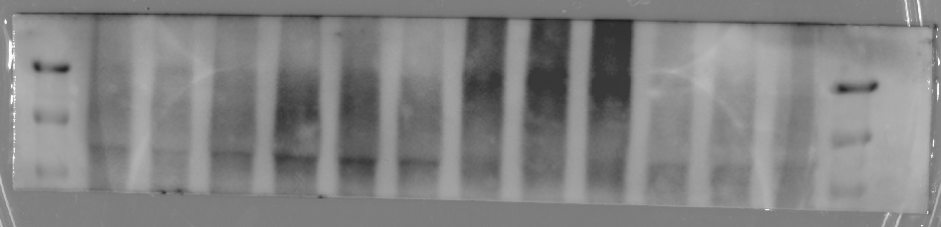
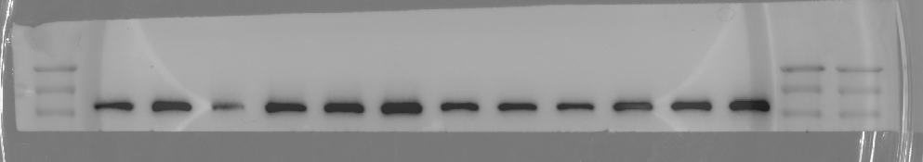
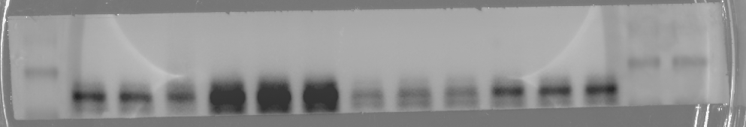
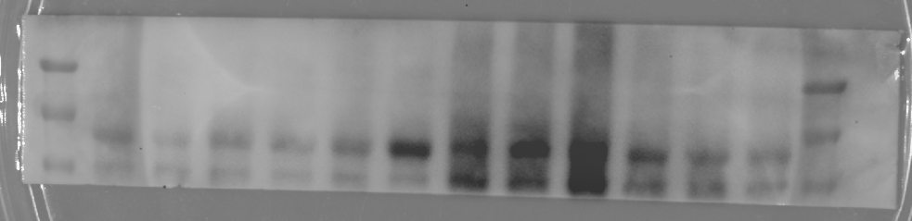
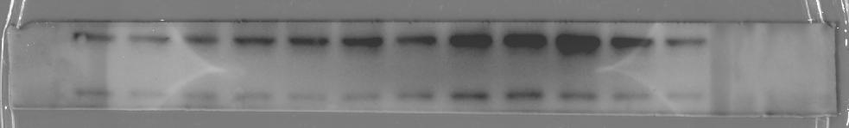
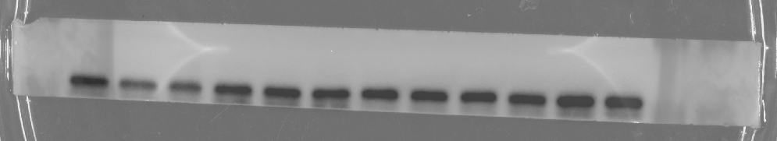
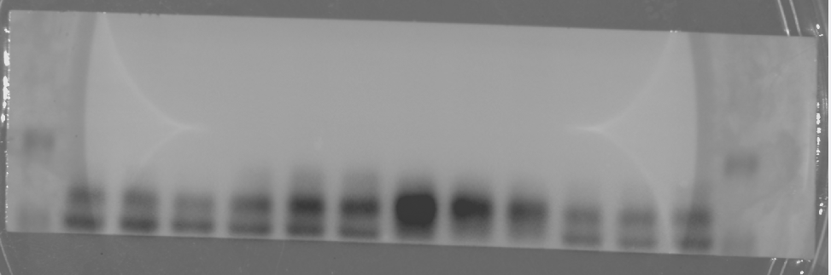
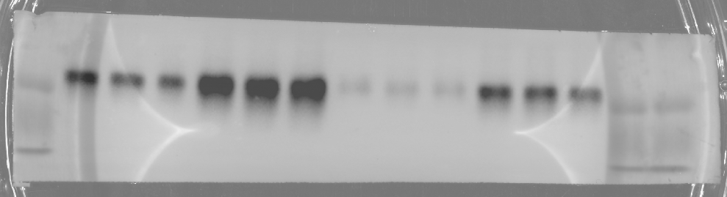
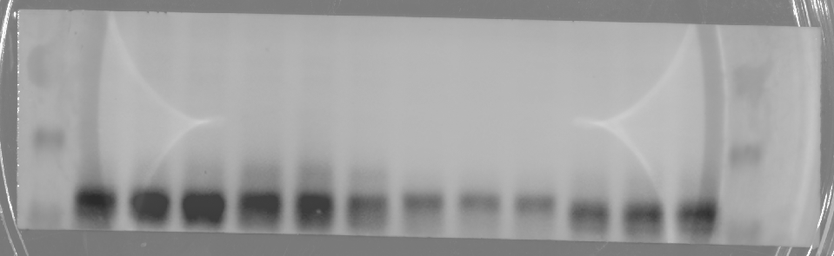
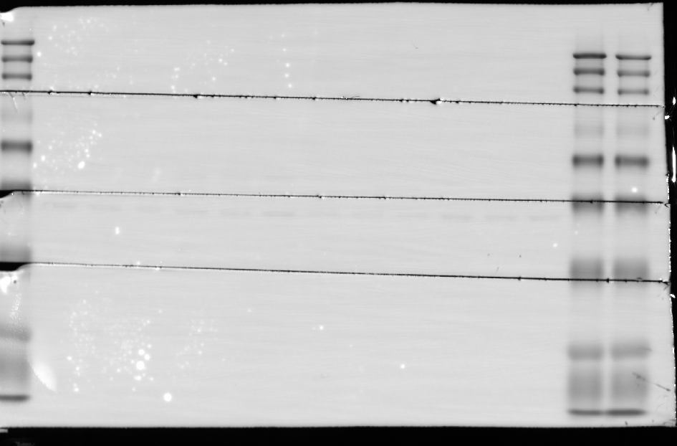
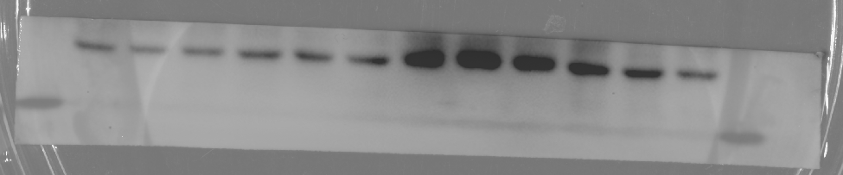
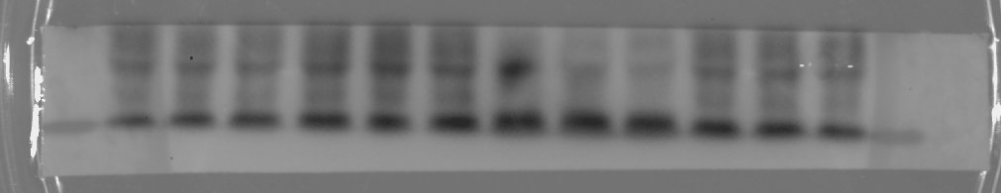
Figure 4B
Sham
CLP
Sham
CLP
MyD88^{fl/fl}
MyD88^{△IEC}
MyD88^{fl/fl}
MyD88^{△IEC}
MyD88^{fl/fl}
MyD88^{△IEC}
MyD88^{fl/fl}
MyD88^{△IEC}
BSEP
ZO-1
FXR
MyD88
CD45
GAPDH
FGF15
CYP7α1
FXR
MyD88
GAPDH

Slide 5
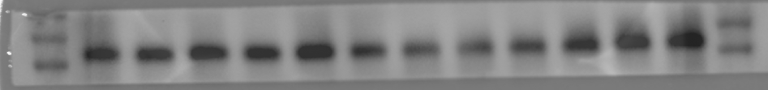
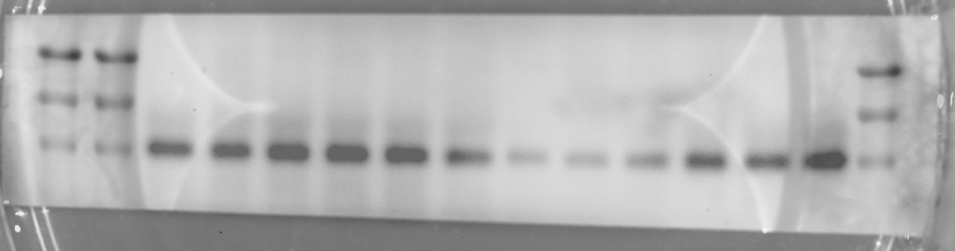
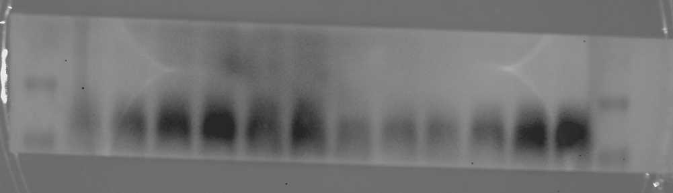
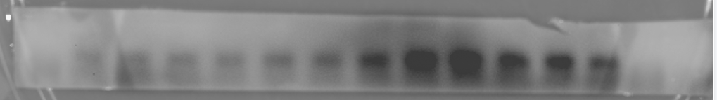
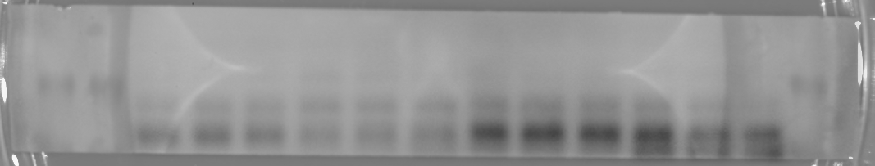
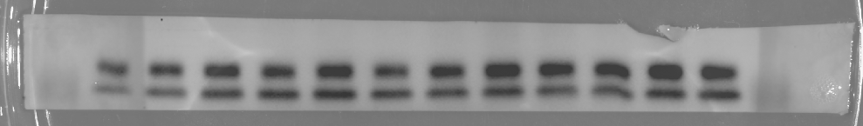
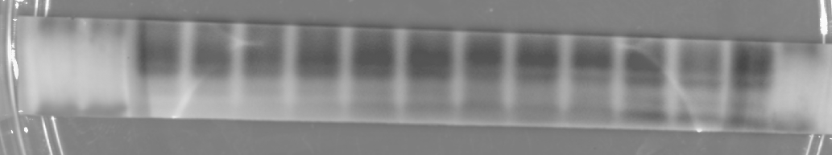
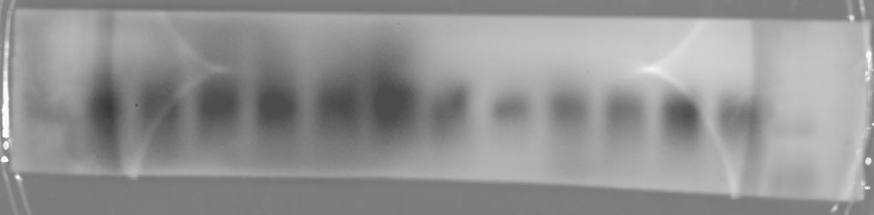
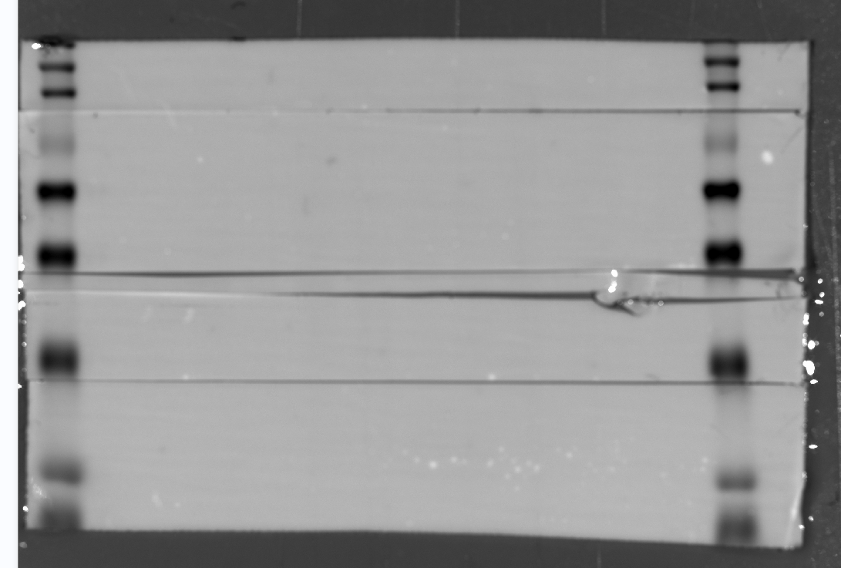
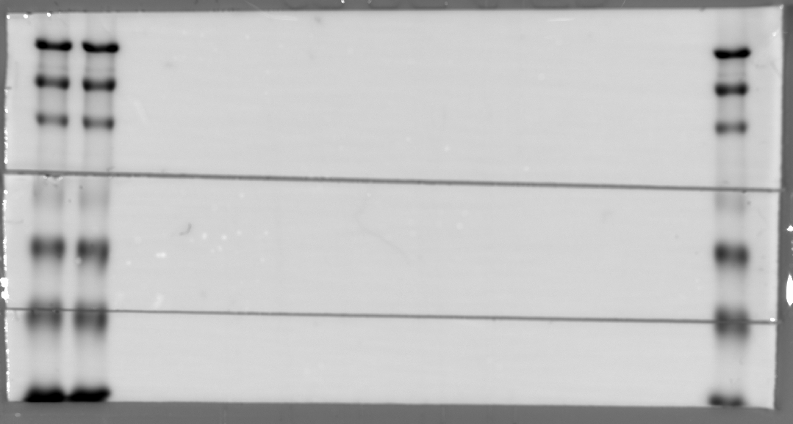
Figure 5D
Sham
CLP
Sham
CLP
MyD88^{fl/fl}
MyD88^{△IEC}
MyD88^{fl/fl}
MyD88^{△IEC}
MyD88^{fl/fl}
MyD88^{△IEC}
MyD88^{fl/fl}
MyD88^{△IEC}
BSEP
BSEP
FXR
MyD88
CYP7α1
GAPDH
GAPDH
FGF15

Slide 6
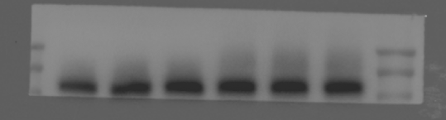
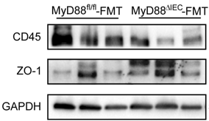
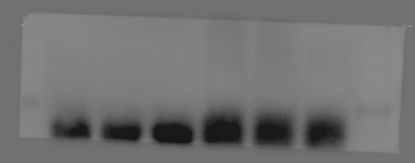
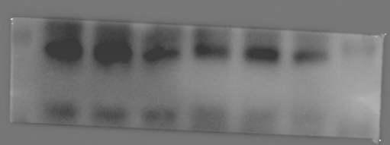
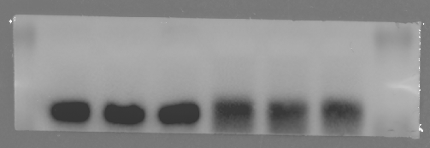
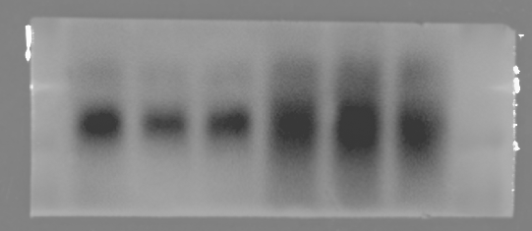
Figure 6D
Figure 6F
MyD88^{fl/fl}-FMT
MyD88^{△IEC}-FMT
BSEP
FXR
MyD88
I apologize for not keeping the original image for this one. If it's necessary, please give me a few days, I’ll refill this experiment as soon as possible.
GAPDH
FGF15

Slide 7
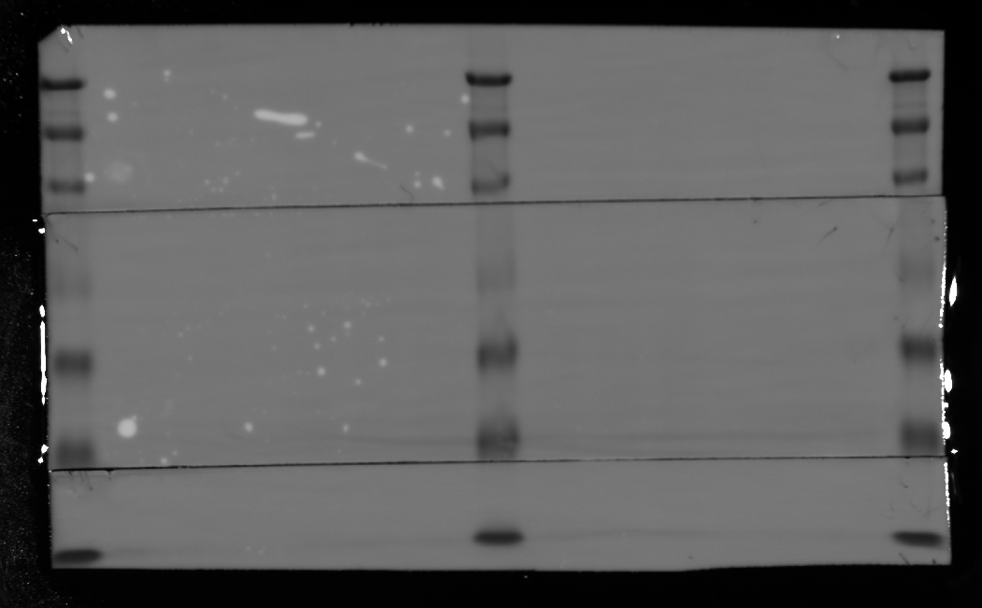




Figure 7E
CLP+Vehicle
CLP+Probiotic
ZO-1
CD45
FXR
MyD88
GAPDH

Slide 8






SFigure 1C
Sham
CLP+Vehicle
CLP+INT
BSEP
FXR
CYP7α1
GAPDH
FGF15

