Slide 1
Supplementary figures

Slide 2
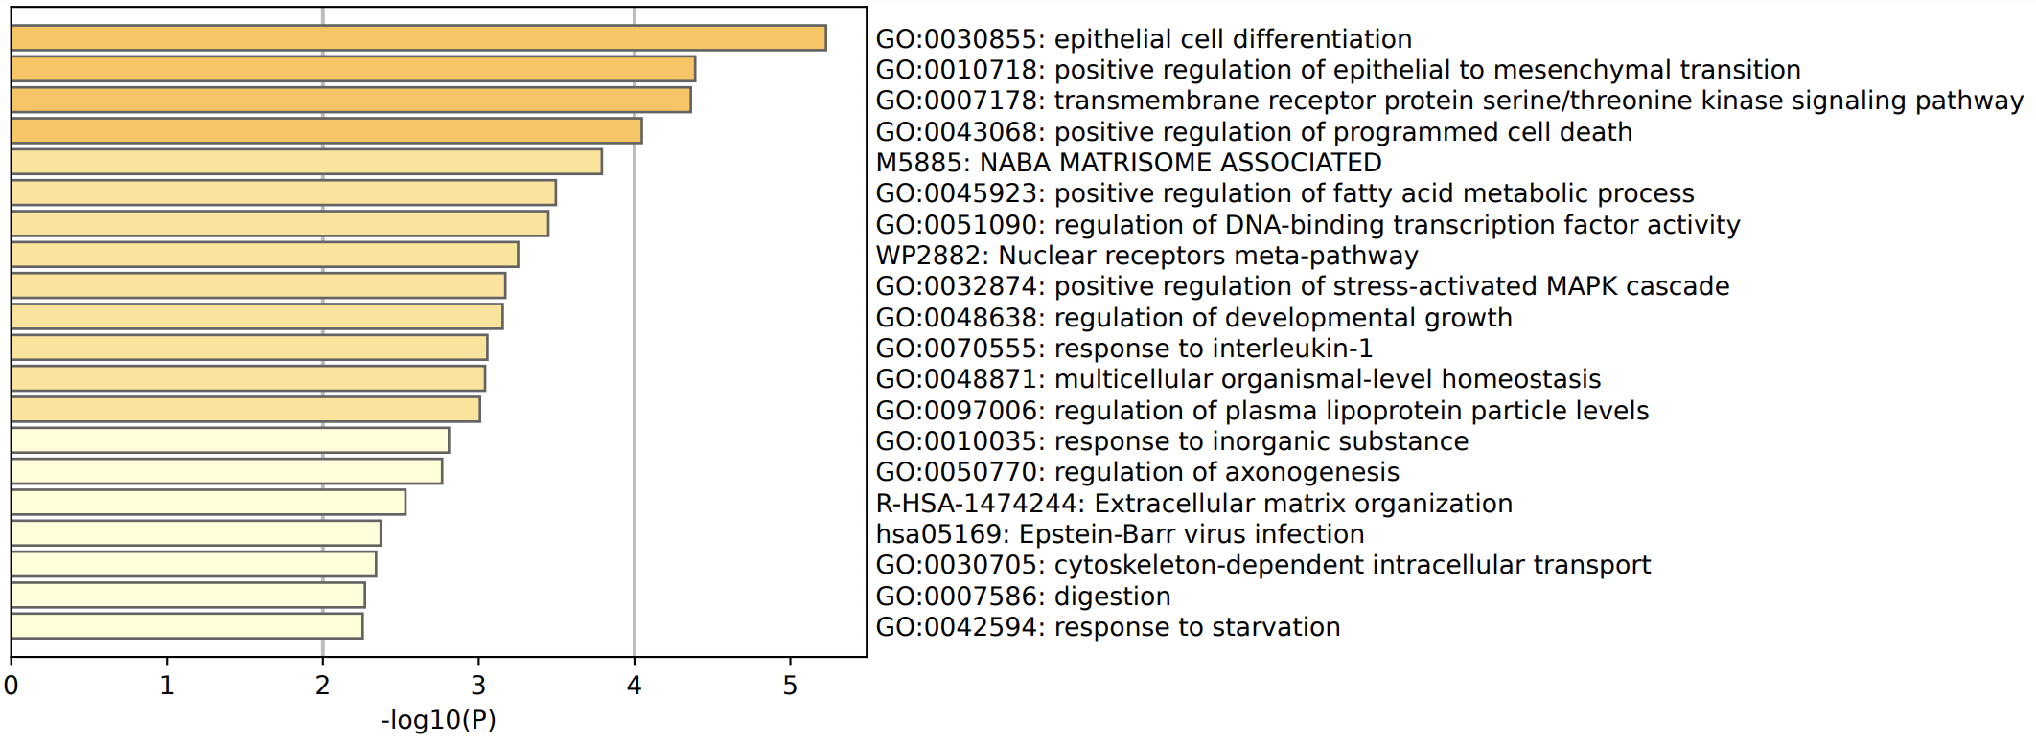
Supplementary Fig.1

Slide 3
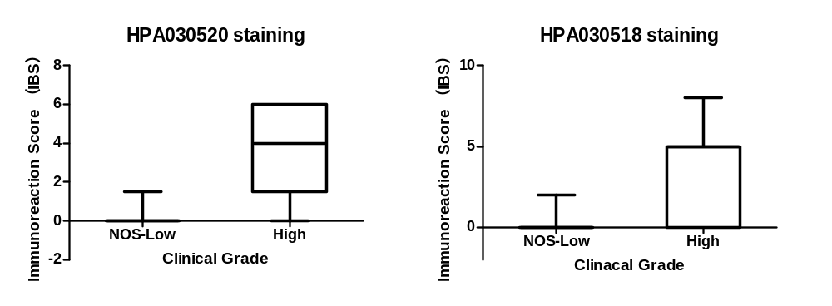
Supplementary Fig.2

Slide 4




Supplementary Fig.3
NC siRNA
NASP siRNA
AR
Foxa1
NASP
β-actin

Slide 5

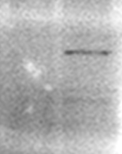
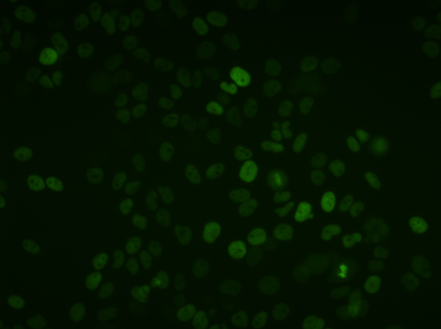
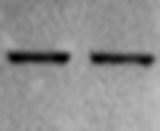
Supplementary Fig.4
A
C42B^{rtTA+}
Tetracyline
10uM
Crosslink & sonication
ChIP-qPCR
pTight-H3-GFP
12hours
Cell lysis
Western blot
B
C
Tetracyline
- +
Tet-
40kD
GFP
Tet+
40kD
β-actin

Slide 6
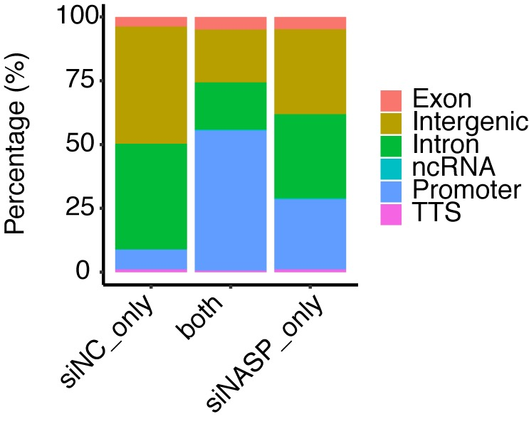
Supplementary Fig.5
B
A

Slide 7
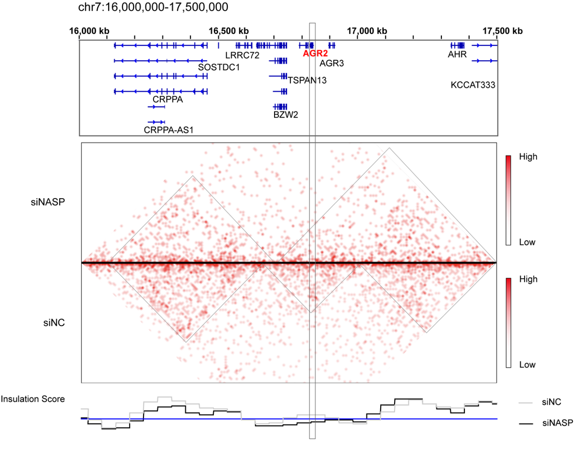
Supplementary Fig.6
A
B

