Slide 1
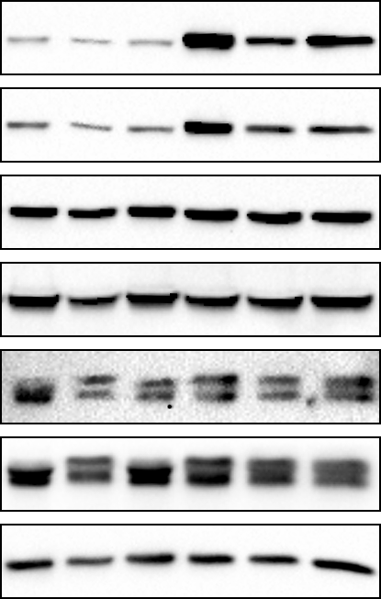
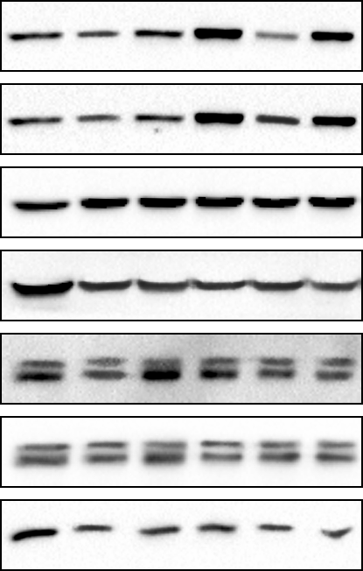
A
MCF7
B
T47D
pFAK
pFAK
FAK
FAK
pAKT
pAKT
AKT
AKT
pERK1/2
pERK1/2
ERK1/2
ERK1/2
GAPDH
GAPDH
Scramble
EV
FAK
siRNA-HSPB8
siRNA-BAG3
-
+
-
-
-
-
Scramble
EV
FAK
siRNA-HSPB8
siRNA-BAG3
-
+
-
-
-
-
-
-
+
-
-
-
-
-
+
-
-
-
-
-
-
+
+
+
-
-
-
+
+
+
-
-
-
-
+
-
-
-
-
-
+
-
-
-
-
-
-
+
-
-
-
-
-
+
C
*
**
D
*
**
pFAK
rel. optical density (%)
pFAK
rel. optical density (%)
*
*
FAK
rel. optical density (%)
FAK
rel. optical density (%)
pAKT
rel. optical density (%)
pAKT
rel. optical density (%)
AKT
rel. optical density (%)
AKT
rel. optical density (%)
pERK/ERK1/2
rel. optical density (%)
pERK/ERK1/2
rel. optical density (%)
Scramble
EV
FAK
siRNA-HSPB8
siRNA-BAG3
-
+
-
-
-
-
Scramble
EV
FAK
siRNA-HSPB8
siRNA-BAG3
-
+
-
-
-
-
-
-
+
-
-
-
-
-
+
-
-
-
-
-
-
+
+
+
-
-
-
+
+
+
-
-
-
-
+
-
-
-
-
-
+
-
-
-
-
-
-
+
-
-
-
-
-
+
Supplementary figure 2
Effect of HSPB8 and BAG3 silencing on FAK overexpression. To strengthen the causal link between HSPB8, BAG3 and FAK activation MCF-7 and T47D cells were transfected with pCMV-PTK2(human)-3xFLAG-Neo, empty vector, siRNA-HSPB8, siRNA-BAG3 or NT-siRNA and analyses were performed 48 h after transfection. pFAK and FAK protein levels were measured by WB analysis (A, B). pFAK and FAK quantification of WB signals in MCF-7 and T47D cells respectively (C, D). Statistical analysis was performed by using one-way ANOVA followed by Bonferroni multiple comparison tests. *p<0.05 vs control, non-transfected cells; **p<0.05 vs FAK. Values represent the mean of three independent experiments (n=3). pCMV-PTK2(human)-3xFLAG-Neo (FAK), pcDNA3.1-Empty vector (EV), Non-Targeting siRNA (Scramble), siRNA-HSPB8, siRNA-BAG3.
Our results indicate that FAK overexpression was effective, producing a significant increase in FAK levels in both BC cell lines. However, HSPB8 and BAG3 silencing effectively counteracted FAK overexpression in MCF7 and T47D cells, thus confirming their efficacy not only on endogenous but also on induced levels of FAK. Furthermore, after FAK overexpression with HSPB8 and BAG3 knockdown, pERK and pAKT returned to be active, confirming that the decrease in FAK phosphorylation, seen with HSPB8 and BAG3 silencing, is the cause of the decrease in ERK and AKT activation.

