Slide 1
Supplementary Information (Source data)
SENP5 enhances antiviral innate immunity by promoting AURKA-dependent STAT2 phosphorylation
Song et al.

Slide 2
Original scans of immunblots: Figure 2
Figure 2A (cell : HEK293T)
IB: SENP5
- 87 kDa
IB: VSV-G
- 65 kDa
IB: β-actin
- 42 kDa
VSV
（h.p.i.）
 | 0 | 3 | 9 | 12 | 24

Slide 3
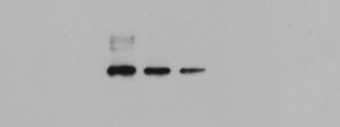

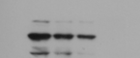
Original scans of immunblots: Figure 2
Figure 2B (cell : HEK293T)
IB: VSV-G
- 65 kDa
IB: SENP5
- 87 kDa
IB: β-actin
- 42 kDa
VSV | + | + | +
siNC | + | - | -
siSENP5 | - | #1 | #2
Figure 2C (cell : HEK293T)
IB: VSV-G
- 65 kDa
IB: Flag-SENP5
- 90 kDa
IB: β-actin
- 42 kDa
VSV | + | + | +
Flag-Vector | + | - | -
Flag-SENP5 | - | + | +

Slide 4





Original scans of immunblots: Figure 2
Figure 2D (cell : HEK293T)
IB: SENP5
- 87 kDa
IB: β-actin
- 42 kDa
Figure 2E (cell : A549)
IB: SENP5
- 87 kDa
IB: β-actin
- 42 kDa
HSV-1 | + | +
siNC | + | -
siSENP5 | - | +
Figure 2F (cell : A549)
IB: Flag-SENP5
- 90 kDa
IB: β-actin
- 42 kDa
HSV-1 | + | + | +
Flag-Vector | + | - | -
Flag-SENP5 | - | + | +

Slide 5
Original scans of immunblots: Figure 3
Figure 3B (cell : HEK293T)
IB: p-JAK1
-130 kDa
IB: JAK1
-130 kDa
IB: p-STAT1
(Y701)
- 91 kDa
IB: STAT1
- 91 kDa
IB: p-STAT2
(Y690)
- 113 kDa
IB: STAT2
- 113 kDa
IB: SENP5
- 87 kDa
IB: β-actin
- 42 kDa
siNC | + | - | + | -
siSENP5 | - | + | - | +
IFNα | - | - | + | +

Slide 6
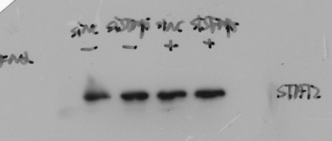
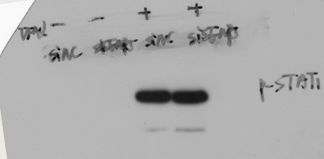
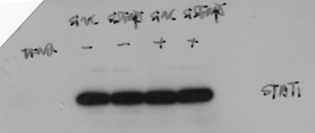
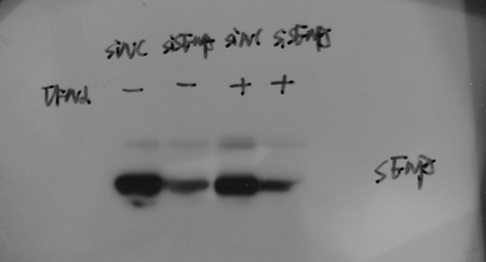
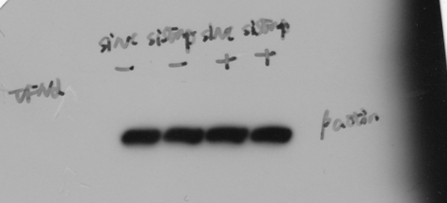
Original scans of immunblots: Figure 3
Figure 3C (cell : Huh7)
IB: p-STAT2
(Y690)
- 113 kDa
IB: STAT2
- 113 kDa
IB: p-STAT1
(Y701)
- 91 kDa
IB: STAT1
- 91 kDa
IB: SENP5
- 87 kDa
IB: β-actin
- 42 kDa
siNC | + | - | + | -
siSENP5 | - | + | - | +
IFNα | - | - | + | +

Slide 7
Original scans of immunblots: Figure 3
Figure 3D (cell : HEK293T)
IB: p-JAK1
-130 kDa
IB: JAK1
-130 kDa
IB: p-STAT1
(Y701)
- 91 kDa
IB: STAT1
- 91 kDa
IB: p-STAT2
(Y690)
- 113 kDa
IB: STAT2
- 113 kDa
IB: Flag-SENP5
- 90 kDa
IB: β-actin
- 42 kDa
Flag-Vector | + | - | + | -
Flag-SENP5 | - | + | - | +
IFNα | - | - | + | +

Slide 8
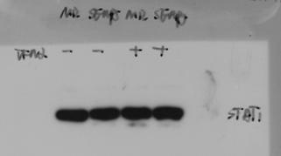
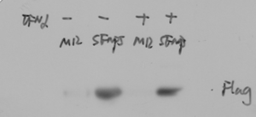
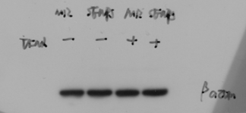
Original scans of immunblots: Figure 3
Figure 3E (cell : Huh7)
IB: p-STAT2
(Y690)
- 113 kDa
IB: STAT2
- 113 kDa
IB: p-STAT1
(Y701)
- 91 kDa
IB: STAT1
- 91 kDa
IB: Flag-SENP5
- 90 kDa
IB: β-actin
- 42 kDa
Flag-Vector | + | - | + | -
Flag-SENP5 | - | + | - | +
IFNα | - | - | + | +

Slide 9

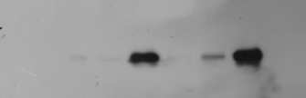
Original scans of immunblots: Figure 3
Figure 3F (cell : A549)
IB: p-STAT2
(Y690)
- 113 kDa
IB: STAT2
- 113 kDa
IB: β-actin
- 42 kDa
siNC | + | - | + | - | + | -
siSENP5 | - | + | - | + | - | +
VSV | 0 | 0 | 3 | 3 | 6 | 6
Figure 3G (cell : A549)
IB: p-STAT2
(Y690)
- 113 kDa
IB: STAT2
- 113 kDa
IB: Flag-SENP5
- 90 kDa
IB: β-actin
- 42 kDa
Flag-Vector | + | + | + | - | - | -
Flag-SENP5 | - | - | - | + | + | +
VSV | 0 | 3 | 6 | 0 | 3 | 6

Slide 10


Original scans of immunblots: Figure 4
Figure 4A (cell : HEK293T)
IB: p-STAT2
(Y690)
- 113 kDa
IB: STAT2
- 113 kDa
IB: Flag-SENP5
- 90 kDa
IB: β-actin
- 42 kDa
Vector | + | + | - | -
SENP5 | - | - | + | -
SENP5 C713L | - | - | - | +
IFNα | - | + | + | +

Slide 11
Original scans of immunblots: Figure 4
Figure 4F (cell : HEK293T)
IB: VSV-G
- 65 kDa
IB: Flag-SENP5
- 90 kDa
IB: β-actin
- 42 kDa
Vector | + | - | -
SENP5 | - | + | -
SENP5 C713L | - | - | +
VSV | + | + | +

Slide 12
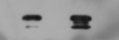
Original scans of immunblots: Figure 5
Figure 5B (cell : HEK293T)
IB: Flag
- 116 kDa
IP
IB: HA
- 48 kDa
IB: Flag
- 116 kDa
Input
IB: HA
- 48 kDa
HA-Vector | + |  | - |  | -
Flag-Vector | - |  | + |  | -
HA-AURKA | - |  | + |  | +
Flag-STAT2 | + |  | - |  | +

Slide 13
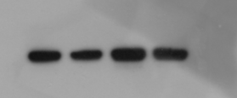
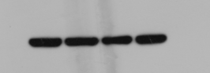
Original scans of immunblots: Figure 5
Figure 5C (cell : HEK293T)
IB: p-STAT2
(Y690)
- 113 kDa
IB: STAT2
- 113 kDa
IB: p-STAT1
(Y701)
- 91 kDa
IB: STAT1
- 91 kDa
IB: AURKA
- 45 kDa
IB: β-actin
- 42 kDa
siNC | + | - | + | -
siAURKA | - | + | - | +
IFNα | - | - | + | +

Slide 14
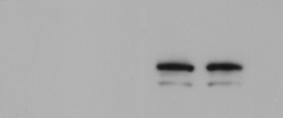

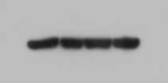
Original scans of immunblots: Figure 5
Figure 5D (cell : HEK293T)
IB: p-STAT2
(Y690)
- 113 kDa
IB: STAT2
- 113 kDa
IB: p-STAT1
(Y701)
- 91 kDa
IB: STAT1
- 91 kDa
IB: HA-AURKA
- 48 kDa
IB: β-actin
- 42 kDa
HA-Vector |  | + | - | + | -
HA-AURKA |  | - | + | - | +
IFNα |  | - | - | + | +

Slide 15
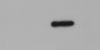
Original scans of immunblots: Figure 5
Figure 5E (cell : HEK293T)
IB: VSV-G
- 65 kDa
IB: AURKA
- 45 kDa
IB: β-actin
- 42 kDa
siNC |  | + |  | -
siAURKA |  | - |  | +
VSV |  | + |  | +
Figure 5G (cell : HEK293T)
IB: VSV-G
- 65 kDa
IB: HA-AURKA
- 48 kDa
IB: β-actin
- 42 kDa
HA-Vector |  | + |  | -
HA-AURKA |  | - |  | +
VSV |  | + |  | +

Slide 16
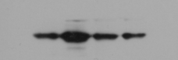
Original scans of immunblots: Figure 6
Figure 6A (cell : HEK293T)
IB: p-STAT2
(Y690)
- 113 kDa
IB: HA-AURKA
- 48 kDa
IB: β-actin
- 42 kDa
HA-Vector |  | + | - | - | -
HA-AURKA |  | - | +
IFNα |  | + | + | + | +
K258R | T288A
Figure 6C (cell : HEK293T)
IB: VSV-G
- 65 kDa
IB: HA-AURKA
- 48 kDa
IB: β-actin
- 42 kDa
HA-Vector |  | + | - | - | -
HA-AURKA |  | - | +
VSV |  | + | + | + | +
K258R | T288A

Slide 17
Original scans of immunblots: Figure 6
Figure 6E (cell : A549)
IB: p-STAT2
(Y690)
- 113 kDa
IB: STAT2
- 113 kDa
IB: AURKA
- 45 kDa
IB: β-actin
- 42 kDa
siNC |  | + | - | + | -
siAURKA |  | - | + | - | +
Endothall |  | - | - | + | +
IFNα |  | + | + | + | +

Slide 18

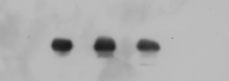
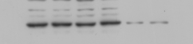
Original scans of immunblots: Figure 6
Figure 6G (cell : HEK293T)
IB: p-STAT2
(Y690)
- 113 kDa
IB: STAT2
- 113 kDa
IB: Flag-SENP5
- 90 kDa
IB: AURKA
- 45 kDa
IB: β-actin
- 42 kDa
Flag-Vector | + | - | + | - | + | -
Flag-SENP5 | - | + | - | + | - | +
siAURKA | - | - | - | - | + | +
IFNα | - | - | + | + | + | +

Slide 19
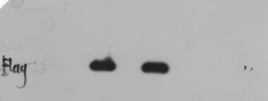

Original scans of immunblots: Figure 6
Figure 6I (cell : HEK293T)
IB: VSV-G
- 65 kDa
IB: Flag-SENP5
- 90 kDa
IB: AURKA
- 45 kDa
IB: β-actin
- 42 kDa
Flag-Vector | + | - | + | -
Flag-SENP5 | - | + | - | +
siAURKA | - | - | + | +
VSV | + | + | + | +

Slide 20
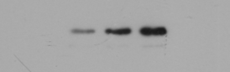
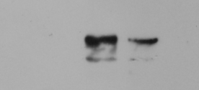
Original scans of immunblots: Figure S2
Figure S2A (cell : A549)
IB: SENP5
- 87 kDa
IB: HSV1-gD
- 55 kDa
IB: β-actin
- 42 kDa
(h.p.i)
HSV-1 |  | 0 | 3 | 9 | 12
Figure S2B (cell : THP-1)
IB: SENP5
- 87 kDa
IB: β-actin
- 42 kDa
shNC | + | -
shSENP5 | - | +
HSV-1 | + | +

Slide 21
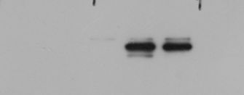
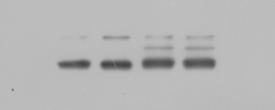
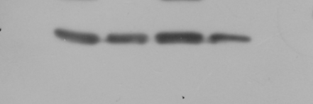
Original scans of immunblots: Figure S3
Figure S3B (cell : A549)
IB: p-STAT1
(Y701)
- 91 kDa
IB: STAT1
- 91 kDa
IB: p-STAT2
(Y690)
- 113 kDa
IB: STAT2
- 113 kDa
IB: SENP5
- 87 kDa
IB: β-actin
- 42 kDa
shNC | + | - | + | -
shSENP5 | - | + | - | +
IFNα | - | - | + | +

Slide 22
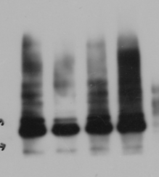
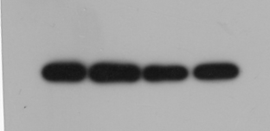
Original scans of immunblots: Figure S4
Figure S4A (cell : HEK293T)
- 250 kDa
IB: HA-SUMO
- 70 kDa
IB: Flag-SENP5
- 90 kDa
IB: β-actin
- 42 kDa
Flag-Vector | + | - | - | -
Flag-SENP5 WT | - | + | - | -
Flag-SENP5 MUT | - | -
HA-SUMO3 | + | + | + | +
 | C713L
C713S

Slide 23
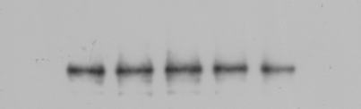
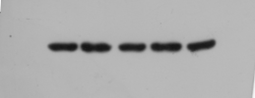
Original scans of immunblots: Figure S4
Figure S4B(cell : HEK293T)
IB: p-STAT2
(Y690)
- 113 kDa
IB: STAT2
- 113 kDa
IB: β-actin
- 42 kDa
siNC | + | + | - | - | -
siDPP9 | - | - | + | - | -
siCARM1 | - | - | - | + | -
siAURKA | - | - | - | - | +
IFNα | - | + | + | + | +

Slide 24
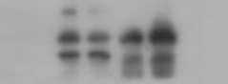
Original scans of immunblots: Figure S4
Figure S4C (cell : HEK293T)
Input
IP
IgG Flag
IB: Flag
- 90 kDa
IB: HA
- 48 kDa
Flag-SENP5 | + | + | + | +
HA-AURKA | - | + | - | +

Slide 25
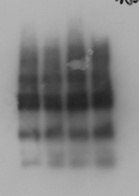
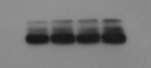
Original scans of immunblots: Figure S4
Figure S4D (cell : HEK293T)
- 180 kDa
SUMO2/3
- 100 kDa
- 70 kDa
IP: HA
HA
- 48 kDa
IB: Flag
- 90 kDa
IB: HA
- 48 kDa
Flag-Vector |  | + | - | - | -
Flag-SENP5 | WT | - | + | - | +
Flag-SENP5 | C713L | - | - | + | -
HA-AURKA | WT | + | + | + | -
HA-AURKA | K258R | - | - | - | +

Slide 26
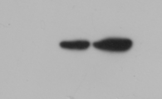
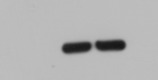
Original scans of immunblots: Figure S5
Figure S5B (cell : A549)
IB: HSV1-gD
- 55 kDa
IB: HA-AURKA
- 48 kDa
IB: β-actin
- 42 kDa
HA-Vector |  | + | -
HA-AURKA |  | - | +
HSV-1 |  | + | +

Slide 27

Original scans of immunblots: Figure S5
Figure S5D (cell : HEK293T)
IB: p-STAT2
(Y690)
- 113 kDa
IB: HA-AURKA
- 48 kDa
IB: β-actin
- 42 kDa
HA-Vector |  | + | - | -
HA-AURKA |  | - | + | +
Alisertib |  | - | - | +
IFNα |  | + | + | +
Figure S5F (cell : HEK293T)
IB: VSV-G
- 65 kDa
IB: HA-AURKA
- 48 kDa
IB: β-actin
- 42 kDa
HA-Vector |  | + | + | - | -
HA-AURKA |  | - | - | + | +
Alisertib |  | - | + | - | +
VSV |  | + | + | + | +

Slide 28
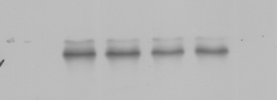
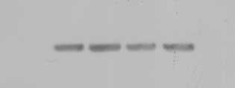
Original scans of immunblots: Figure S5
Figure S5G (cell : A549)
IB: p-STAT2
(Y690)
- 113 kDa
IB: STAT2
- 113 kDa
IB: β-actin
- 42 kDa
Endothall(μM) |  | 0 | 1 | 10 | 20
IFNα |  | + | + | + | +

