Slide 1
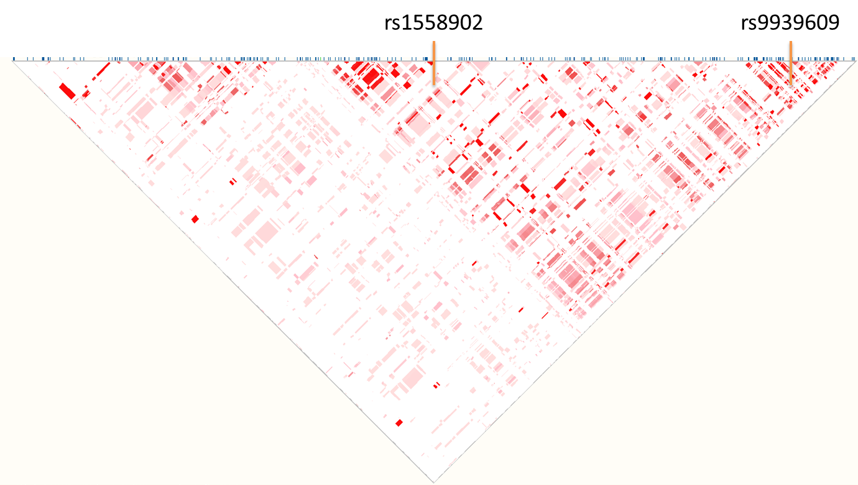
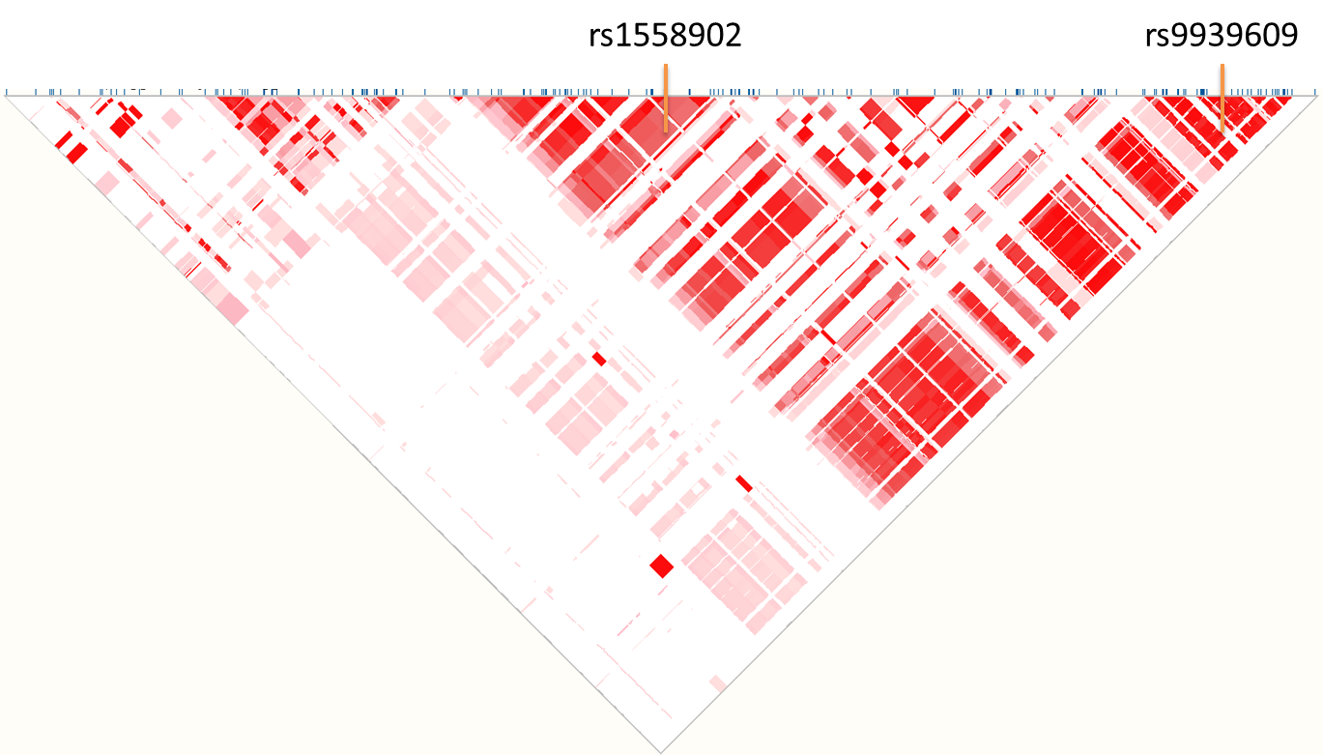
Supplementary Figure 1
YRI
(Yoruba in Ibadan, Nigeria)
n=88
CEU
(Utah Residents with Northern and Western European ancestry)
n=85
Suppl. Fig. 1. LD (r²) of the FTO SNPs within intron 1 retrieved from Ensembl (www.ensembl.org, location coordinates based on Ensembl 75 (GRCh37.p13), 16:53783574-53823573). Highlighted are the SNPs rs1558902 (in this study) and rs9939609 (the most associated to obesity in Western populations)

