Slide 1
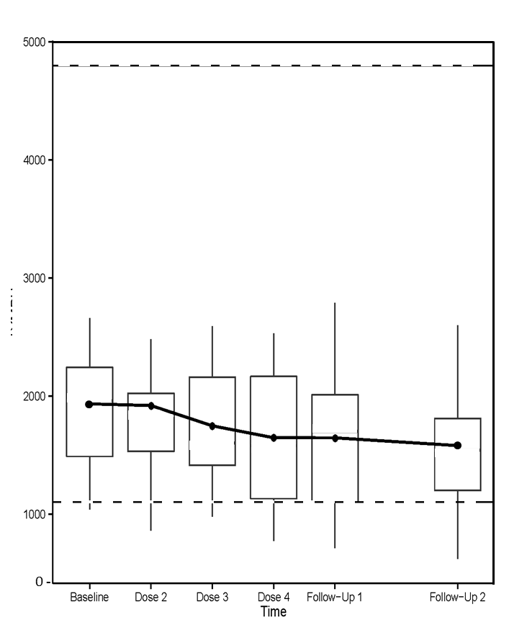
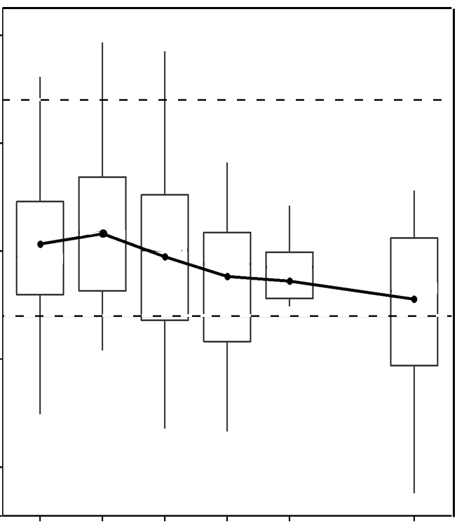
Supplementary Figure S3
5000
50
4000
40
3000
Lymphocytes among leukocytes (%)
30
Lymphocytes per mm³ of whole blood (number)
2000
20
1000
10
0
0
C1 C2 C3 C4 4 mos 6 mos
C1 C2 C3 C4 4 mos 6 mos

