Slide 1
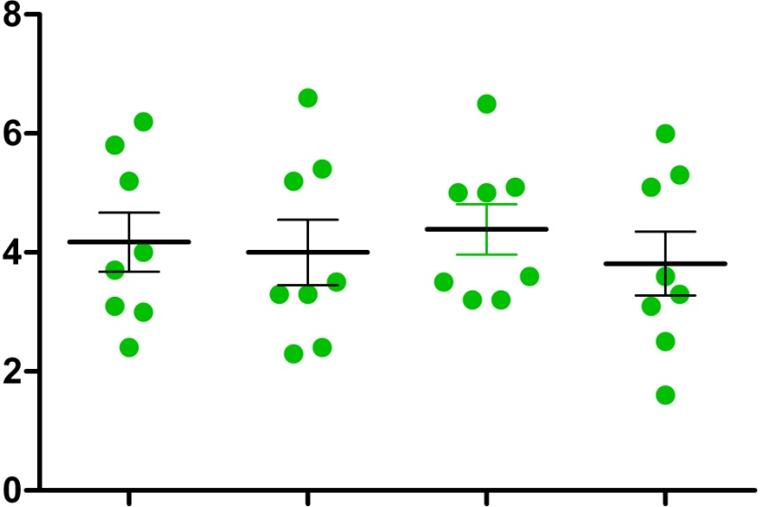
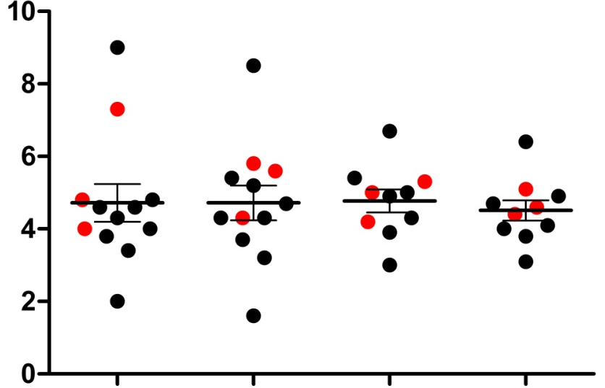
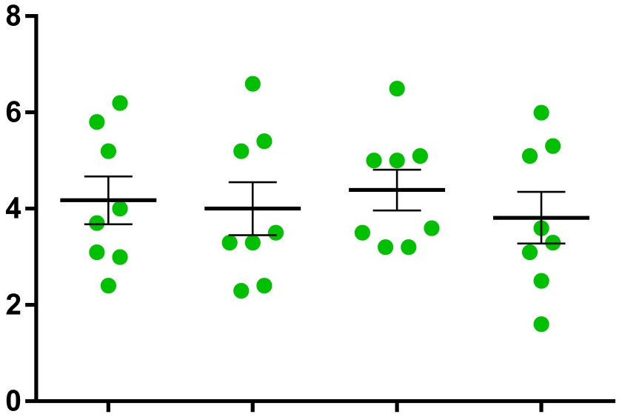
Supplementary Figure S4
Cohorts A & B
Cohort C
Tregs
(% of CD4+ lymphocytes)
C1D1
n=12
C1D3
n=12
C4D1
n=10
C4D3
n=10
C1D0
n=8
C1D3
n=8
C4D0
n=8
C4D3
n=8
= Cohort A
= Cohort B
= Cohort C

