Slide 1
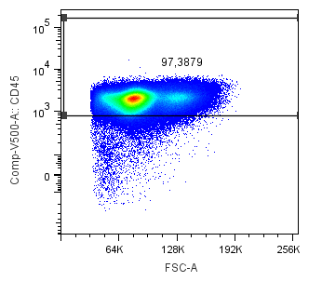
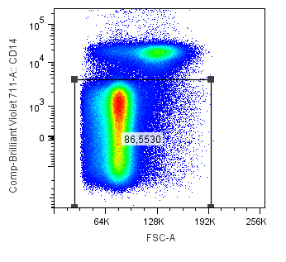
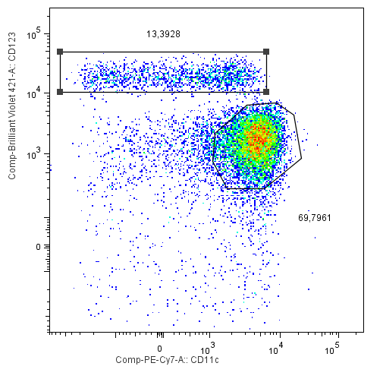
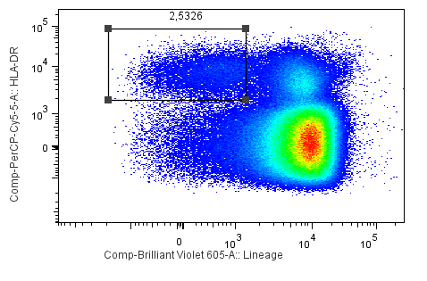
Supplementary Figure 1
CD45
CD14
FSC
FSC
CD123
HLA-DR
CD11c
Lineage
S1: Duplicates were removed using an FSC-area versus FSC-height/width plot. After gating the CD45+ and CD14(neg) population, we considered Lin(-)HLA-DR(+) for further analysis. Further, pDCs are gated as (CD123+CD11c-) and mDCs as (CD123-CD11c+).

Slide 2
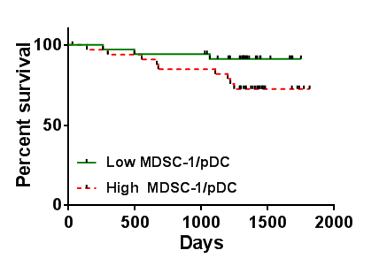
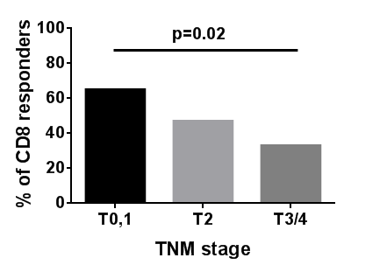
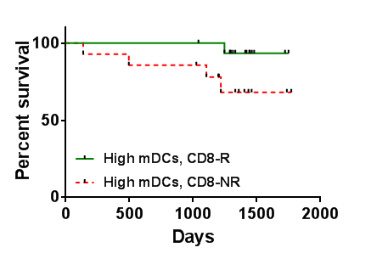
Supplementary Figure 2
A
p=0.06
B
C
p=0.06
S2: (A) Kaplan-Meier survival analysis of patients with a low ratio of MDSC-1/pDCs vs high ratio of MDSC-1/pDCs (B) Percentage of CD8+ T-cell responders to Her-2 at different TNM stage (C) Kaplan- Meier survival analysis of patients with CD8 responses to Her-2 and high levels of mDCs vs high levels of mDCs and no CD8 response to Her-2 in non-metastatic patients.

Slide 3
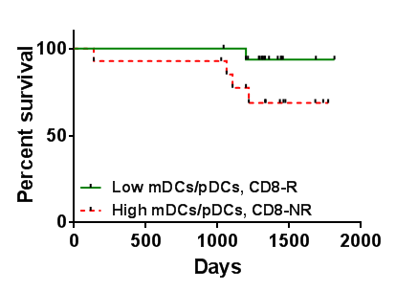
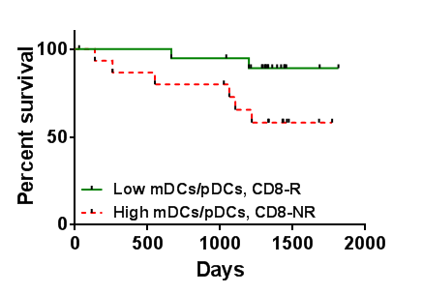
Supplementary Figure 3
A
p=0.07
B
p=0.03
S3: Kaplan-Meier survival analysis of patients (A) with a CD8 response to Her-2 and low ratio of mDCs/pDCs vs high ratio of mDCs/pDCs and no CD8 response to Her-2 in non-metastatic and (B) all patients

Slide 4
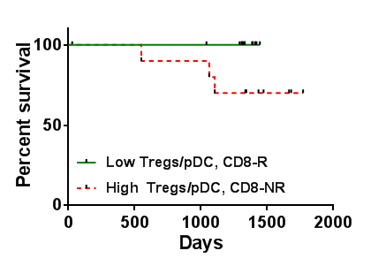
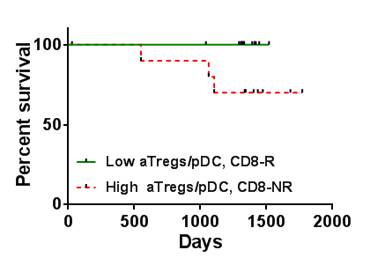
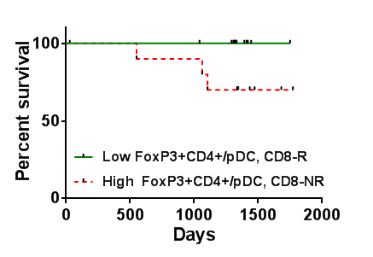
Supplementary Figure 4
A
p=0.03
B
B
p=0.03
p=0.03
C
C
p=0.03
p=0.03
S4: Kaplan Meier survival analysis of all patients (A) with a CD8 response to Her-2 and low ratio of Tregs/pDCs vs high ratio of Tregs/pDCs and no CD8 response to Her-2, (B) with a CD8 response to Her-2 and low ratio of aTregs/pDCs vs high ratio of aTregs/pDCs and no CD8 response to Her-2 and (C) with a CD8 response to Her-2 and low ratio of FoxP3+CD4+/pDCs vs high ratio of FoxP3+CD4+/pDCs and no CD8 response to Her-2

