Slide 1
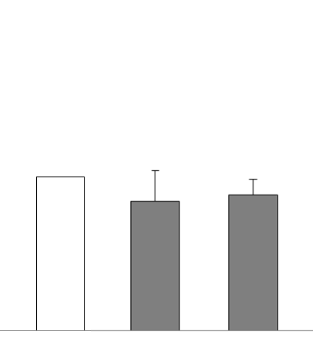
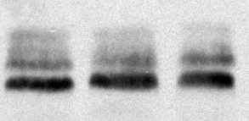

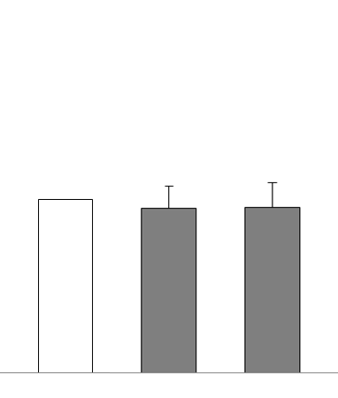


A
Suppl. Figure 2
2
NS
Relative GLUT-4
mRNA level
1
0
Ctr
20’
48h
EXE
B
GLUT 4
β-actin
2
NS
GLUT-4/β−actin levels
(fold increase over basal)
1
0
Ctr
20’
48h
EXE
C
IR β
GLUT4
GLUT-4 PM translocation
(fold increase over basal)
Ctr
20’
48h
EXE

