Slide 1
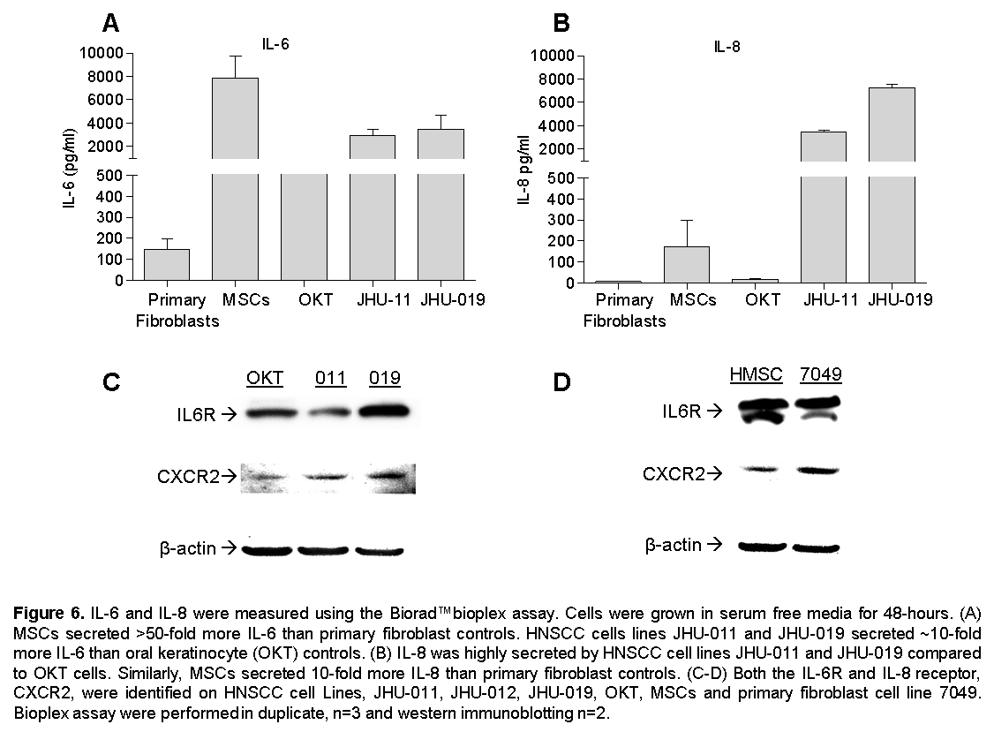
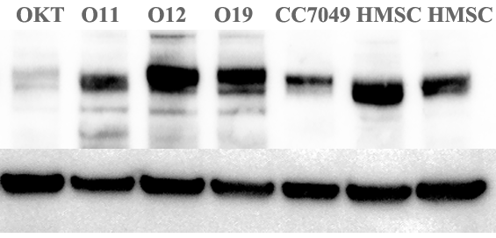
Supplemental Figure S8
A
B
gp130
β-actin

