Slide 1
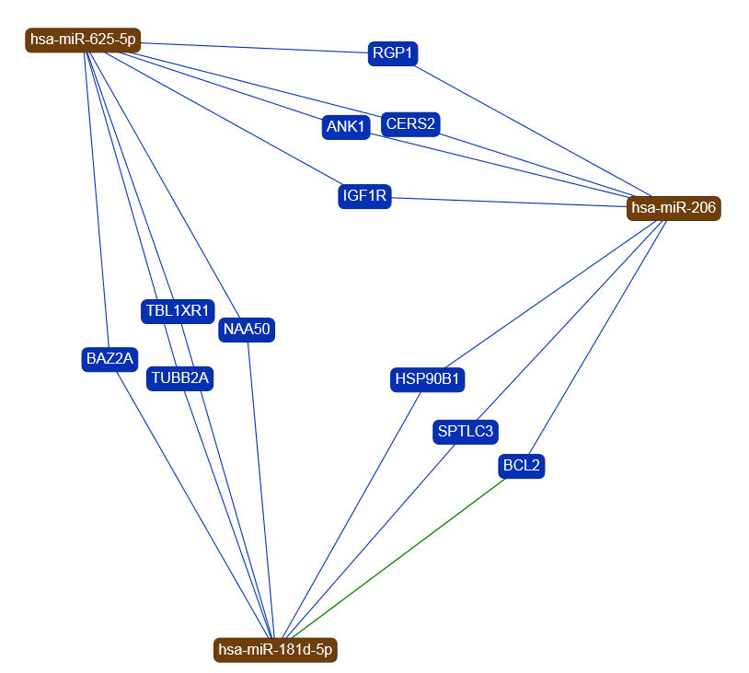
Figure S2
miRNA | Gene | Evidence
hsa-miR-625-5p | CERS2 | Weak
hsa-miR-625-5p | IGF1R | Weak
hsa-miR-625-5p | TBL1XR1 | Weak
hsa-miR-625-5p | RGP1 | Weak
hsa-miR-625-5p | BAZ2A | Weak
hsa-miR-625-5p | ANK1 | Weak
hsa-miR-625-5p | NAA50 | Weak
hsa-miR-625-5p | TUBB2A | Weak
miRNA | Gene | Evidence
hsa-miR-206 | BCL2 | Weak
hsa-miR-206 | IGF1R | Weak
hsa-miR-206 | RGP1 | Weak
hsa-miR-206 | CERS2 | Weak
hsa-miR-206 | ANK1 | Weak
hsa-miR-206 | HSP90B1 | Weak
hsa-miR-206 | SPTLC3 | Weak
miRNA | Gene | Evidence
hsa-miR-181d-5p | BCL2 | Strong
hsa-miR-181d-5p | HSP90B1 | Weak
hsa-miR-181d-5p | TUBB2A | Weak
hsa-miR-181d-5p | SPTLC3 | Weak
hsa-miR-181d-5p | TBL1XR1 | Weak
hsa-miR-181d-5p | NAA50 | Weak
hsa-miR-181d-5p | BAZ2A | Weak

