Slide 1
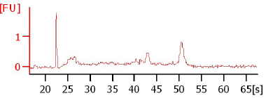
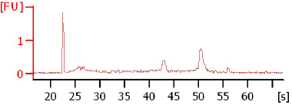
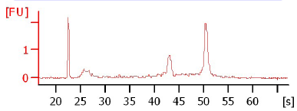
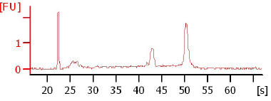
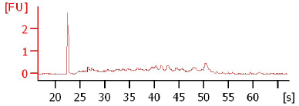
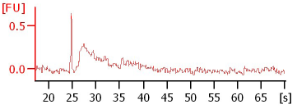
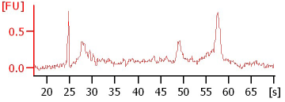

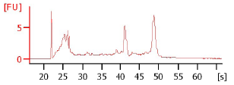
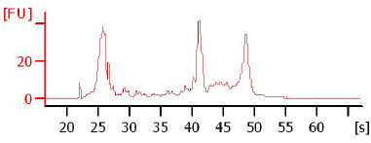
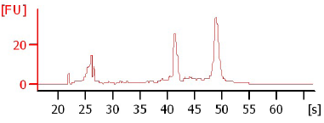
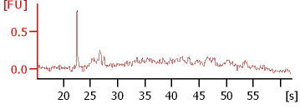
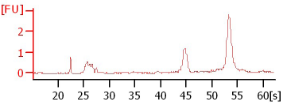

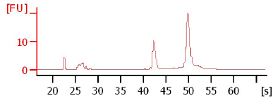
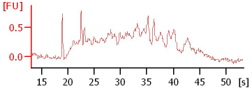
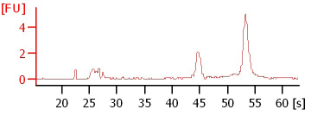
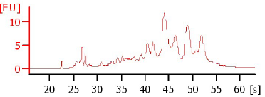
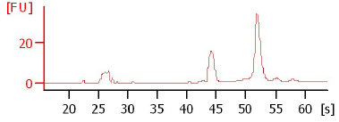
Figure S1
a
1 x SSC
2 x SSC
3 x SSC
5 x SSC
b
PBS SSC
PBS SSC
PBMC
Spleen Cell
RIN=1.5
RIN=8.4
RIN=1.4
RIN=8.1
CD8+
KLM1
RIN=1.3
RIN=7.0
RIN=7.5
RIN=8.9
HMVEC-L
293T
RIN=2.4
RIN=9.4
RIN=7.0
RIN=9.6
BMSC
MEF
RIN=2.1
RIN=9.5
RIN=5.3
RIN=9.7
Notes:
Additional File 3: Figures S1. Resuspension in 3X SSC preserved cell RNA integrity. a. The methanol-fixed PBMCs resuspended in 3X or 5X SSC buffer showed high quality of RNA determined with Bioanalyzer traces. b. The new processing method was validated in several other cell types resuspended in 3X SSC for 30min. The RIN numbers were significantly improved in primary cell types and cell lines with a p value of 0.00001 and 0.008 respectively.

