Slide 1
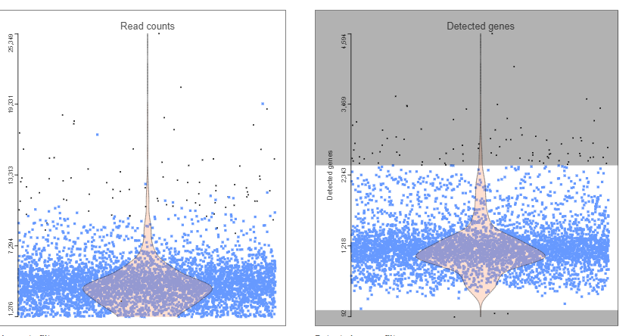
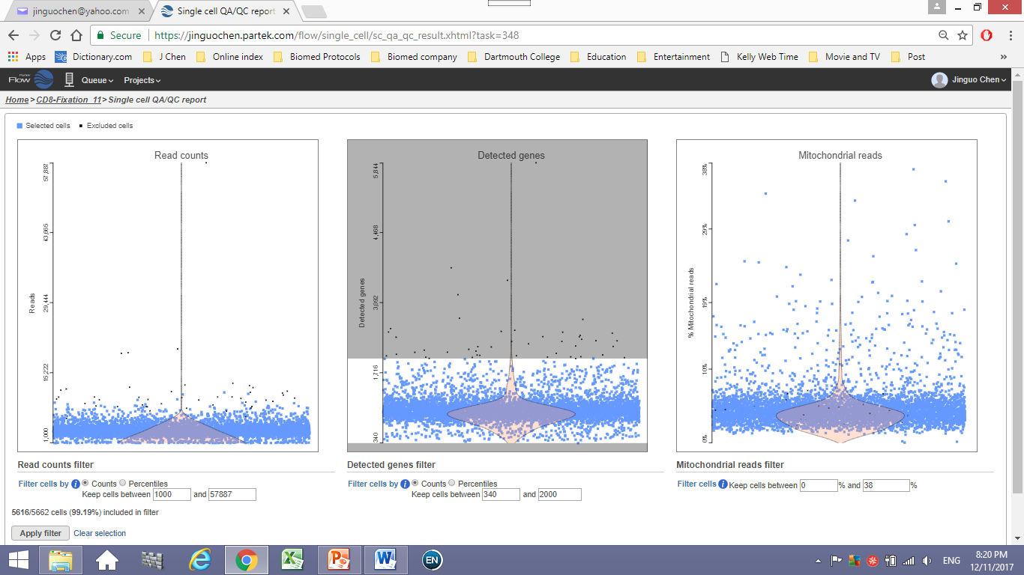
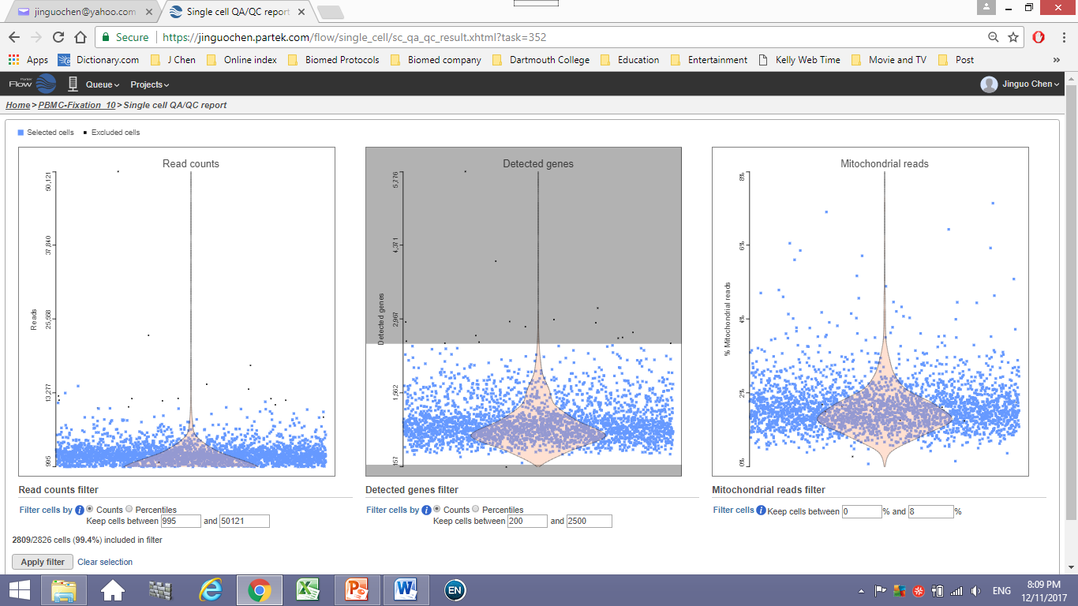
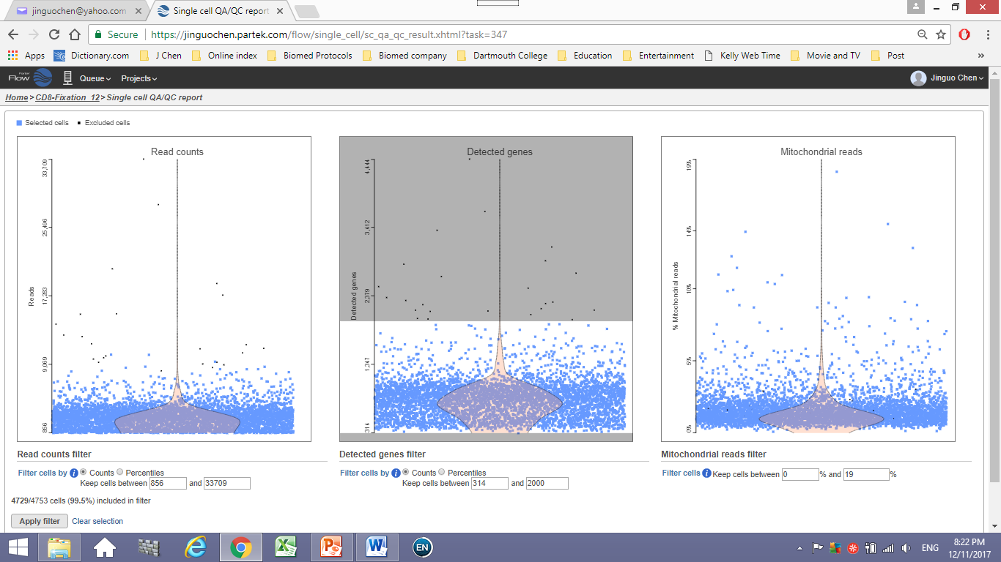
Figure S2. a
b
PBMC
CD8+
1.75%
0.81%
Reads
Detected genes
Detected genes
Live
Reads
Medium: 1174
Medium: 981
0.60%
0.50%
Fixed
(3weekS)
Detected genes
Detected genes
Reads
Reads
Medium: 944
Medium: 831
Notes:
Additional File 4: Figure S2. Fixation processing did not aggregate the cells. PBMCs with greater than 2500 genes detected (a) or CD8+ cells with more than 2000 genes detected (b) were flagged because these droplets usually contain more than one cell (doublet or multiplet). Fixation did not increase the rate of these GEMs/cells. Methanol-fixed PBMCs remained microscopically visible as single, intact round cells with the similar size as live ones.

