Slide 1
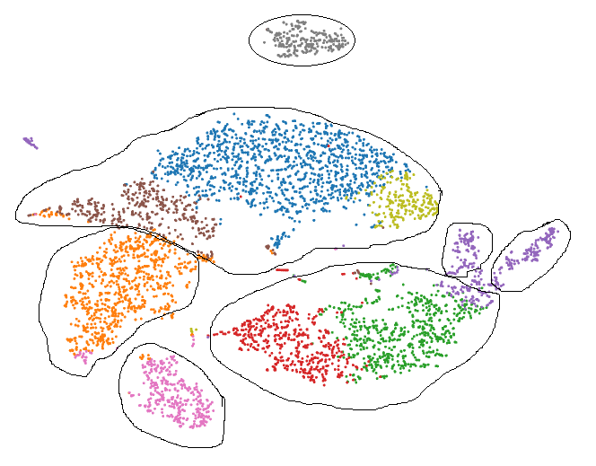
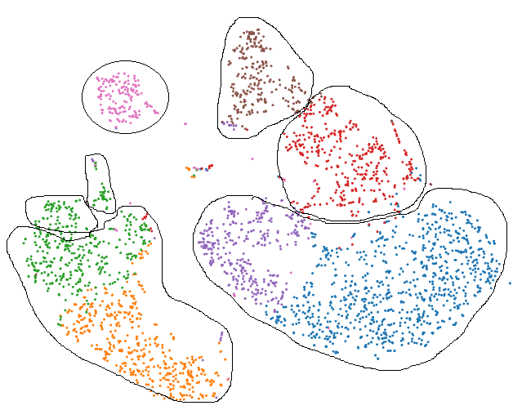
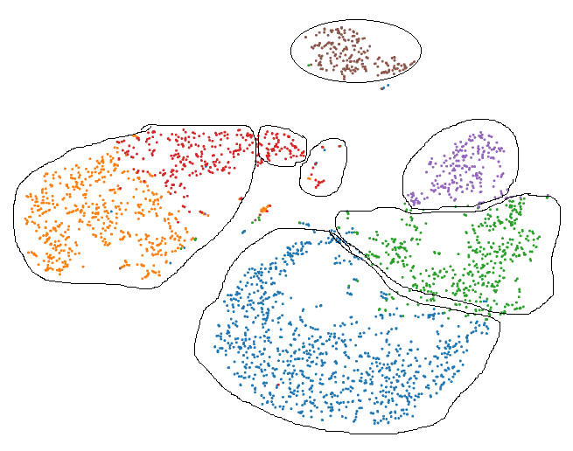
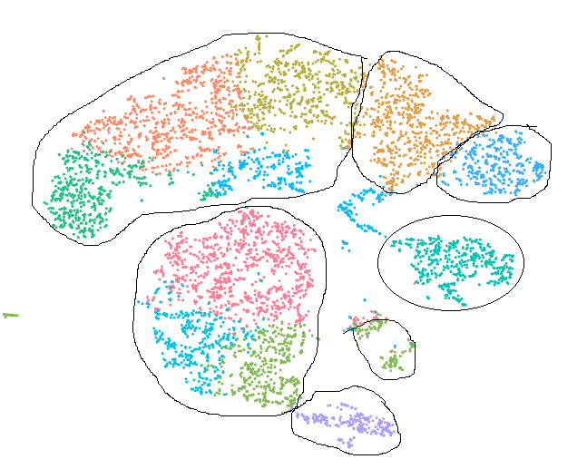
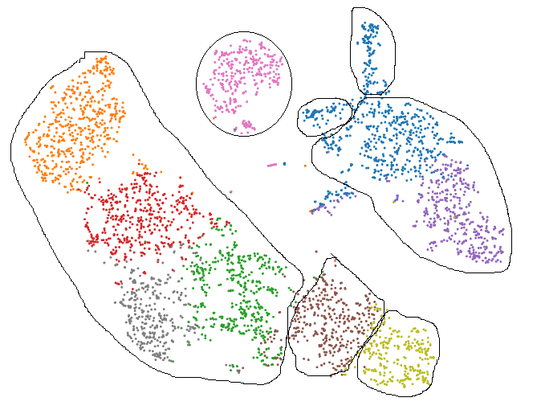
a.
DTM-X_PBMC_live
DTM-X_PBMC_methanol-3H+SSC
DTM-X_PBMC_methanol-3W+SSC
B cells
B cells
NKs
B cells
CD16+
NKs
CD8+
DC
DC
CD16+
DC
CD4+
CD14+ Monocytes
CD8+
CD8+
CD16+
CD4+
NKs
CD14+ Monocytes
CD14+ Monocytes
CD4+
b.
DTM-Y_PBMC_live
DTM-Y_PBMC_methanol-3W+SSC
CD8+
B cells
CD16+
CD4+
DC
NKs
CD4+
CD14+ Monocytes
B cells
CD14+ Monocytes
DC
CD16+
CD8+
NKs
Notes:
Additional file 6: Figure S3. tSNE projection of live and fixed PBMCs from donor DTM-X (a) and donor (b). Cells were grouped using graph-based method. Classification of PBMCs was inferred from the annotation of cluster-specific genes, and based on expression of some well-known markers of immune cell types. Although fixation lead to changes of the relative distances of the clusters due to the loss of genes detected, it did not impact the resolution of the low abundant populations (B, NK, DC) in each sample. Subpopulations were detected from fixed PBMCs at a similar proportion to those of live PBMCs (Table 1).

