Slide 1
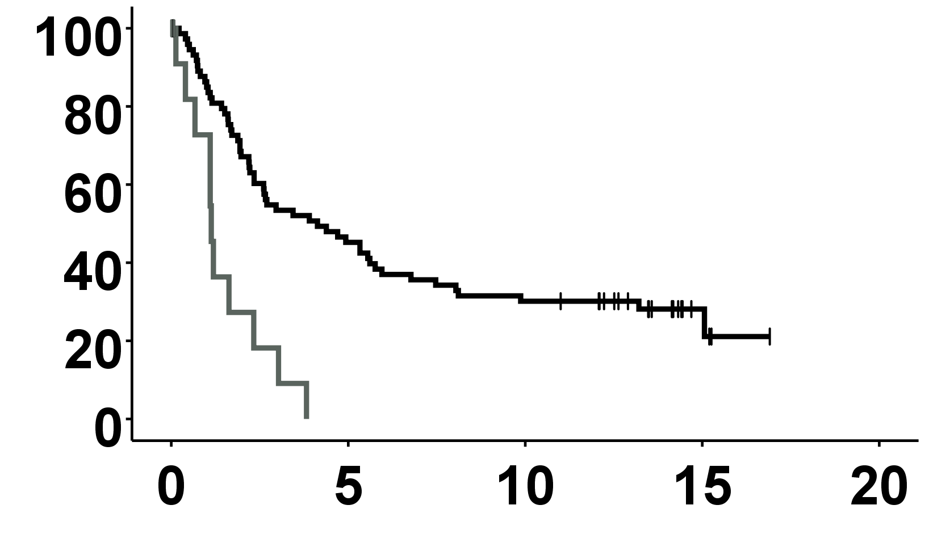
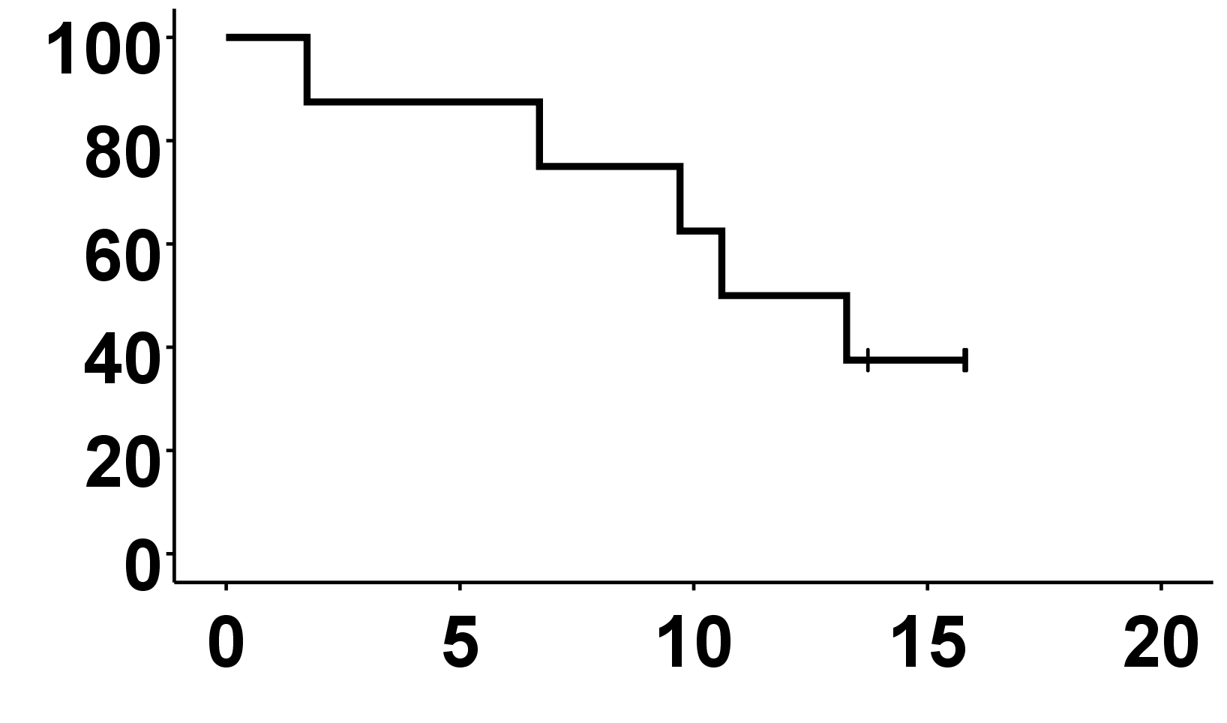
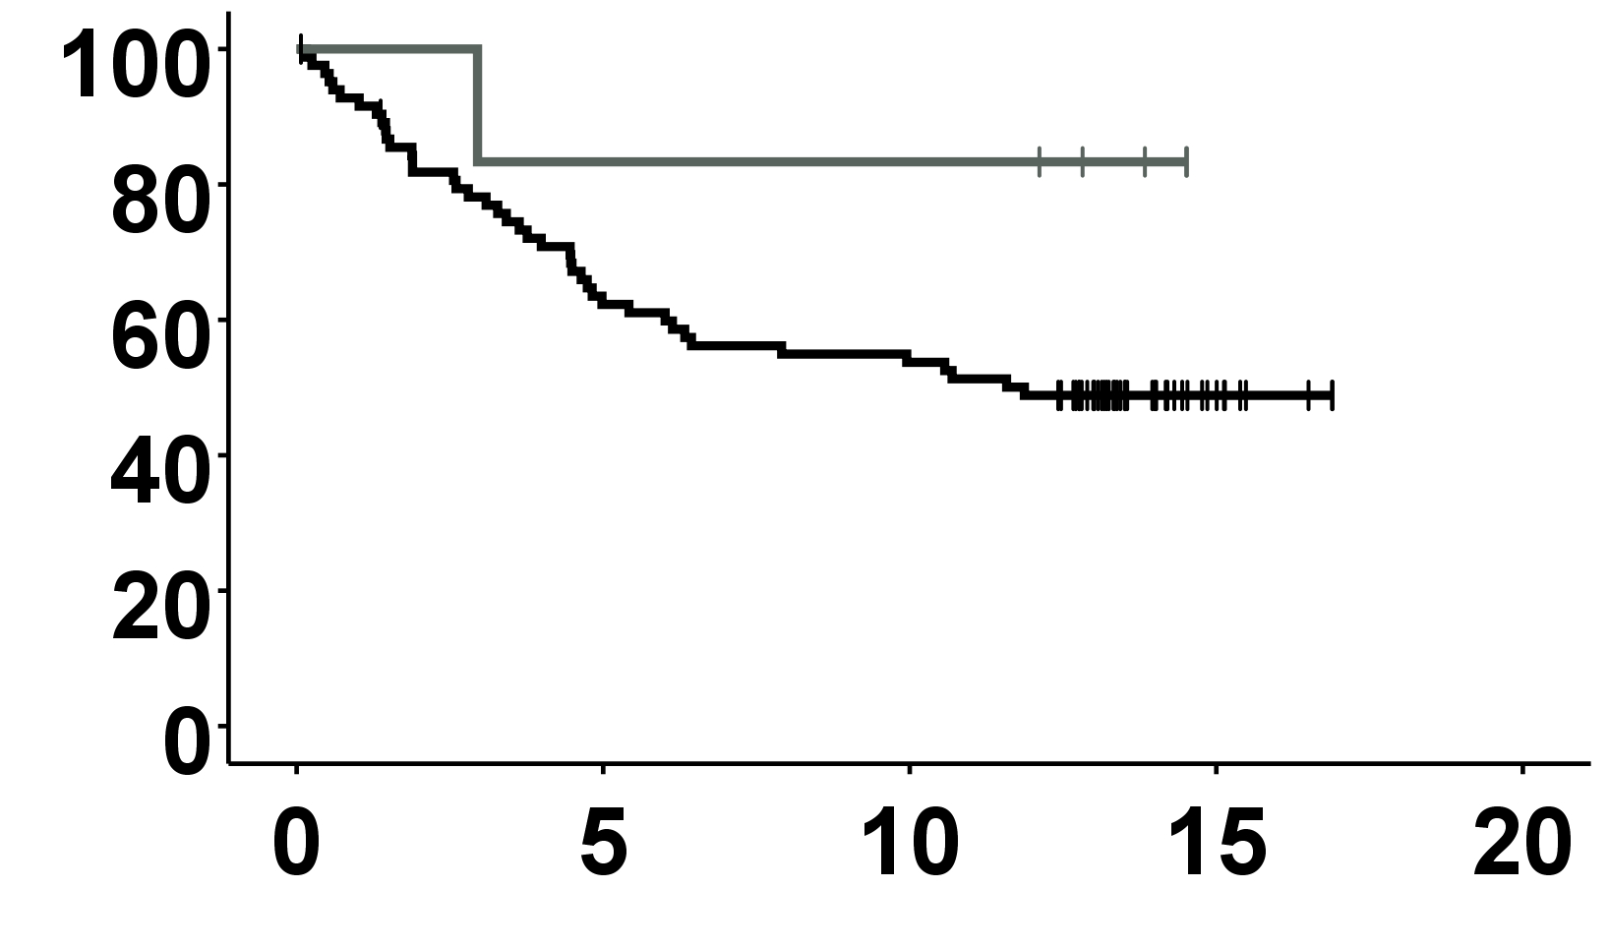
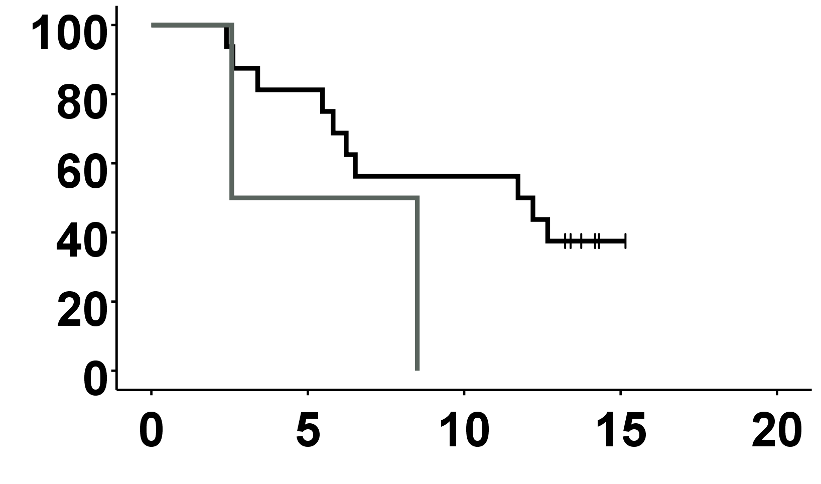
pMMR, FOXP3+ ≤ 42 (cells/mm2)
dMMR, FOXP3+ ≤ 42 (cells/mm2)
CRP < 50 (mg/l), N=80
CRP ≥ 50 (mg/l), N=13
Cumulative OS (%)
Cumulative OS (%)
CRP < 50 (mg/ml), N=8
CRP ≥ 50 (mg/l), N=0
P<0.001
Survival time (Years)
Survival time (Years)
pMMR, FOXP3+ > 42 (cells/mm2)
dMMR, FOXP3+ > 42 (cells/mm2)
CRP < 50 (mg/l), N=16
CRP ≥ 50 (mg/l), N=2
Cumulative OS (%)
Cumulative OS (%)
p=0.156
CRP < 50 (mg/l), N=84
CRP ≥ 50 (mg/l), N=6
p=0.148
Survival time (Years)
Survival time (Years)

