Slide 1
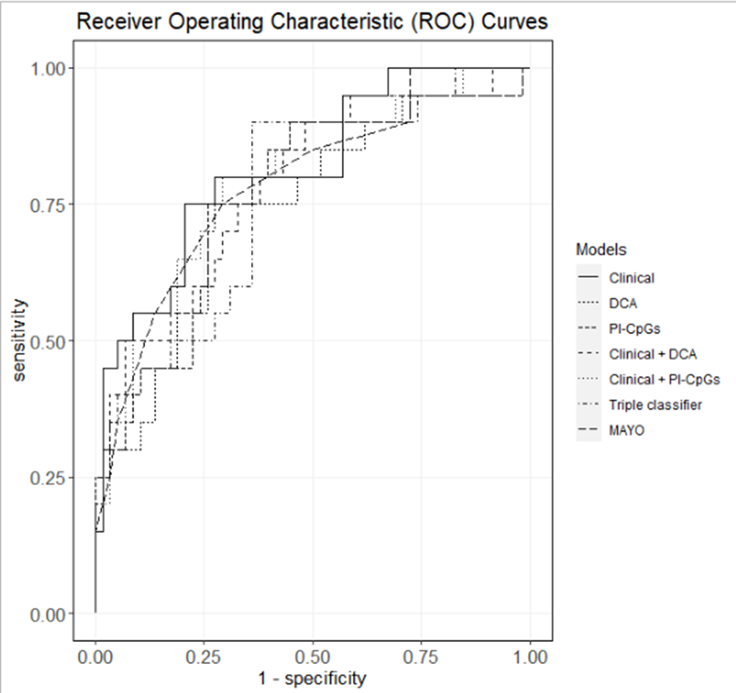
Additional Figure S1
 | AUC
Clinical | 0.816
DCA | 0.743
PI-CpGs | 0.766
Clinical+DCA | 0.783
Clinical + PI-CpGs | 0.798
Triple classifier | 0.765
MAYO | 0.789

