Slide 1
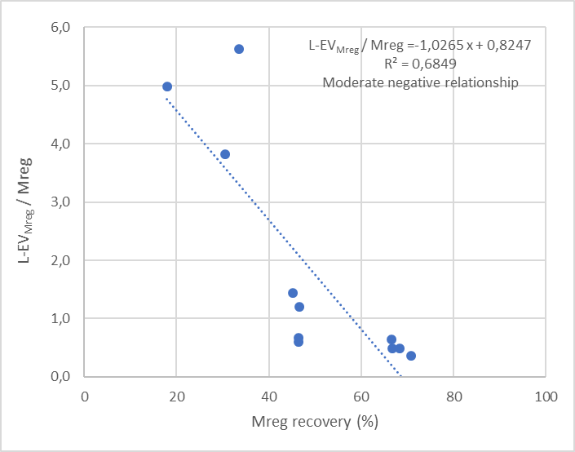
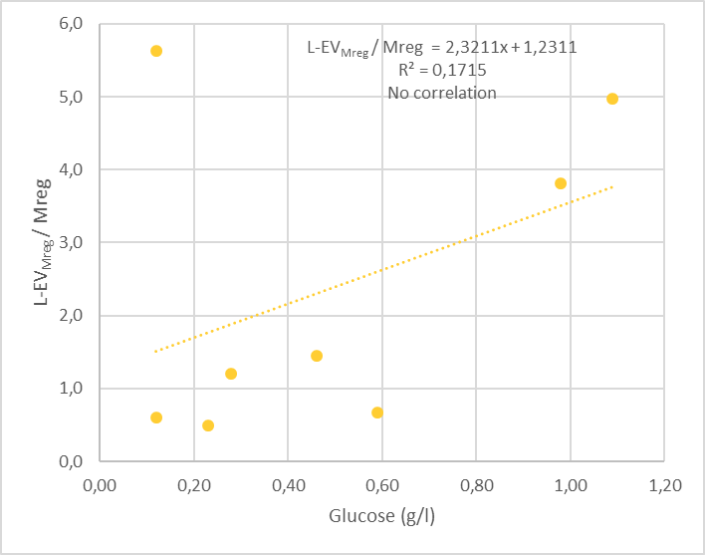
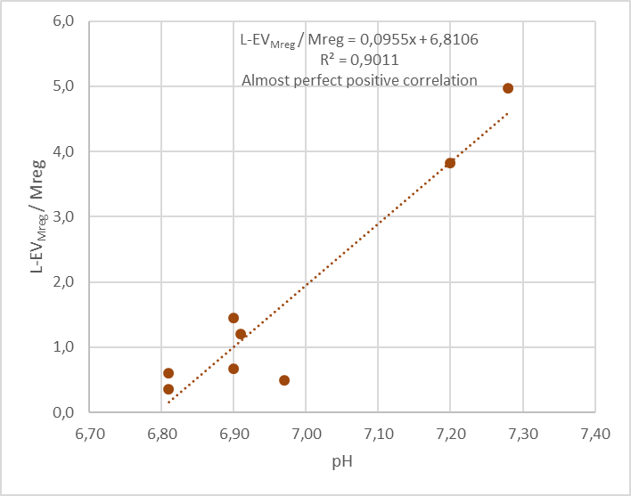
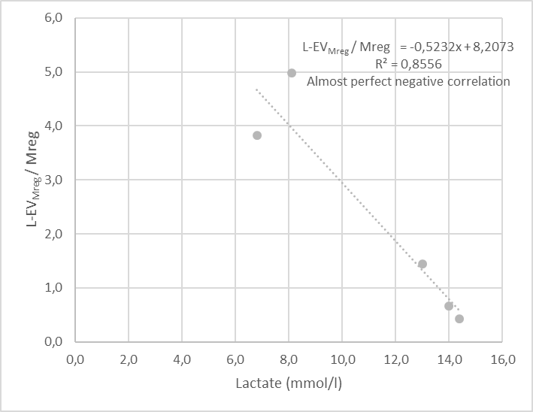
A
B
C
D
Supplemental Figure S1: Correlation of L-EV_{Mreg}/Mreg ratios with cell culture media characteristics at harvest. A. Mreg recovery. B. Glucose concentration. C. pH. D. Lactate concentration.

