Slide 1
Supplemental Material S1

Slide 2
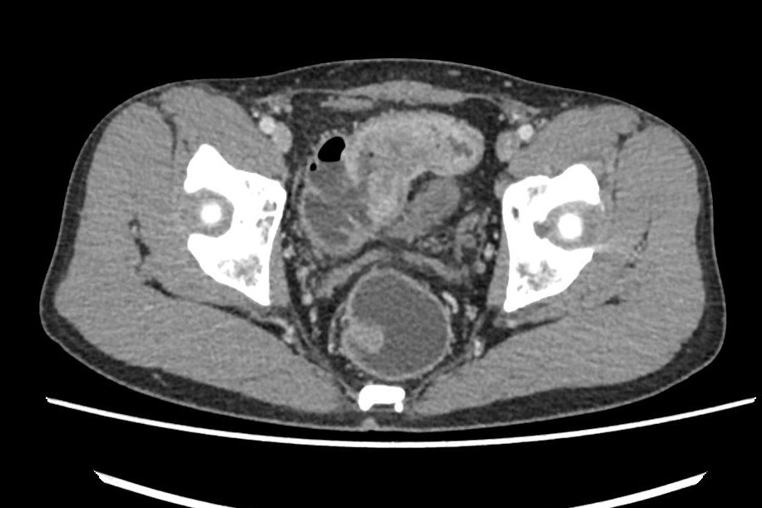
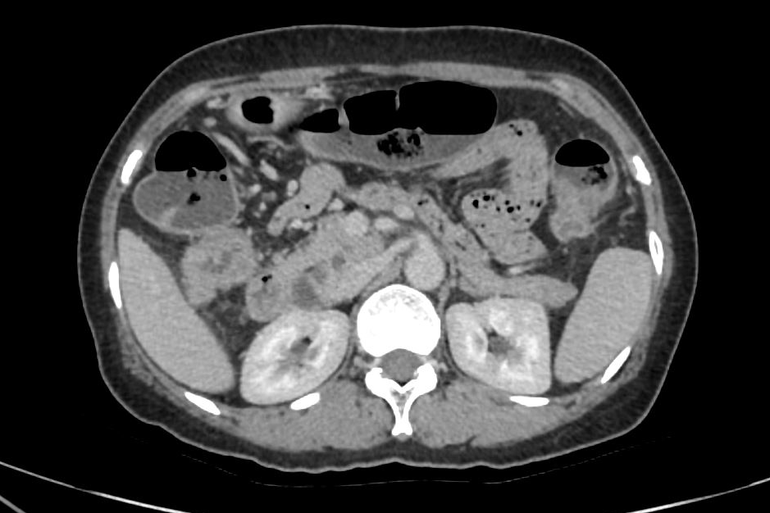
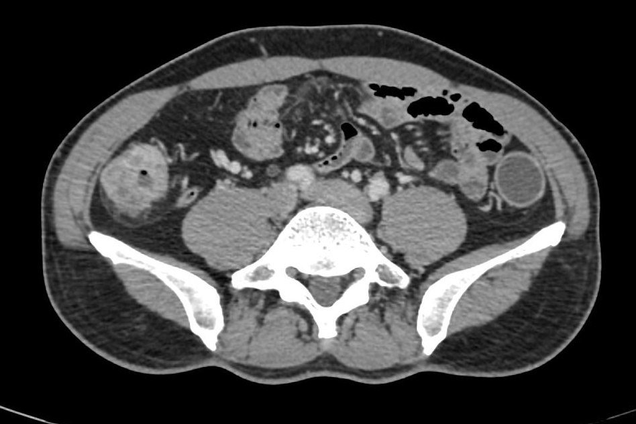
a
b
c
Cases of CT images of dMMR colorectal cancer. a. A 36-year-old male with sigmoid colon cancer. b. A 57-year-old female with carcinoma of flexura coli dextra. c. A 48-year-old male with ascending colon cancer.

Slide 3
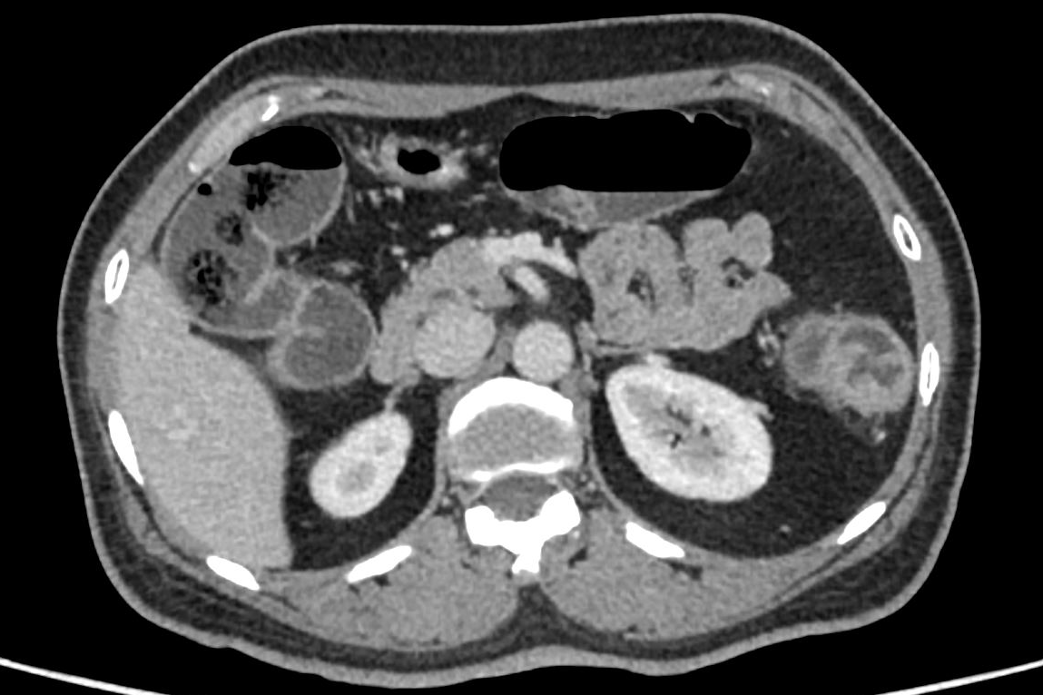
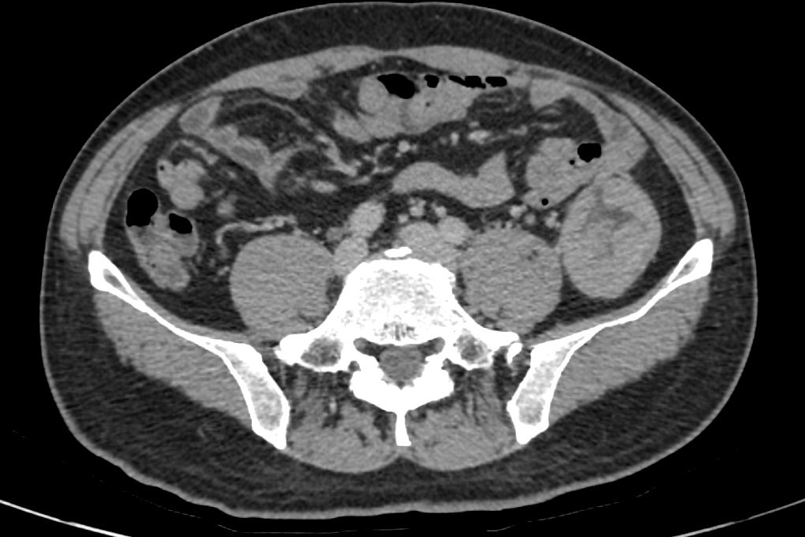
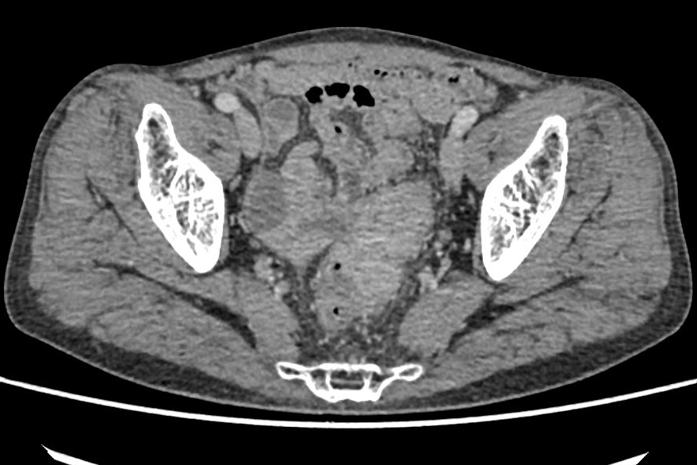
a
b
c
Cases of CT images of pMMR colorectal cancer. a. A 53-year-old female with descending colon cancer. b. A 48-year-old male with descending colon cancer. c. A 64-year-old male with sigmoid colon cancer.

Slide 4
MLH1
MSH2
MSH6
PMS2
Case of immunohistochemistry images of dMMR colorectal cancer. A 30-year-old woman with transverse colon cancer, lacking expression of MSH2 andMSH6 but retaining expression of MLH1 and PMS2, was diagnosed as dMMR (original magnification: 100×).

Slide 5
MLH1
MSH2
MSH6
PMS2
Case of immunohistochemistry images of pMMR colorectal cancer. An 83-year-old man with sigmoid carcinoma, with all four DNA MMR proteins (MLH-1, MSH-2, MSH-6 and PMS-2) expression, was diagnosed as pMMR (original magnification: 100×).

