Slide 1
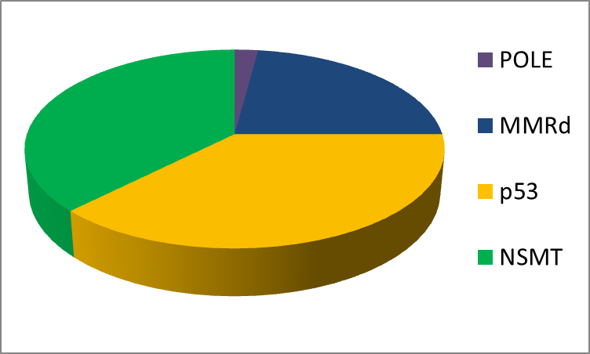
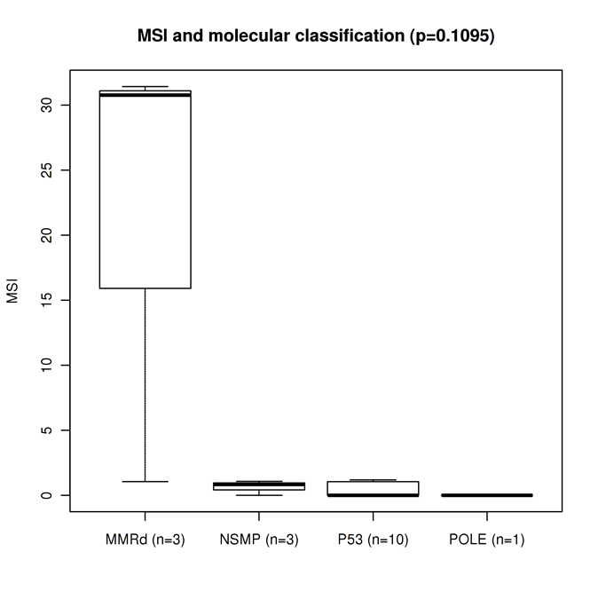
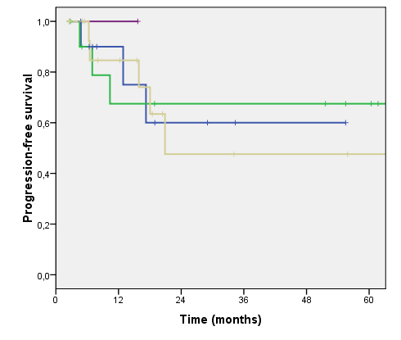
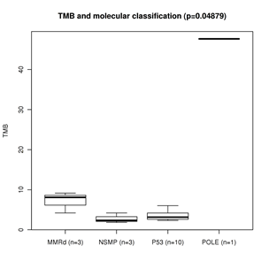
A.
B.
p=0.072
POLEmut
HRD
HRD
MMRd
P53mut
MMRd
(N=11)
NSMP
(N=17)
P53mut
(N=18)
POLEmut
(N=1)
MMRd
(N=3)
NSMP
(N=17)
P53mut
(N=18)
POLEmut
(N=1)
NSMP
C.
p=0.107
E.
MSI
p=0.97, log-rank test
MMRd
(N=3)
NSMP
(N=3)
P53mut
(N=10)
POLEmut
(N=1)
D.
2y-PFS
NSMP=68%
MMRd=60%
P53=48%
p=0.048
TMB
MMRd
(N=3)
NSMP
(N=3)
P53mut
(N=10)
POLEmut
(N=1)
Notes:
Sup Figure 4. ProMisE classification according to TMA and NGS (when available) data. (A) Distribution of molecular subtypes in our set. (B) HRD (homologous recombination score according to molecular subtypes. (C) Kaplan Meier curves for progression-free survival. MMRd: mismatch repair deficient; NSMP: non-specific molecular profile

