Slide 1
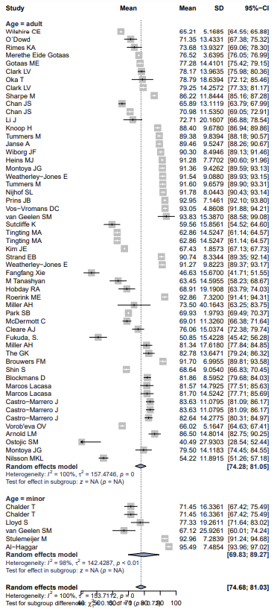
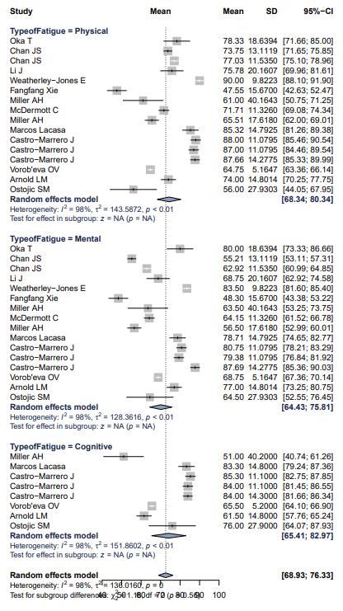
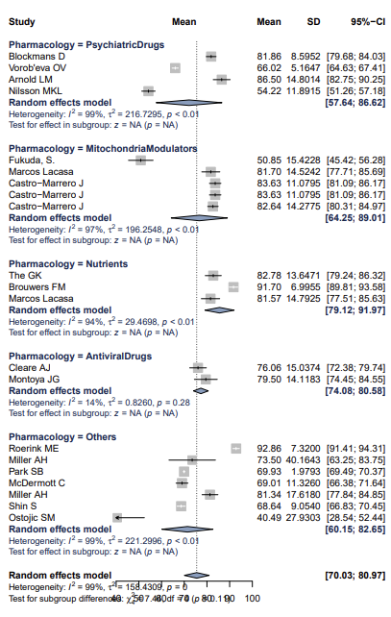
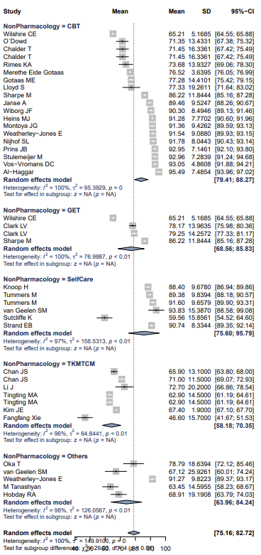
Figure S3. Forest plots
A. Studies by age
B. Studies by fatigue domain
C. Studies by pharmacological intervention
D. Studies by non-pharmacological intervention

