Slide 1
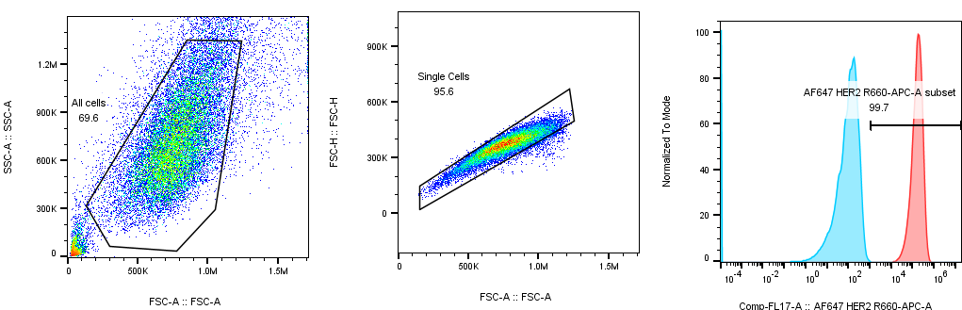
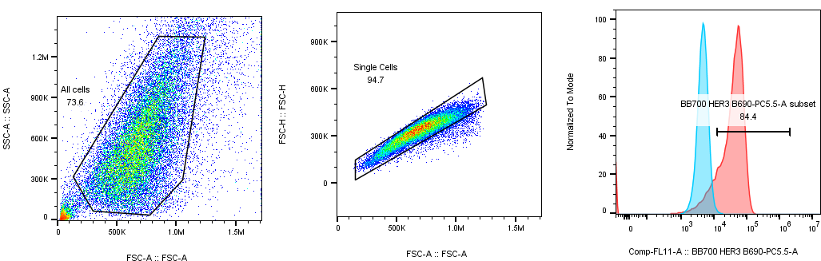
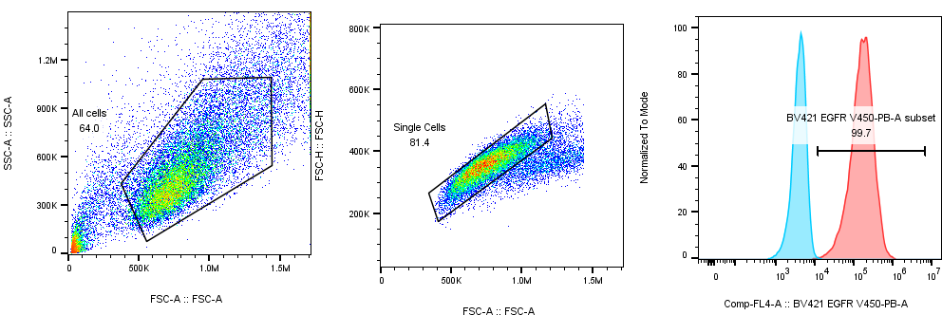
Gating strategy
Negative
Positive
AF647-HER2
Negative
Positive
BB700-HER3
Negative
Positive
BV421-EGFR

