Slide 1
Figure S1.The correlation analysis between the grade of ICANS and CRS.
The Spearman correlation analysis was used for statistical analysis. Grades of ICANS and CRS given on x-axis and y-axis labels, respectively.

Slide 2
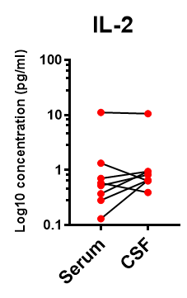
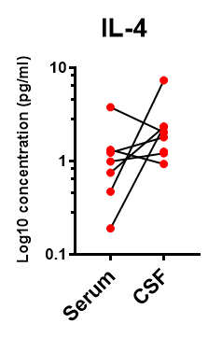
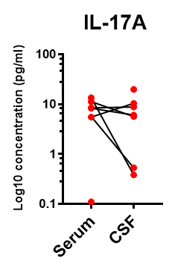
Figure S2. Cytokines in the peripheral blood and CSF.
Cytokine analysis showing the peak levels of IL-2, IL-4, and IL-17A in the serum and CSF of 6 evaluable patients at the time of ICANS.

