Slide 1
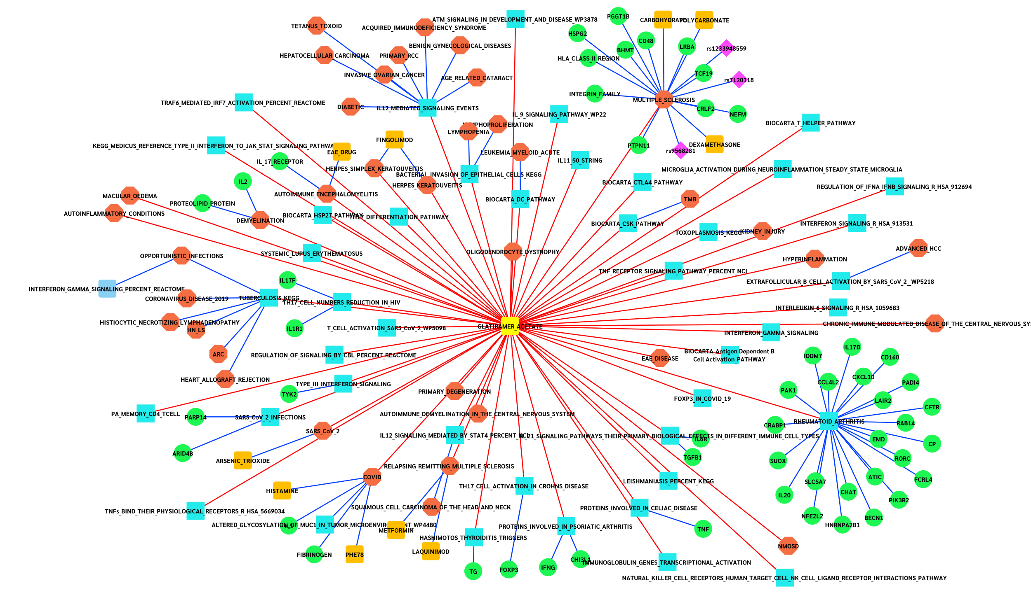
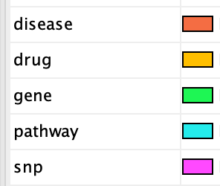

Node Colour
Interaction Colour
Figure S1. Copaxone Knowledge Network (Pathways & Disease)
Notes:
The image is a SVG so scales, the excel file for this is “copa_pathway_disease_v1_2.5_network.xlsx”

