Slide 1
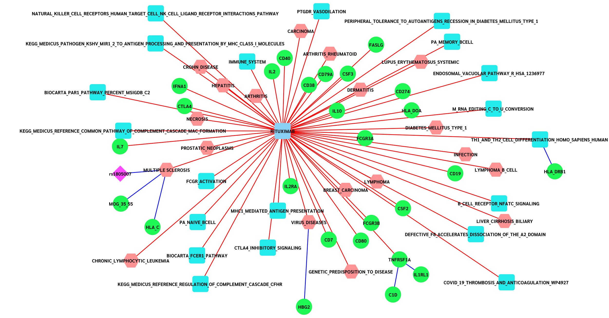
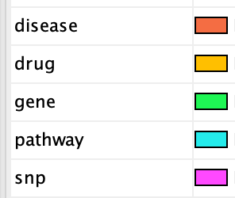

Node Colour
Interaction Colour
Figure S2. Rituximab Knowledge Network (Pathways & Disease)
Notes:
The image is a SVG so scales, the excel file for this is “rituximab_network_big_small_cyto.xlsx”. The 1st tab is the larger network and the 2nd tab is the smaller one shown above

