Slide 1
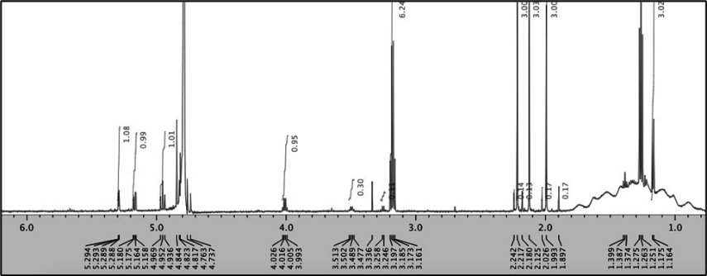
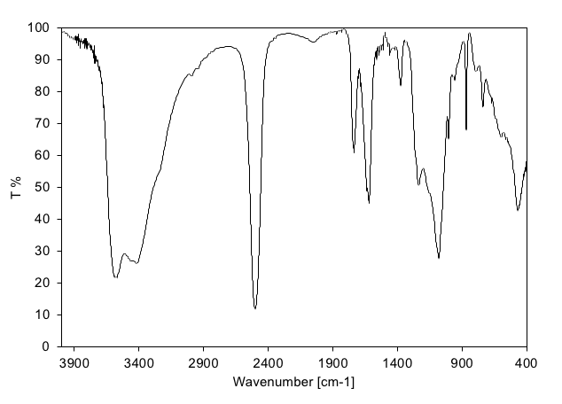
Supplementary Figure S2.
A
B
Supplementary Figure S2. Structural characterization of the fucose-conjugated boron compound (fucose-BSH).
(A) Proton nuclear magnetic resonance (^1H NMR) spectrum of (fucose triacetate)-¹⁰BSH conjugate 2 in D₂O.
(B) Infrared (IR) spectrum of (fucose triacetate)-¹⁰BSH conjugate 2
Notes:
マススペクトリミー依頼

