Slide 1
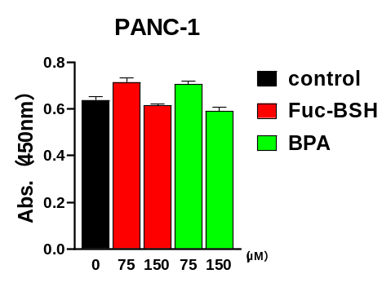
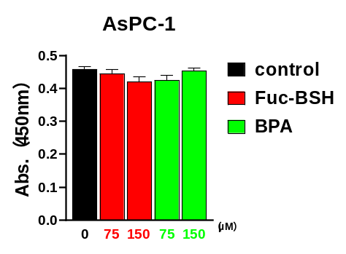
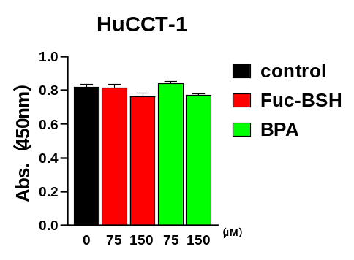

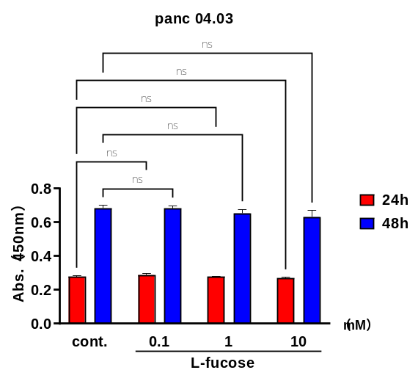
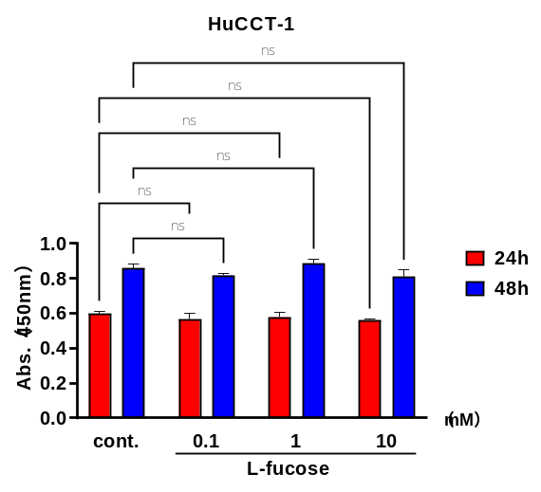

Supplementary Figure S3.
A
B
Supplementary Figure S3. Cytotoxicity assessment of fucose-BSH and L-fucose in CA19-9–positive and –negative cancer cell lines.
(A) Cell viability of CA19-9–negative PANC-1, CA19-9–positive AsPC-1 (pancreatic cancer), and HuCCT-1 (cholangiocarcinoma) cells after treatment with fucose-BSH (0–150 µM) for 48 h. Data represent mean ± SEM (n = 4 per group).
(B) Cell viability of CA19-9–positive Panc 04.03 and HuCCT-1 cells after treatment with L-fucose (0–10 mM) for 48 h. Data represent mean ± SEM (n = 4 per group).

